Slide 2
Foundation Module_1 Acute Inflammation Vascular Event
Dr. kiran Fatima Dr.Fatima-tuz-Zahra
MBBS, M.Phil. (Chem), FCPS(Chem), CHPE
Pathology Department, RMU
Assistant Professor Pathology

Slide 4
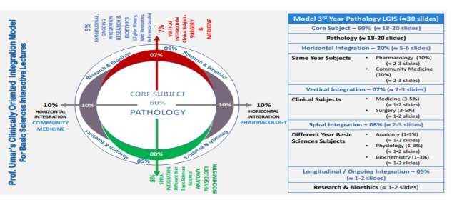

Slide 5
Learning Objectives
At The End Of The Lecture Student should be able to:
Define Inflammation And Enlist Its Types.
Enumerate The Causes And Cardinal Signs Of Inflammation.
Differentiate Between Acute And Chronic Inflammation.
Enumerate The Vascular Events Of Inflammation And Describe The Underlying Pathological Mechanisms.

Slide 6
Introduction
CORE SUBJECT
Inflammation is defined as the local response of living mammalian tissue to injury due to any agent.
Body defense reaction-eliminate or limit the spread of injurious agent.

Slide 7
Cause Of Inflammation
CORE SUBJECT
Infective agents like bacteria virus and their toxins, fungi, parasites.
Immunological agents like cell-mediated and antigen antibody reactions.
Physical agents like heat, cold, radiation, mechanical trauma.
Chemical agents like organic and inorganic poisons.
Inert materials such as foreign bodies.

Slide 8
CORE SUBJECT

Slide 9
CORE SUBJECT
Cardinal Clinical Signs Of Acute Inflammation

Slide 10
Types Of Inflammation
CORE SUBJECT
Vertical Integration
Mainly of 2 types i.e. acute and chronic
Acute Inflammation
-short duration
- represents early body reaction- followed by healing
Chronic inflammation
- longer duration
- causative agents of acute inflammation persists for a long
time
Another variant, Chronic Active Inflammation:
stimulus is such that it induces chronic inflammation from
the beginning

Slide 11
Introduction Of Inflammation
CORE SUBJECT
Vertical Integration

Slide 12
Vertical Integration
CORE SUBJECT
Acute Inflammation
The main feature of acute inflammation are:
Accumulation of fluid and plasma at the affected site;
Intravascular activation of platelets:
Polymorphonuclear neutrophils as inflammatory cell.

Slide 13
Vertical Integration
CORE SUBJECT
Acute Inflammation
Divided into following two events
-Vascular events
-Cellular events
These 2 event are followed intermittently by release of mediators of acute inflammation.

Slide 14
Vertical Integration
CORE SUBJECT
Vascular Events
Alteration in the microvasculature
This is again divide in 2 phases
-hemodynamic changes
-Changes in the vascular permeability

Slide 15
Vertical Integration
CORE SUBJECT
Hemodynamic Changes
Transient Vasoconstriction:
Immediate vascular response irrespective of type of injury,
mainly arterioles.
- Mild injury – 3-5 seconds
- Severe injury – 5 minutes
Persistent Progressive Vasodilation:
mainly arterioles, other to a lesser extent.
-obvious within half an hour of the injury
- increased blood volume in microvascular bed of the area
- redness and warmth

Slide 16
Vertical Integration
CORE SUBJECT
Hemodynamic Changes
3. Progressive Vasodilation :
elevate the local hydrostatic pressure
- transudation of fluid into the
extracellular space
- swelling
4. Slowing and Stasis:
-increased concentration of red blood
cells and thus raised blood viscosity

Slide 17
Vertical Integration
CORE SUBJECT
Hemodynamic Changes
5. Leucocytic Migration:
Peripheral orientation of leucocytes along the vascular
endothelium
- stick to the vascular endothelium briefly
extracellular space
- move and migrate through the gaps between the
endothelial cells- extravascular space
-this is known as emigration

Slide 18
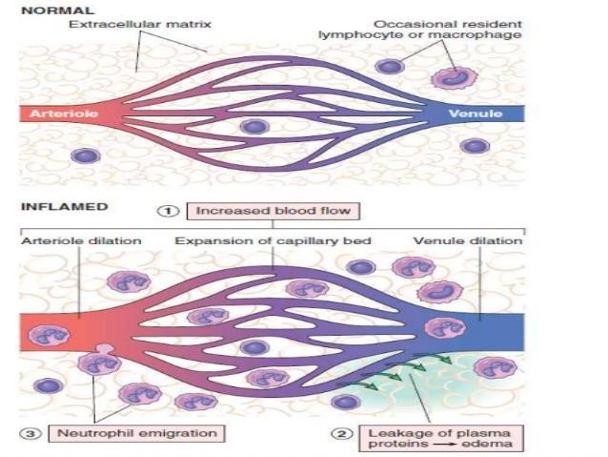
Vertical Integration
Vascular Events

Slide 19
CORE SUBJECT
Altered Vascular Permeability
Accumulation of oedema fluid-interstitial compartment which comes from blood plasma by its escape through the endothelial wall of peripheral vascular bed.
Escape of fluid due to vasodilation and consequent elevation in hydrostatic pressure-transudate.
subsequently, the characteristic inflammatory oedema, appears by increased vascular permeability of microcirculation-exudate.

Slide 20
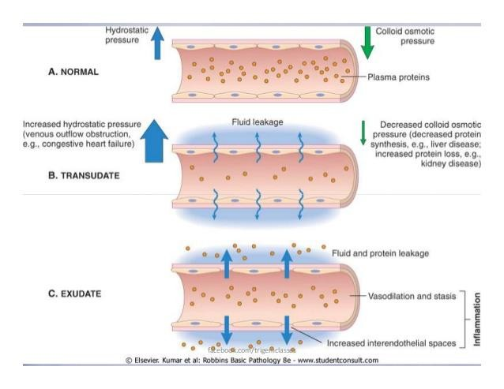

Slide 21
CORE SUBJECT
Transudate Vs Exudate

Slide 22
CORE SUBJECT
Mechanisms Of Increased Vascular Permeability
Contraction of endothelial cells.
Retraction of endothelial cells
Direct injury to endothelial cells.
Endothelial injury mediated by leucocytes.
Leakiness and neo-vascularization.

Slide 23
CORE SUBJECT
Contraction Of Endothelial Cells
Affects venules exclusively.
Endothelial cells develop temporary gaps.
Contraction resulting in vascular leakiness.
Mediated by release of histamine, bradykinin and other chemical mediators.
Short duration-immediatly after injury.

Slide 24
CORE SUBJECT
Increased Vascular Permeability

Slide 25
CORE SUBJECT
Vertical Integration
Retraction Of Endothelial Cells
Structural re-organisation of the cytoskeleton of endothelial cells - Reversible retraction at the intercellular junctions.
Mediated by cytokines such as interleukin-1 (IL-1) and tumour necrosis factor (TNF)-α.

Slide 26
CORE SUBJECT
Vertical Integration
Direct Injury To Endothelial Cells
Causes cell necrosis and appearance of physical gaps.
Process of thrombosis is initiated at the site of damaged endothelial cells.
Affects all levels of microvasculature.
Either appear immediately after injury and last for several hours or days – severe bacterial infections.
Or delay of 2-12 hours and last for hours or days - moderate thermal injury and radiation injury.

Slide 27
CORE SUBJECT
Vertical Integration
Increased Vascular Permeability

Slide 28
CORE SUBJECT
Endothelial Injury Mediated By Leucocytes
Adherence of leucocytes to the endothelium at the site of inflammation.
Activation of leucocytes - release proteolytic enzymes and toxic oxygen.
Cause endothelial injury and increased vascular leakiness.
Affects mostly venules and is a late response.

Slide 29
CORE SUBJECT
Vertical Integration
Increased Vascular Permeability

Slide 30
Vertical Integration
CORE SUBJECT
Leakiness And Neovascularization
Newly formed capillaries under the influence of vascular endothelial growth factor.
Process of repair and in tumors are excessively leaky.

Slide 31
Vascular Event
CORE SUBJECT

Slide 32
Summary
Inflammation is a defensive host response to foreign invaders and necrotic tissue, but it is itself capable of causing tissue damage
The main components of inflammation are a
Vascular reaction
Cellular response
Both components are activated by mediators derived from plasma
proteins and various cells

Slide 33
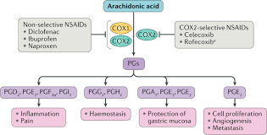
Horizontal Integration
Vertical Integration
Anti-inflammatory drugs targeting vascular responses (NSAIDs, steroids).

Slide 34
End Of Lesson Assessment
A patient comes to the Dermatology OPD with complains of sunburn. His back is very red, warm, and painful to touch. What is the most likely cause of this erythema?
A. Ischemia
B. Edema of the dermis
C. Vasodilation of blood vessels in dermis
D. Infiltration of neutrophils
E. Bradykinin

Slide 35
End Of Lesson Assessment
Approximately 30-60 minutes after being bitten by a ”bug", a 26-year-old man noticed a localized swelling and erythema in the affected area.The edema is most likely the result of:
A.Altered plasma oncotic pressure
B. Increased arterial hydrostatic pressure
C. Increased vascular permeability
D. Lymphatic obstruction
E.Venous obstruction

Slide 36
Research

Slide 37
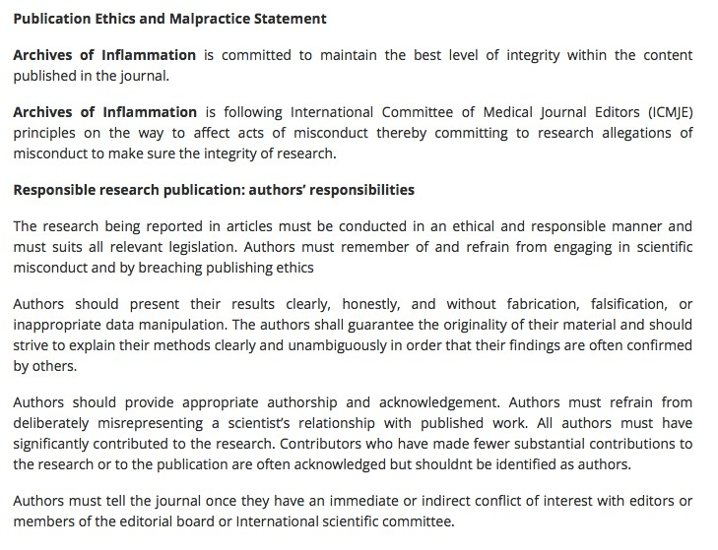
Ethics

