Slide 2
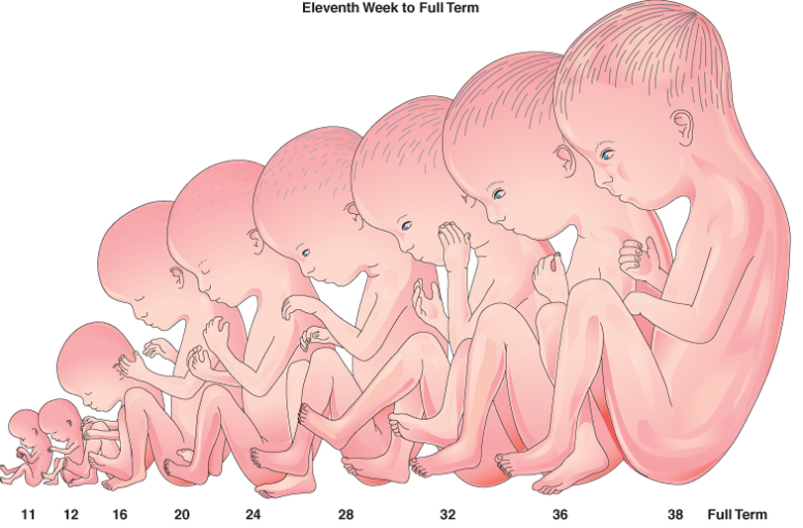
Foundation Module 1st Year MBBS(LGIS) Introduction to Human Development
Presented by:
Prof. Dr. Ayesha Yousaf
Date:17-02-2023
Updated on 24.01.2025

Slide 3
Motto, Vision; The Dream/Tomorrow
Wisdom
Truth
Service
To impart evidence based, research oriented medical education
To provide best possible patient care
To inculcate the values of mutual respect and ethical practice of medicine

Slide 4
Professor Umar Model of Integrated Lecture

Slide 5
Learning Objectives
At the end of the lecture, students will be able to
1.Discuss significance and importance of studying embryology
2. Define different terminologies to describe developmental stages
3. Describe series of critical events that take place during embryonic development
4. Compare the difference between embryonic and fetal period
5. Categorize common chromosomal abnormalities

Slide 6
Quran: Surah Az-zumar, 39:Ayah 6)
“He makes you in the wombs of your mothers in stages, one after another, in three veils of darkness..”

Slide 7
Interactive Session
A 2-year-old male is brought to the clinic by his parents for developmental concerns.
On examination, the child exhibits a flattened facial profile, almond-shaped eyes, and a single transverse palmar crease.
Developmental milestones are delayed.

Slide 8
ANATOMY
Core Knowledge
The branch of science concerned with the bodily structure of humans, animals, and other living organisms, especially as revealed by dissection and the separation of parts.

Slide 9
Embryology/Developmental Anatomy
Core Knowledge
The study of human growth and development.
It includes the study of both the prenatal and the postnatal developmental changes in an individual.
From a single cell to a baby in 9 months is a developmental process with amazing integration.

Slide 10
Significance Of Embryology
Core Knowledge
Develops knowledge concerning the beginnings of human life.
Help to understand the causes of variations in human structure.
Illuminates gross anatomy and explains how normal and abnormal relations develop.
Resulted in new techniques for prenatal diagnosis and treatment, therapeutic procedures to circumvent problems with infertility and mechanisms to prevent birth defects

Slide 11
Life Span Of Man
Core Knowledge
Prenatal Life:
Embryo
Fetus
Post Natal Life:
Neonate
Infancy
Childhood
Puberty
Adolescence
Adult age

Slide 12
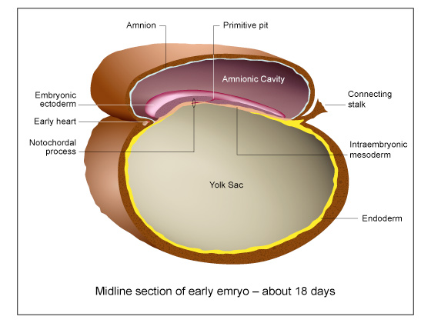
Embryo
Core Knowledge
Process of progressing from a single cell through the period of establishing organ primordia is called EMBRYOGENESIS (First eight weeks of human development).
Importance Of Embryonic Period

Slide 13
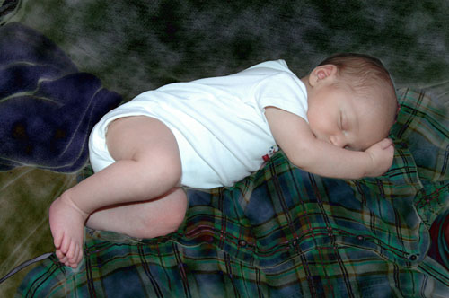
Fetus & Neonate
Core Knowledge
9th to 40th week or till birth = Fetal Period
First month after birth=Neonate

Slide 14
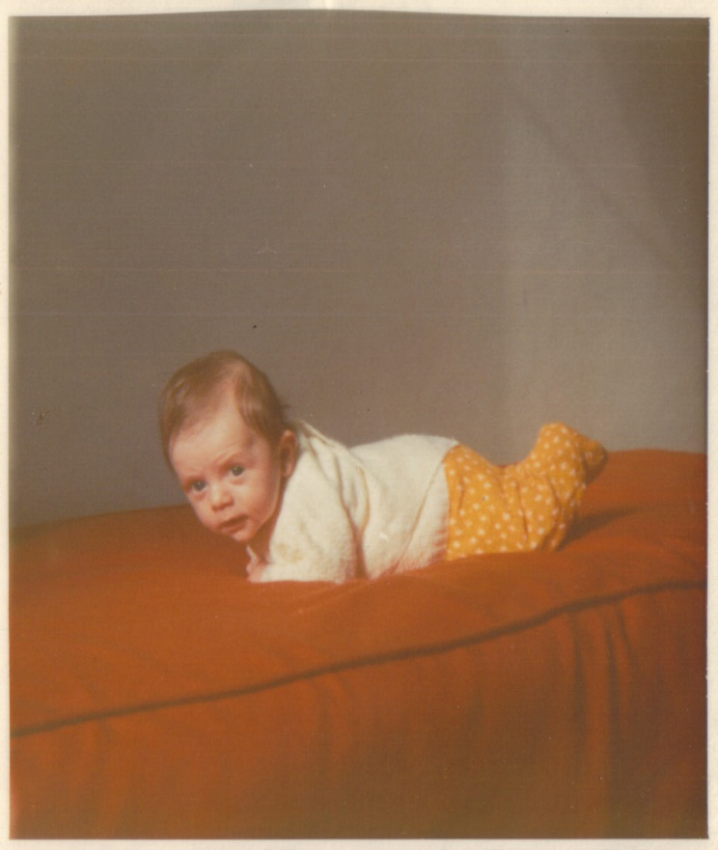
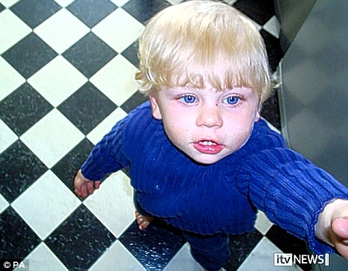
Infancy
Core Knowledge
INFANTS = 2ND MONTH TO 1ST YEAR
until

Slide 15
Childhood
Core Knowledge
This is the period between infancy and puberty
Primary deciduous teeth appear
Active ossification of bones
Rate of body growth slows down
Early childhood (2nd -6th year)
Middle childhood (7th - 10th year)
Late childhood (10th- till puberty)

Slide 16
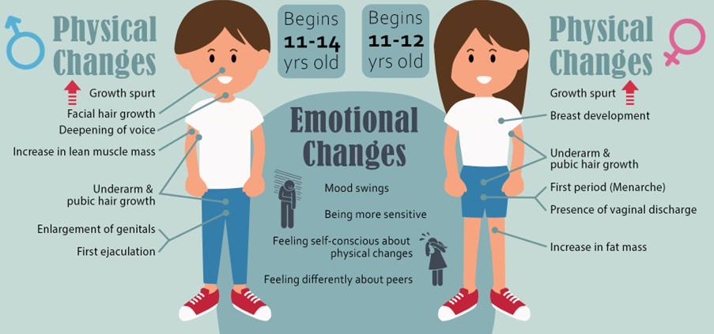
Puberty & Adolescence
Core Knowledge
Puberty is phase of sexual maturity
Adolescence-first Six Years After Puberty

Slide 17
Adult Age
Core Knowledge
Prime age= 20-60 years
Old age= 61-last day of life
EARLY ADULT AGE
20-40 YEARS
LATE ADULT AGE
41-60 YEARS

Slide 18
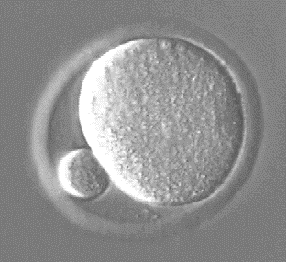
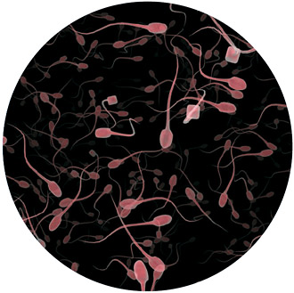
Oocyte & Sperm
Core Knowledge
The female germ or sex cells are produced in the ovaries.
The sperm, or spermatozoon, refers to the male germ cell produced in the Testes (testicles).

Slide 19
Zygote
Core Knowledge
Development begins with fertilization in which the male gamete (sperm) and the female gamete (oocyte) unite to give rise to a zygote.

Slide 20
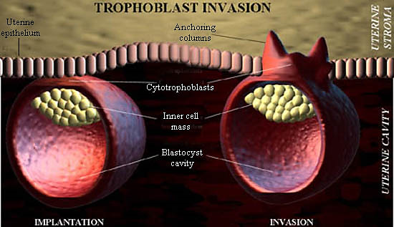
Implantation
Core Knowledge
The process during which the blastocyst attaches to the endometrium.

Slide 21
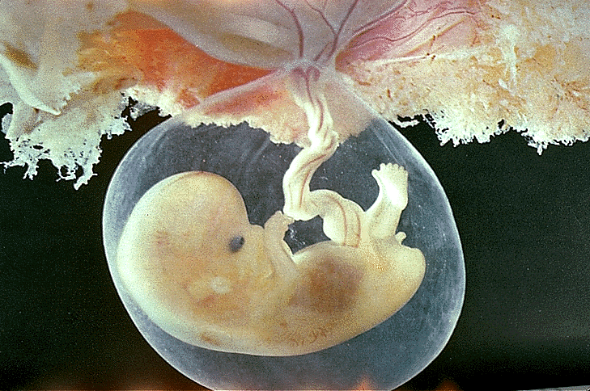
Conceptus (L. conceptio, derivatives of zygote).
Core Knowledge
The embryo and its adnexa

Slide 22
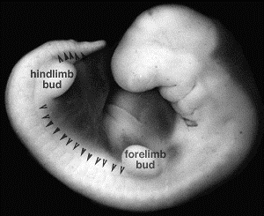
Primordium (L. primus, first + ordior, to begin)
Core Knowledge
The beginning or first indication of an organ or structure.

Slide 23
Gamete: egg or sperm
Gametogenesis: production of eggs or sperm
Oogenesis: production of eggs
Spermatogenesis: production of sperm
Spermiogenesis: differentiation of sperm morphology
Follicle: where eggs mature in the ovary
Ovulation: release of egg from follicle
Polar body: nonfunctional product of meiotic divisions in oogenesis
Zygote: Fertilized egg

Slide 24
The Chromosome Theory Of Inheritance
Horizontal Integration
Humans have 35,000 genes on 46 chromosomes
In somatic cells the chromosomes appear as 23 homologous pairs to form the diploid number of 46.
There are 22 pairs of matching autosomal chromosomes and one pair of sex chromosomes
If sex pair is XX→ Genetically Female
If Sex Pair Is XY→ Genetically Male

Slide 25
Numerical Abnormalities of chromosomes
Vertical Integration
Normal human somatic cell contain 46 chromosomes→Diploid
Normal gamete contain =23 chromosomes→Haploid or Euploid
Aneuploid refers to any number that is not euploid. It is applied when an extra chromosome is present (Trisomy) OR when one is missing (Monosomy)

Slide 26
Non-disjunction
Vertical Integration
In meiosis if separation pf homologous pair does not occur (non-disjunction) and both members move into one cell. One cell receives 24 chromosome and the other receives 22 instead of 23.
Nondisjunction occurs during mitosis in an embryonic cell during earlier cell divisions (mitotic nondisjunction), produces mosaicism.

Slide 27
Translocations
Vertical Integration
Sometimes chromosomes breaks and pieces of one chromosome attach to another
No critical genetic material is lost and individuals are normal
Balanced Translocations
Breakage and reunion occurs between the two chromosomes
Unbalanced Translocations
Part of one chromosome is lost
Altered phenotype is produced
DOWN SYNDROME (21 n 14)

Slide 28
Trisomy 21-Down Syndrome
Vertical Integration
Caused by extra copy of chromosome 21 resulting from meiotic nondisjunction and in 75% cases occurs during oocyte formation
In 4% caused by unbalanced translocation between chromosome 21 and chromosome 13,14 and 15
Incidence increases with age of mother to 1 in 100 at the age of 40

Slide 29
Clinical Features
Vertical Integration
Growth retardation
Mental retardation
Upward slanting eyes
Flat facies and small ears
Cardiac defects
High incidence of leukemia, infections and premature aging

Slide 30
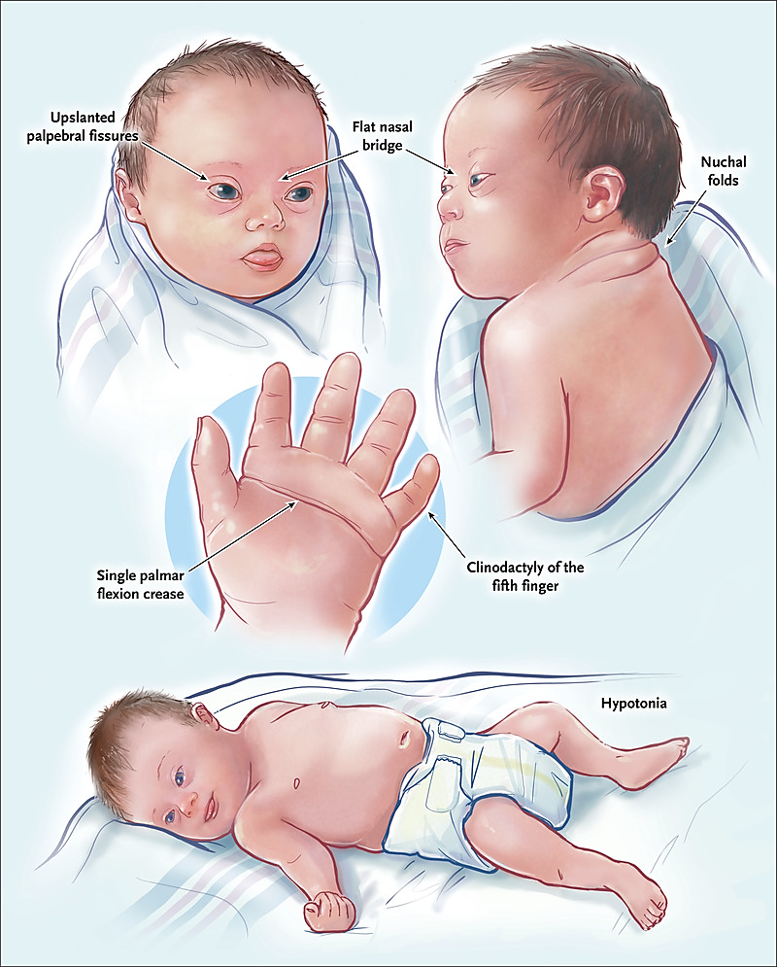
Vertical Integration
Clinical Features

Slide 31
Interactive Session
A 2-year-old male is brought to the clinic by his parents for developmental concerns.
On examination, the child exhibits a flattened facial profile, almond-shaped eyes, and a single transverse palmar crease.
Developmental milestones are delayed, raising suspicion of Down syndrome.
Genetic testing confirms Trisomy 21.

Slide 32
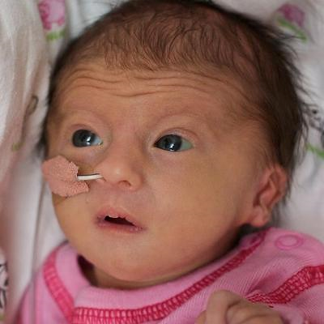
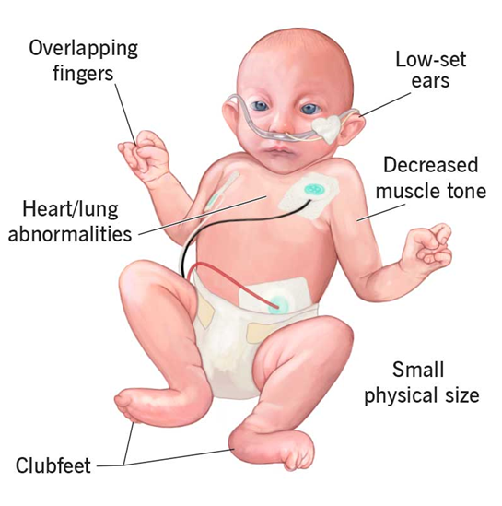
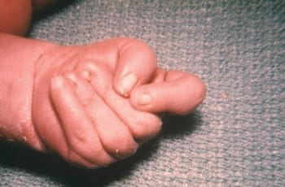
Vertical Integration
Trisomy 18-Edward’s Syndrome

Slide 33
Klinefelter Syndrome
Vertical Integration
Found in males only
Detected at puberty
Incidence = 1 in 500 births
Clinical features
Sterility
Testicular atrophy
Gynecomastia
The cells have 47 chromosomes with a sex chromosomal complement of the XXY type

Slide 34
Turner Syndrome
Vertical Integration
45X karyotype, it is the only monosomy compatible with life
Only few survive and are mostly females
Clinical Features
Absence of ovaries
Gonadal dysgenesis
Webbed neck
Edema of extremities
Broad chest

Slide 35
Structural Abnormalities
Vertical Integration
Results from chromosome breakage caused by viruses, radiations and drugs
If broken piece is lost then infant with partial deletion of a chromosome is abnormal.
Cri-du-chat-syndrome (CH-5) cat-like cry microcephaly mental retardation

Slide 36
Microdeletions
Vertical Integration
Angelman Syndrome (microdeletion occurs on chromosome 15 (Maternal)
mentally retarded
cannot speak
poor motor development
prone to unprovoked and prolonged periods of laughter

Slide 37
Fragile Sites
Vertical Integration
Are regions of chromosomes that are prone to separate or break under certain cell manipulations
FRAGILE X SYNDROME
Males are affected more
Clinical features
large ears
prominent jaw
pale blue iris
mental retardation

Slide 38
Paternal age is affected by genetic abnormalities, perinatal complications and mental health of the offspring
Spiral Integration
Research Article
While a plethora of research is available linking increasing maternal age to genetic abnormalities, this relatively rare research highlights the connection between increasing paternal age and the incidence of genetic diseases.
https://www.spandidos-publications.com/10.3892/br.2019.1266?s2=N106345832_1683417608447427969

Slide 39
Learning Resources
Langman's Medical Embryology, 14th Edition
The Developing Human: Clinically Oriented Embryology KLM Embryology
Textbook of Clinical Embryology (Kevin Coward, Dagan Wells)
Witters G, Van Robays J, Willekes C, Coumans A, Peeters H, Gyselaers W, Fryns JP. Trisomy 13, 18, 21, Triploidy and Turner syndrome: the 5T's. Look at the hands. Facts Views Vis Obgyn. 2011;3(1):15-21. PMID: 24753843; PMCID: PMC3991414
Google images

Slide 40
Let’s Recap

