Slide 2
Motto Vision; The Dream/Tomorrow
To impart evidence based research oriented medical education
To provide best possible patient care
To inculcate the values of mutual respect and ethical practice of medicine
Wisdom
Truth
Service

Slide 3
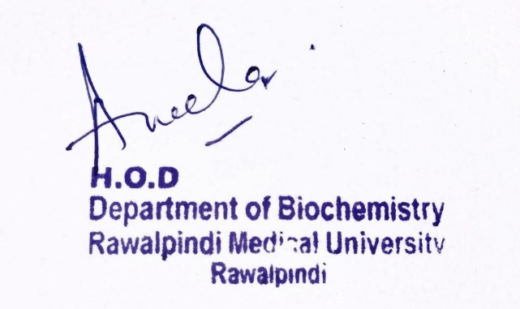
2nd Year MBBS Gastrointestinal Tract Module Digestion and Absorption Large Group Interactive Session (LGIS)
Dr.Kashif Rauf
Biochemistry department
Date:28.03.2024

Slide 4
Learning Objectives
At the end of the lecture, students will be able to
Describe the process of lipid digestion
Describe role of different enzymes involved in digestion
Explain absorption of end products of lipid digestion
Vertically integrate related disorder

Slide 5
Professor Umar Model of Integrated Lecture
60%
CORE SUBJECT
20%
HORIZONTAL
INTEGRATION
Physiology
biochemistry
8%
VERTICAL INTEGRATION
Pathology
pharmacology
7%
VERTICAL INTEGRATION
Clinical integration
5%
VERTICAL INTEGRATION
Research, professionalism
Ethics
Digital library

Slide 6
Horizontal Integration (Basic sciences subjects of same year)

Slide 7
Anatomical aspects of GIT

Slide 8
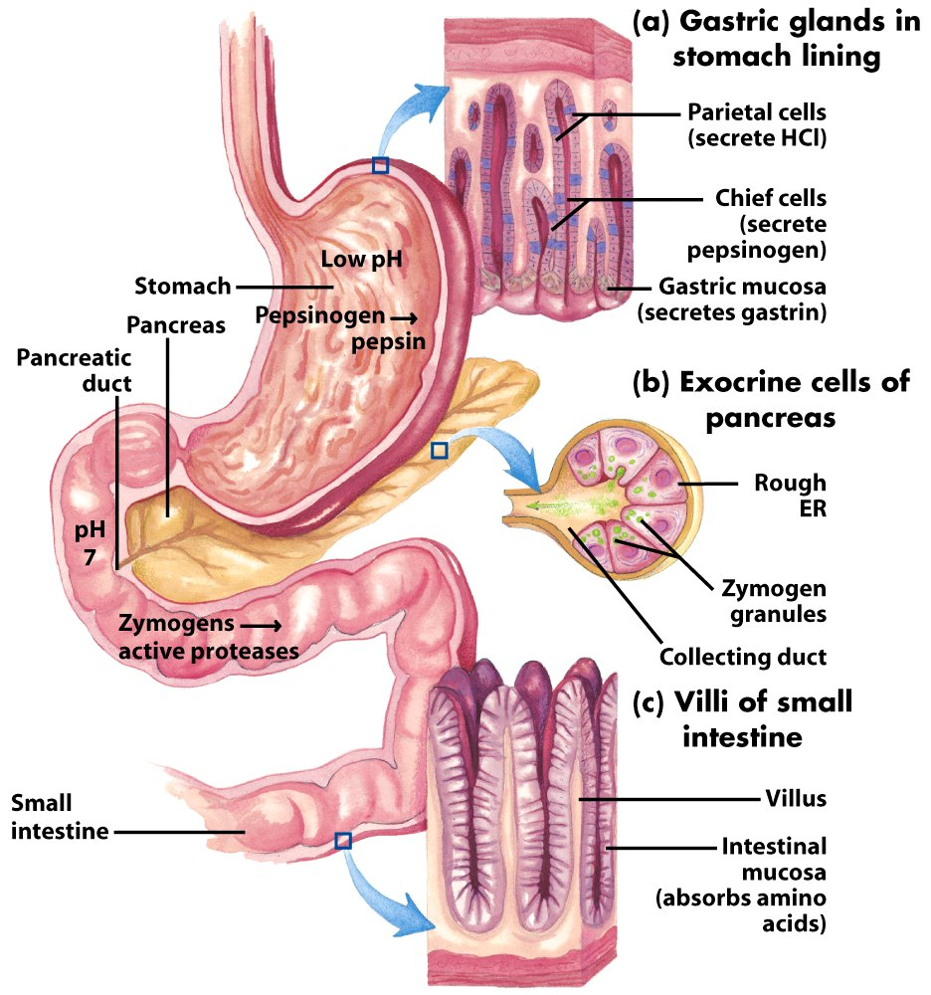
Notes:
A little review: pancreas secreters zymogens of the proteases. Major proteases in Small Intestine are trypsin, chymotrypsin, and carboxypeptidases. Both endo- and exo-proteases.

Slide 9
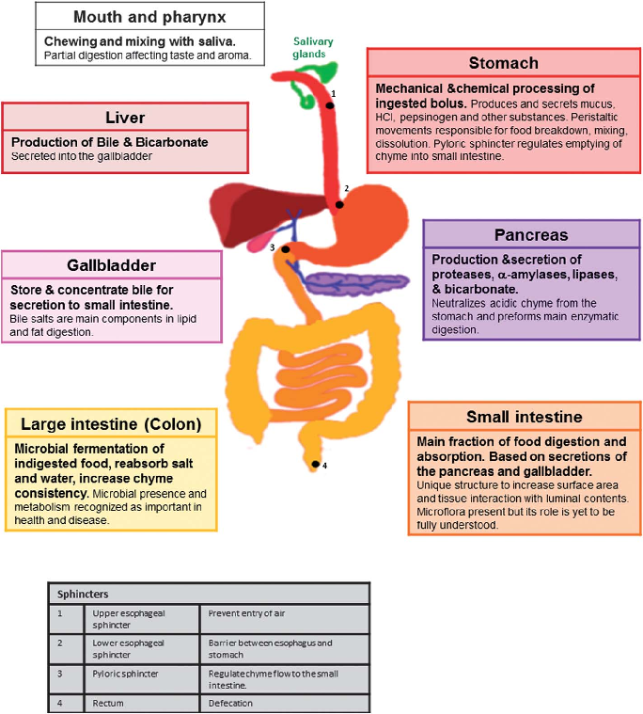
Physiological aspects of GIT

Slide 10
Core concept
Digestion and Absorption of Lipids

Slide 11
Sites of lipid digestion
Stomach (gastric & lingual lipases)
Small intestine (pancreatic enzymes)
Note: no digestion occurs in the oral cavity

Slide 12
Lipid digestion in stomach
By lingual lipase and gastric lipase
Up to 30% digestion of triglycerides occurs in stomach
Lingual lipase
Gastric lipase

Slide 13
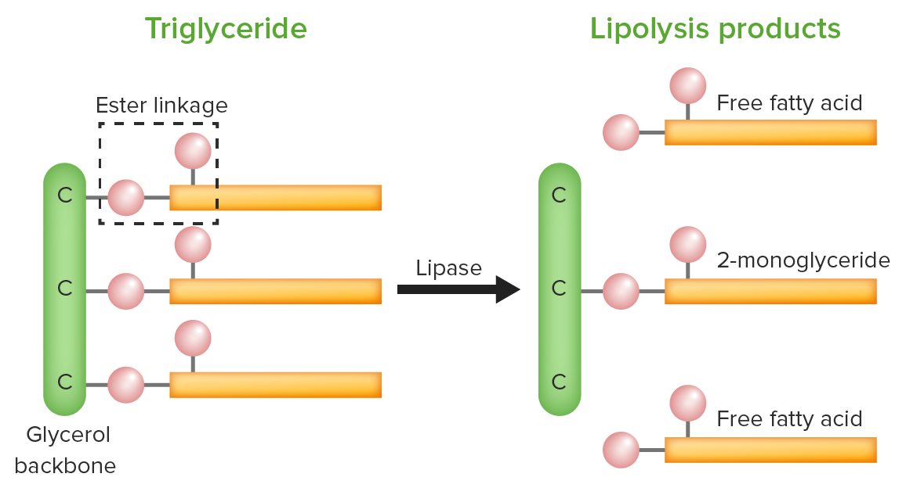

Slide 14
Emulsification of dietary lipids
Process by which lipids are dispersed into smaller droplets; surface area of hydrophobic lipid droplets is increased so that the digestive enzymes can act effectively
Accomplished by
Bile salts
Peristalsis

Slide 15
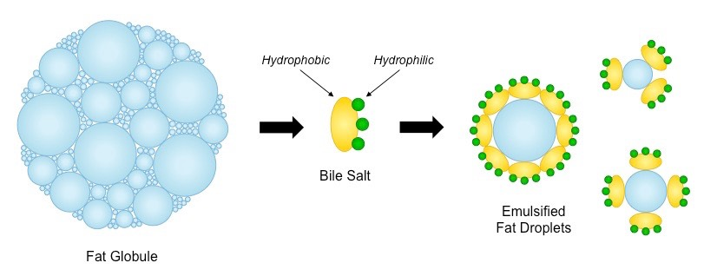

Slide 16
Lipid digestion in small intestine
TAG degradation:
pancreatic lipase & colipase enzyme
Cholesteryl ester degradation:
pancreatic cholesterol esterase
Phospholipid degradation:
pancreatic phospholipase A2

Slide 17
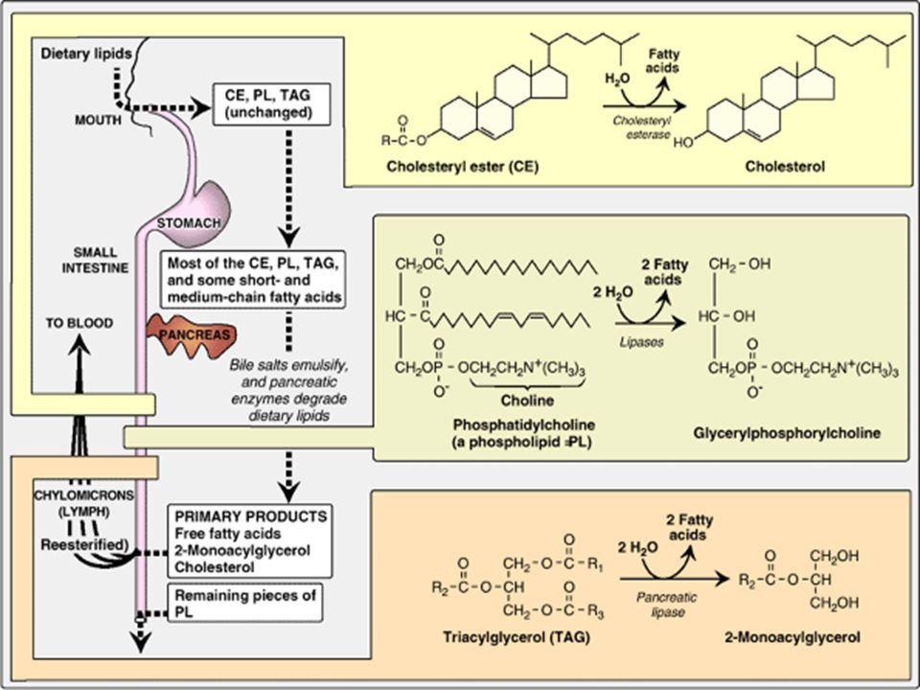

Slide 18
Absorption of long chain fatty acids
Mixed micelles formation
Resynthesis of TAG & cholesteryl esters
Secretion of chylomicrons

Slide 21
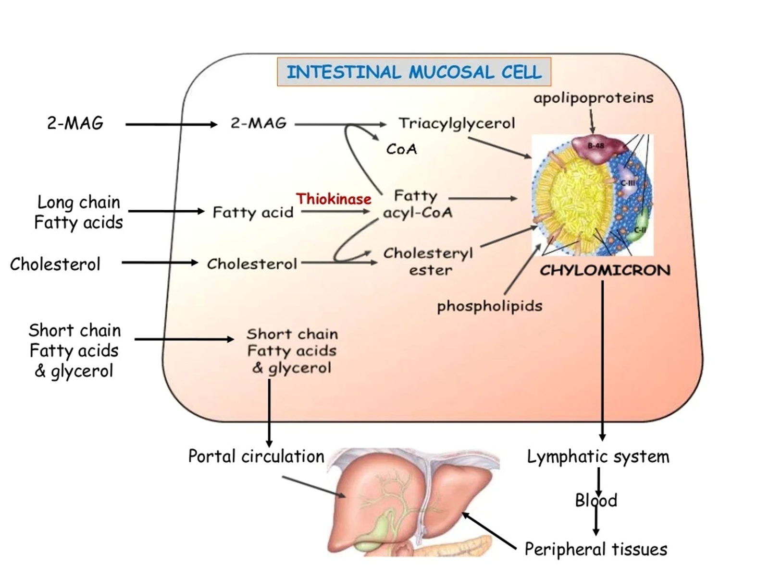

Slide 22
Absorption of short & medium chain fatty acids
do not require the assistance of mixed micelles
do not need re-esterification
can directly enter into portal vein
their absorption is rapid

Slide 23
(Basic sciences subjects of different years)
Vertical integration

Slide 24
Orlistat inhibits gastric and pancreatic lipases, thereby decreasing fat absorption, resulting in weight loss

Slide 25
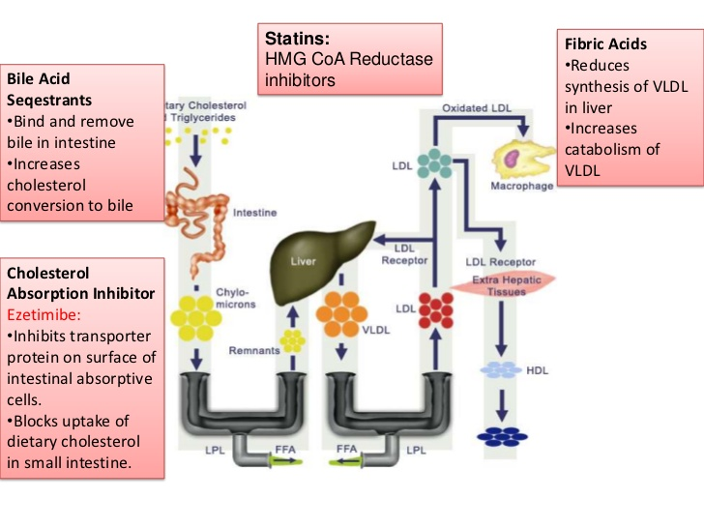

Slide 26
(Clinical sciences)
Vertical integration

Slide 27
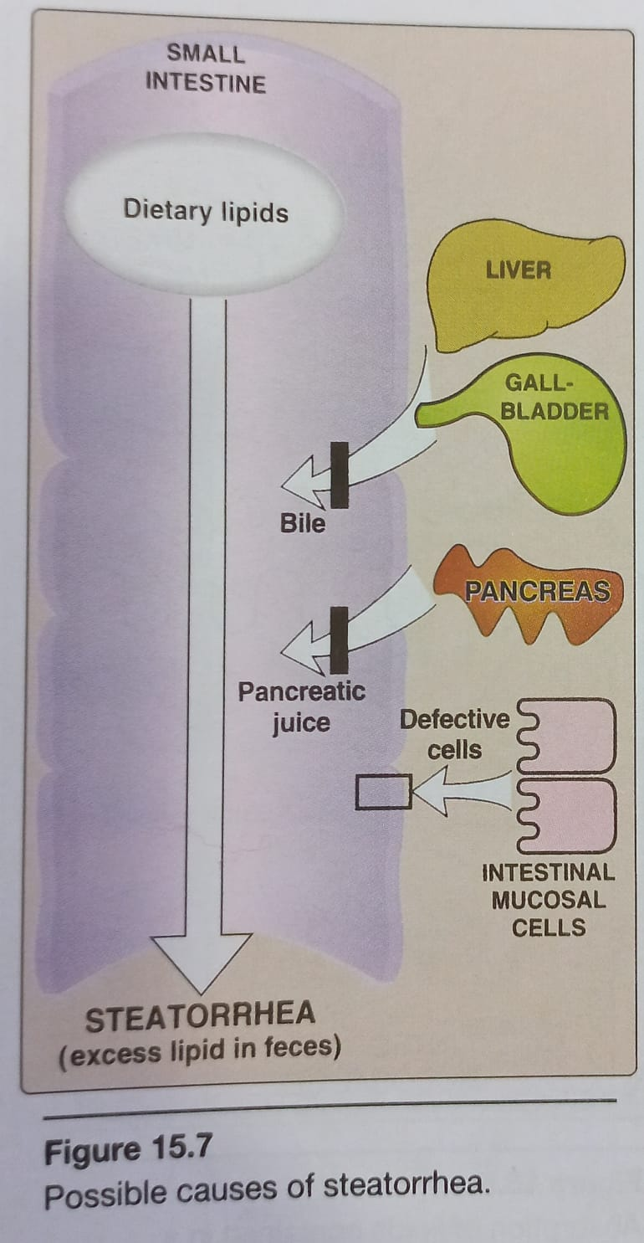
Possible causes of steatorrhea (Figure 15.7) – page 196

Slide 28
Family Medicine
Family Medicine plays important role in following manner:
Diagnosis
Education
Monitoring
Refer to Specialists

Slide 29
Artificial Intelligence
Artificial Intelligence plays role in following aspects:
Predictive Analysis
Diagnostic Tools
Drug Development

Slide 30
Suggested Research Article
Link :https://www.ncbi.nlm.nih.gov/pmc/articles/PMC3125014/
Journal Name: NIH
Title:Evaluation of efficacy and safety of orlistat in obese patients
Author Name:Suyog S. Jain
Abstract
Rapidly rising prevalence of obesity is alarming. Obesity predisposes to co-morbidities like hypertension, type 2 diabetes mellitus, dyslipidemias, thus substantially rising healthcare expenditure. Lifestyle modifications alone have very limited success, necessitating the addition of pharmacotherapy to it.
Objective:
Present study was carried out to evaluate the efficacy and safety of orlistat in obese patients.
Materials and Methods:
Eighty obese (BMI>30) patients according to inclusion and exclusion criteria were randomized into either of the two groups. Group 1 received orlistat 120 mg three times a day and group 2 received placebo three times a day. Weight, waist circumference, BMI, total cholesterol, triglycerides, HDL, LDL were measured at baseline and then at 8th, 16th and 24th week. ADR reported by patients were recorded. For safety evaluation various hematological and biochemical parameters were assessed. Z test was used for analysis of data.
Results:
Compared to placebo, orlistat caused significant reduction (P<0.05) in weight (4.65 kg vs 2.5 kg; orlistat vs placebo, respectively), BMI (1.91 kg/m² vs 0.64 kg/m²) and waist circumference (4.84 cm vs 2 cm), cholesterol (10.68 mg vs 6.18 mg) and LDL level (5.87 mg vs 2.33 mg). In the orlistat group, the GI side effects like loose stools, oily stools/spotting, abdominal pain and fecal urgency were observed.
Conclusion:
Orlistat is an effective and well-tolerated antiobesity drug, which can be employed as an adjunct to therapeutic lifestyle changes to achieve and maintain optimal weight.
Keywords: Antiobesity agents, obesity, orlistat, weight loss

Slide 31
Bioethics
Ethical considerations include the decision which diseases and/or traits are eligible for gene therapy research, how gene therapy can be safely tested and evaluated in humans, which cell types should be used, what components are necessary for informed consent.
Spiral Integration

Slide 32
Learning Resources
Lippincott Illustrated Reviews Biochemistry, 8th Edition, Chapter 15, page no. 191-197
Google scholar
Google images

