Slide 2
Motto Vision; The Dream/Tomorrow
To impart evidence based research oriented medical education
To provide best possible patient care
To inculcate the values of mutual respect and ethical practice of medicine
Wisdom
Truth
Service

Slide 3
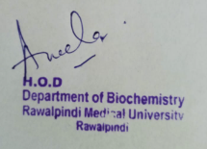
1st Year MBBS Foundation Module Large Group Interactive Session (LGIS) Translation
Dr. Aneela Jamil
Biochemistry Department
Date:
Date:

Slide 4
Sequence of LGIS
Learning Objectives
Horizontal Integration
Core Concept
Vertical Integration
Spiral Integration
Learning Resources

Slide 5
Learning Objectives
At the end of this lecture students should be able to
Explain process of Translation in prokaryotes and eukaryotes
Describe posttranslational modifications
Discuss related clinical disorders

Slide 6
Professor Umar Model of Integrated Lecture
60%
Core Subject
20%
Horizontal
Integration
Physiology
Anatomy
8%
Vertical Integration
Pathology
Pharmacology
7%
Vertical Integration
Clinical Integration
5%
Vertical Integration
Research, Professionalism
Ethics
Digital library

Slide 7
Horizontal Integration

Slide 8
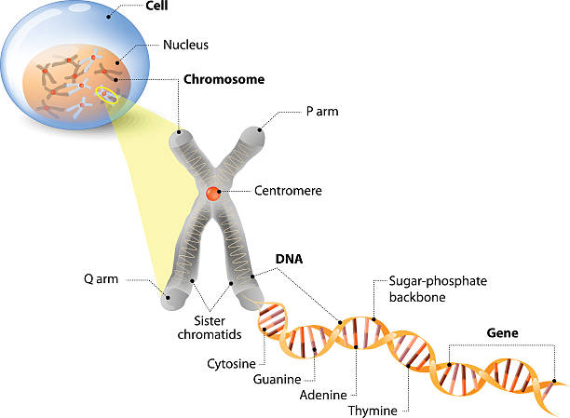
Anatomical & Physiological Aspects

Slide 9
Anatomical & Physiological Aspects
Control center of cell
Contains genetic material
Cell division
Heredity

Slide 10
Core Concept

Slide 11
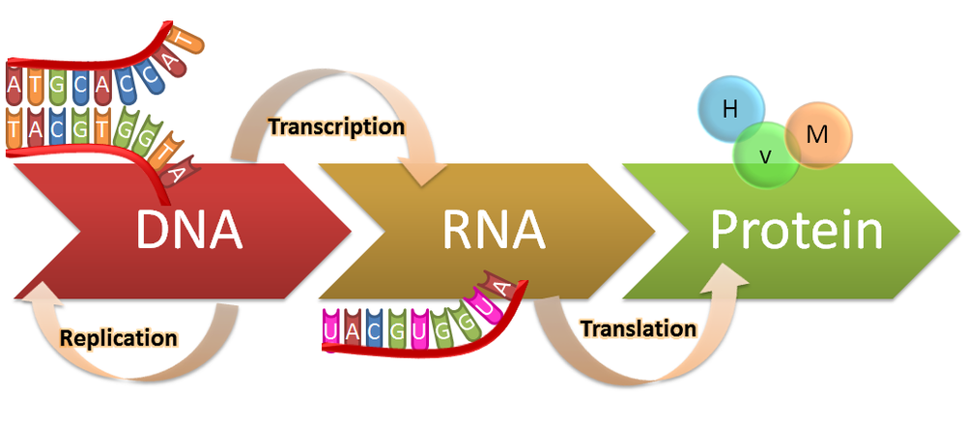
Translation

Slide 12
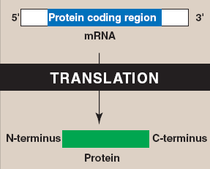
Translation
Core Concept
12

Slide 13
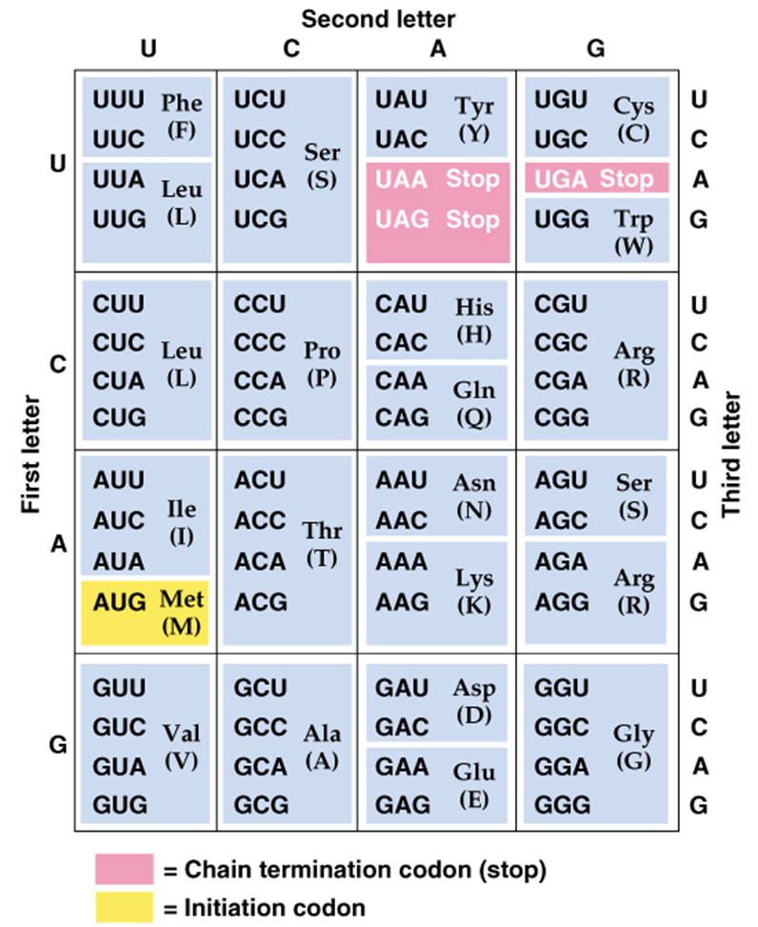
Genetic Code
Non-overlapping
Specific
Universal
Degenerate
Core Concept
13

Slide 14
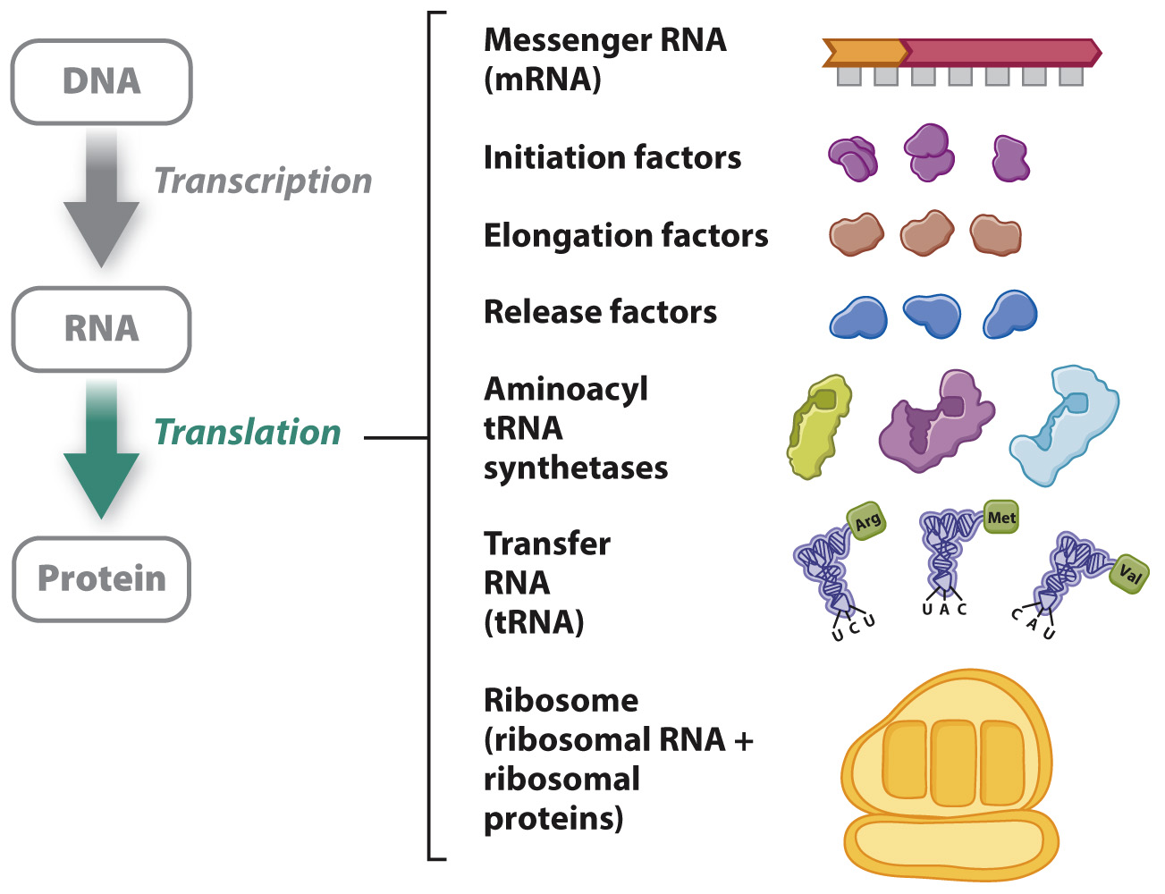
Translation Components Required
Core Concept
14

Slide 15
Translation Components Required
Core Concept
15

Slide 16
Translation Components Required
Core Concept
16

Slide 17
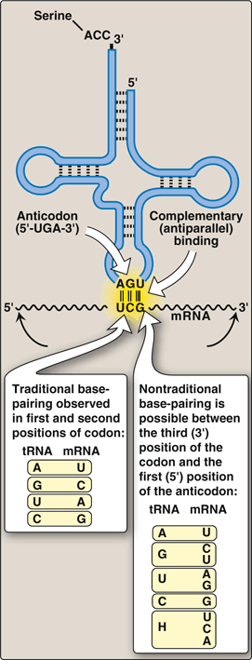
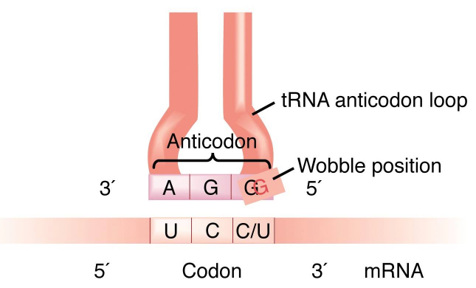
Translation Wobble Hypothesis
Core Concept
17

Slide 18
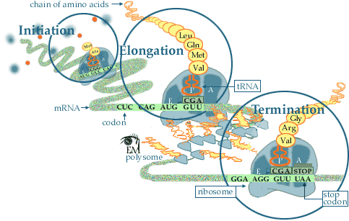
Translation
Steps
Initiation
Elongation
Termination
Core Concept
18

Slide 19
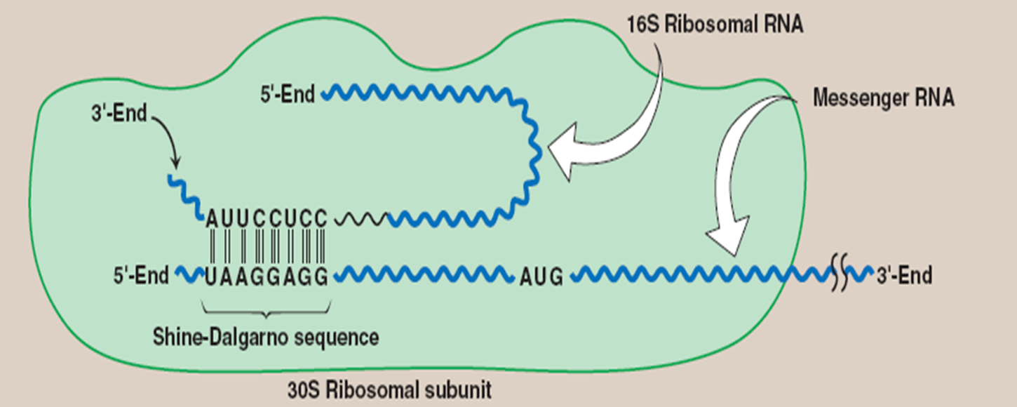
Initiation
Core Concept

Slide 20
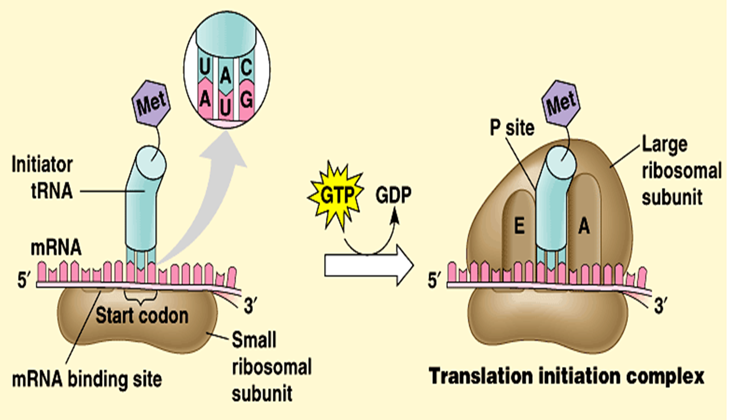
Initiation
Core Concept

Slide 21
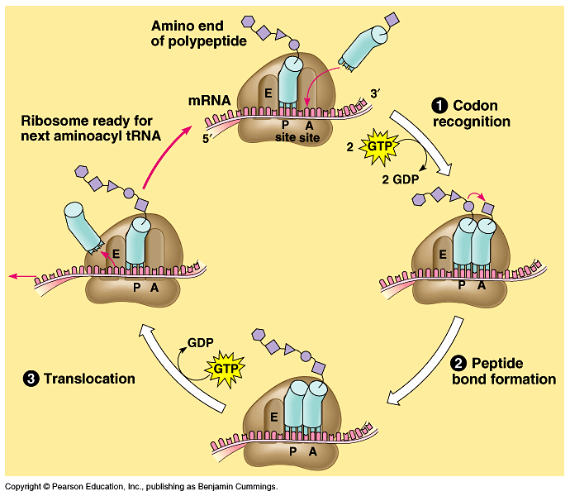
Elongation

Slide 22
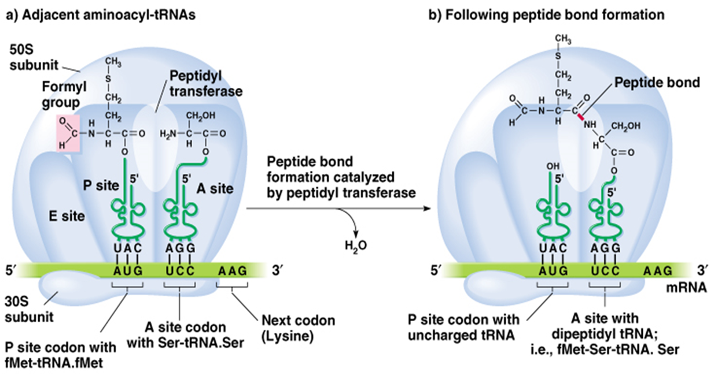
Elongation

Slide 23
Elongation

Slide 24
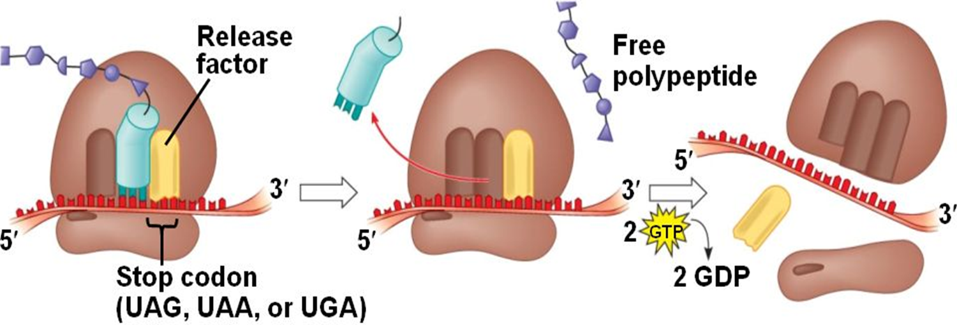
Termination
Core Concept

Slide 25
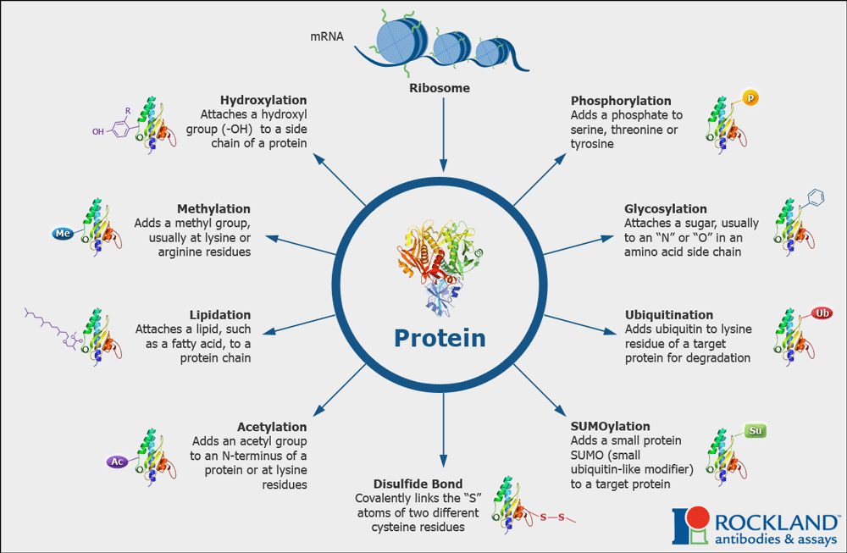
Posttranslational Modification
Core Concept

Slide 26
Vertical Integration

Slide 27
Action of Antibiotics
Erythromycin, Clindamycin | Bind to 50S ribosomal subunit Inhibit translocation
Chloramphenicol | Inhibits prokaryotic peptidyltransferase
Streptomycin | Bind to 30S subunit Inhibits initiation
Tetracycline | Bind to 30S subunit Prevents binding of aminoacyl-tRNA to mRNA ribosome complex
Diphtheria toxin | Inactivates eukaryotic EF-2, prevents translocation

Slide 28
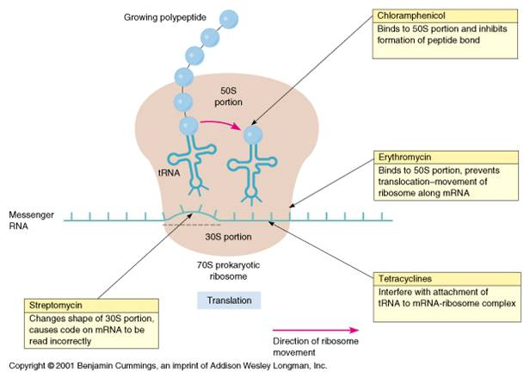
Action of Antibiotics

Slide 29
Family Medicine
Family Medicine plays important role in following manner:
Diagnosis
Education
Monitoring
Refer to Specialists

Slide 30
Artificial Intelligence
Artificial Intelligence plays role in following aspects:
Decoding DNA sequences to
pinpoint genetic variations
identify genetic abnormalities
Utilizes extensive data from patient thereby enhancing prevention, diagnosis & treatment based on individual genetic profiles

Slide 31
Suggested Research Article
Link: https://www.frontiersin.org/journals/microbiology/articles/10.3389/fmicb.2020.624830/full
Journal Name : Front. Microbiol
Title: Coupled Transcription-Translation in Prokaryotes: An Old Couple With New
Author Name: Mikel Irastortza-Olaziregi, Orna Amster-Choder
Abstract
Coupled transcription-translation (CTT) is a hallmark of prokaryotic gene expression. CTT occurs when ribosomes associate with and initiate translation of mRNAs whose transcription has not yet concluded, therefore forming “RNAP.mRNA.ribosome” complexes. CTT is a well-documented phenomenon that is involved in important gene regulation processes, such as attenuation and operon polarity. Despite the progress in our understanding of the cellular signals that coordinate CTT, certain aspects of its molecular architecture remain controversial. Additionally, new information on the spatial segregation between the transcriptional and the translational machineries in certain species, and on the capability of certain mRNAs to localize translation-independently, questions the unanimous occurrence of CTT. Furthermore, studies where transcription and translation were artificially uncoupled showed that transcription elongation can proceed in a translation-independent manner. Here, we review studies supporting the occurrence of CTT and findings questioning its extent, as well as discuss mechanisms that may explain both coupling and uncoupling, e.g., chromosome relocation and the involvement of cis- or trans-acting elements, such as small RNAs and RNA-binding proteins. These mechanisms impact RNA localization, stability, and translation. Understanding the two options by which genes can be expressed and their consequences should shed light on a new layer of control of bacterial transcripts fate.

Slide 32
Bioethics
Appropriate information
Counselling
Spiral Integration

Slide 33
Learning Resources
Textbook of Biochemistry, Lippincott Illustrated Reviews 8th edition, chapter no. 32, page no. 885-910
Google scholar
Google images

