Slide 2
Motto Vision; The Dream/Tomorrow
To impart evidence based research oriented medical education
To provide best possible patient care
To inculcate the values of mutual respect and ethical practice of medicine
Wisdom
Truth
Service

Slide 3
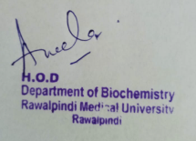
1st Year MBBS Foundation Module Large Group Interactive Session (LGIS) Transcription
Dr. Aneela Jamil
Biochemistry Department
Date: 14-03-2023
Date: 12-03-2024

Slide 4
Sequence of LGIS
Learning Objectives
Horizontal Integration
Core Concept
Vertical Integration
Spiral Integration
Learning Resources

Slide 5
Learning Objectives
At the end of this lecture students should be able to
Explain Transcription in prokaryotes and eukaryotes
Discuss related clinical disorders

Slide 6
Professor Umar Model of Integrated Lecture
60%
Core Subject
20%
Horizontal
Integration
Physiology
Anatomy
8%
Vertical Integration
Pathology
Pharmacology
7%
Vertical Integration
Clinical Integration
5%
Vertical Integration
Research, Professionalism
Ethics
Digital library

Slide 7
Horizontal Integration

Slide 8
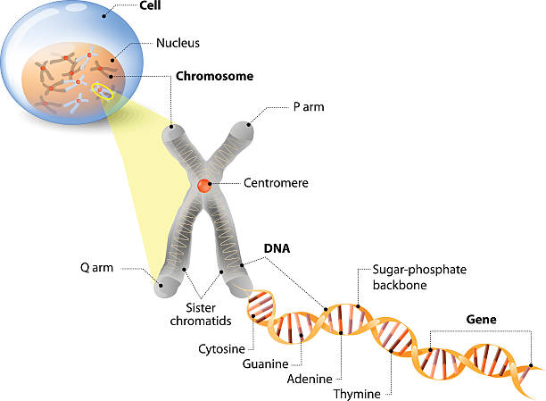
Anatomical & Physiological Aspects

Slide 9
Anatomical & Physiological Aspects
Control center of cell
Contains genetic material
Cell division
Heredity

Slide 10
Core Concept

Slide 11
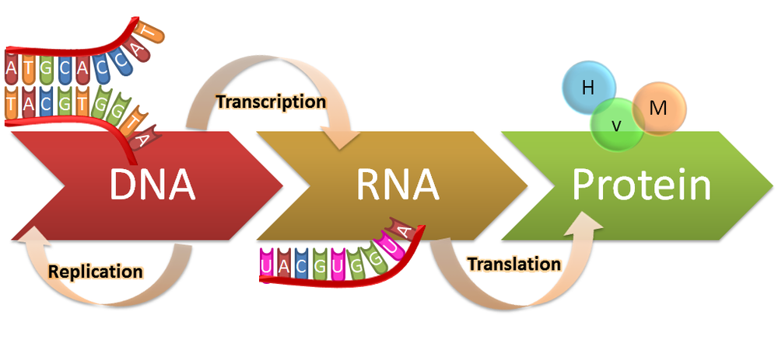
Transcription

Slide 12
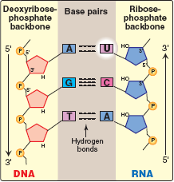
Transcription
Process during which a DNA strand serves as a template for the synthesis of RNA, with the help of RNA polymerase is called transcription
Core Concept
12

Slide 13
Transcription
One species of RNA polymerase
No role of transcription factors
Steps
Initiation
Elongation
Termination
Core Concept
13

Slide 14
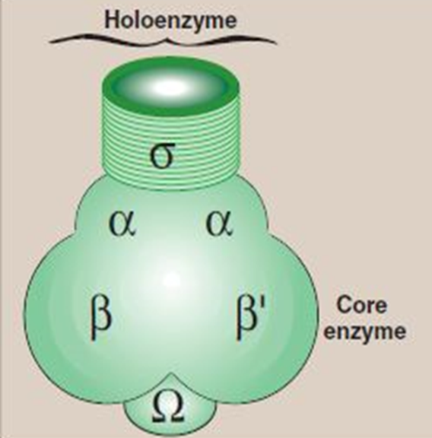
Transcription
RNA polymerase
Core enzyme
Holoenzyme
Core Concept
14

Slide 15
Transcription unit
Primary transcript
Core Concept

Slide 16
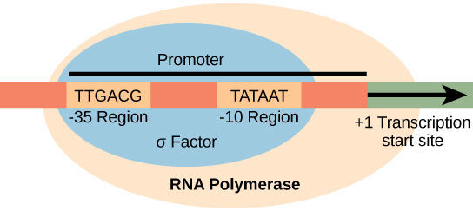
Initiation
Core Concept

Slide 17
Promoter region
-35 sequence
Pribnow box
Core Concept

Slide 18
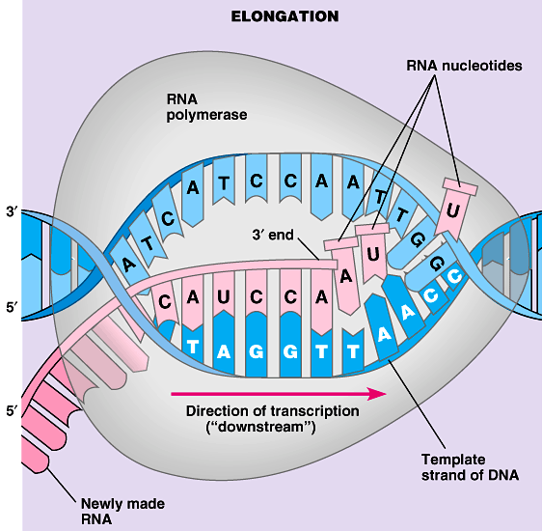
Elongation

Slide 19
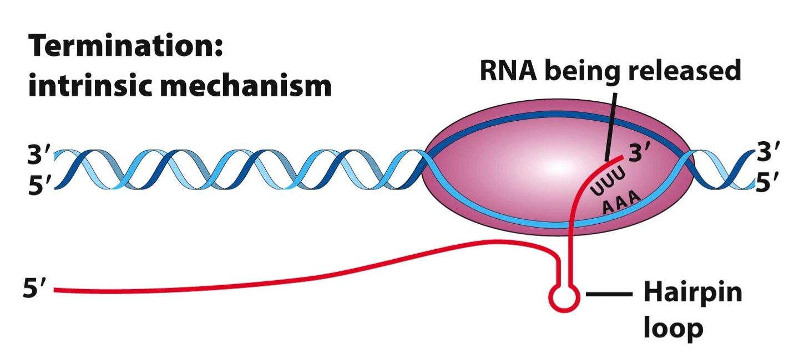
Termination
ρ-dependent Termination
ρ-independent Termination
Core Concept

Slide 20
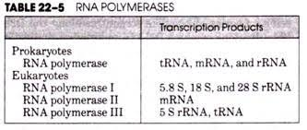
Separate RNA polymerases
Role of transcription factors
Core Concept

Slide 21
General transcription factors
Required for recognition of the promoter, recruitment of RNA polymerase II to the promoter and initiation of transcription
TFIID recognizes and binds the TATA box,
TFIIF brings the polymerase to the promoter
TFIIH melts the DNA and allows RNA polymerase to clear the promoter
Core Concept

Slide 22
Specific transcription factors
Bind to sequences within and outside of the core promoter
Regulate the frequency of initiation and gene expression
Bind other proteins (“coactivators”), recruiting them to the transcription complex
Core Concept

Slide 23
Posttranscriptional Modification
Ribosomal RNA
Core Concept

Slide 24
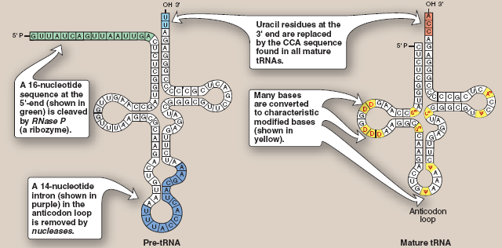
Posttranscriptional Modification
Transfer RNA
Core Concept

Slide 25
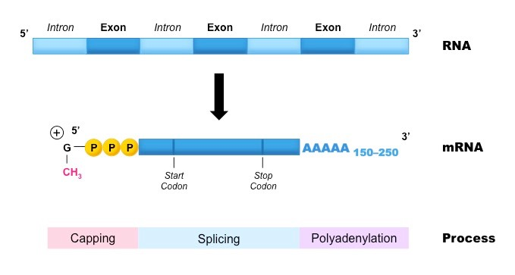
Posttranscriptional Modification
Messenger RNA
Core Concept

Slide 26
Posttranscriptional Modification
Core Concept

Slide 27
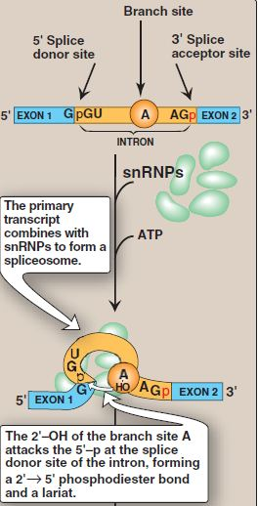
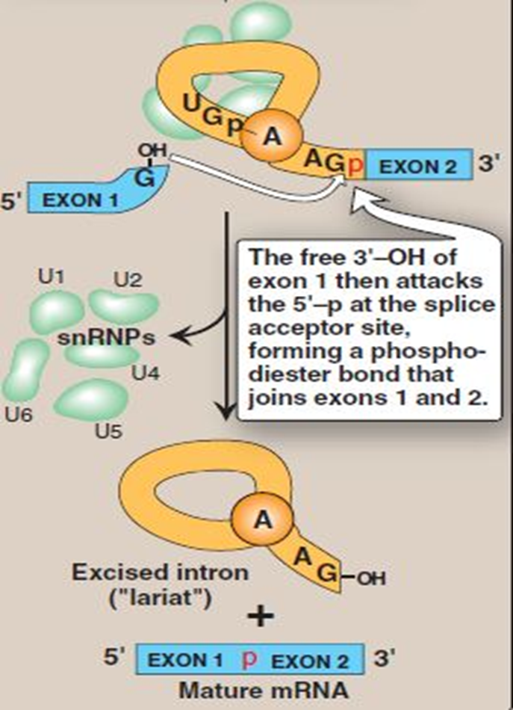
Mechanism of Splicing

Slide 28
Vertical Integration

Slide 29
Action of Antibiotics

Slide 30
Family Medicine
Family Medicine plays important role in following manner:
Diagnosis
Education
Monitoring
Refer to Specialists

Slide 31
Artificial Intelligence
Artificial Intelligence plays role in following aspects:
Decoding DNA sequences to
pinpoint genetic variations
identify genetic abnormalities
Utilizes extensive data from patient thereby enhancing prevention, diagnosis & treatment based on individual genetic profiles

Slide 32
Suggested Research Article
Link: https://pubmed.ncbi.nlm.nih.gov/31213387/
Journal Name : Trends Genet
Title: Transcriptional Control by Premature Termination: A Forgotten Mechanism
Author Name: Kinga Kamieniarz-Gdula, Nick J Proudfoot
Abstract
The concept of early termination as an important means of transcriptional control has long been established. Even so, its role in metazoan gene expression is underappreciated. Recent technological advances provide novel insights into premature transcription termination (PTT). This process is frequent, widespread, and can occur close to the transcription start site (TSS), or within the gene body. Stable prematurely terminated transcripts contribute to the transcriptome as instances of alternative polyadenylation (APA). Independently of transcript stability and function, premature termination opposes the formation of full-length transcripts, thereby negatively regulating gene expression, especially of transcriptional regulators. Premature termination can be beneficial or harmful, depending on its context. As a result, multiple factors have evolved to control this process

Slide 33
Bioethics
Appropriate information
Counselling
Spiral Integration

Slide 34
Learning Resources
Textbook of Biochemistry, Lippincott Illustrated Reviews 8th edition, chapter no. 31, page no. 862-78
Google scholar
Google images

