Slide 2
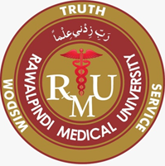
Motto Vision; The Dream/Tomorrow
The Rawalpindi Medical Collage
Wisdom
Truth
Service
To impart evidence based research oriented medical education
To provide best possible patient care
To inculcate the values of mutual respect and ethical practice of medicine

Slide 3
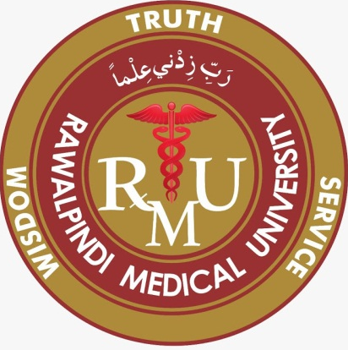
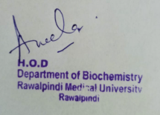
1st Year MBBS Foundation Module Large Group Interactive Session (LGIS) Chemistary of Nucleic Acid I
The Rawalpindi Medical Collage
Dr. Uzma Zafar
Biochemistry Department
Date :00

Slide 4
Sequence of LGIS
The Rawalpindi Medical Collage
Learning Objectives
Horizontal Integration
Core Concept
Vertical Integration
Spiral Integration
Learning Resources

Slide 5
The Rawalpindi Medical Collage
LEARNING OBJECTIVES
At the end of the lecture, students will be able to
Describe types of nucleic acid
Describe components of nucleic acid
Describe structure of DNA
Describe types of DNA

Slide 6
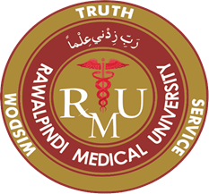
Professor Umar Model of Integrated Lecture
The Rawalpindi Medical Collage
60%
Core Subject
20%
Horizontal
Integration
Physiology
Anatomy
8%
Vertical Integration
Pathology
Pharmacology
7%
Vertical Integration
Clinical Integration
5%
Vertical Integration
Research, Professionalism
Ethics
Digital library

Slide 7
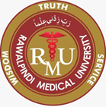
The Rawalpindi Medical Collage
Horizontal Integration

Slide 8
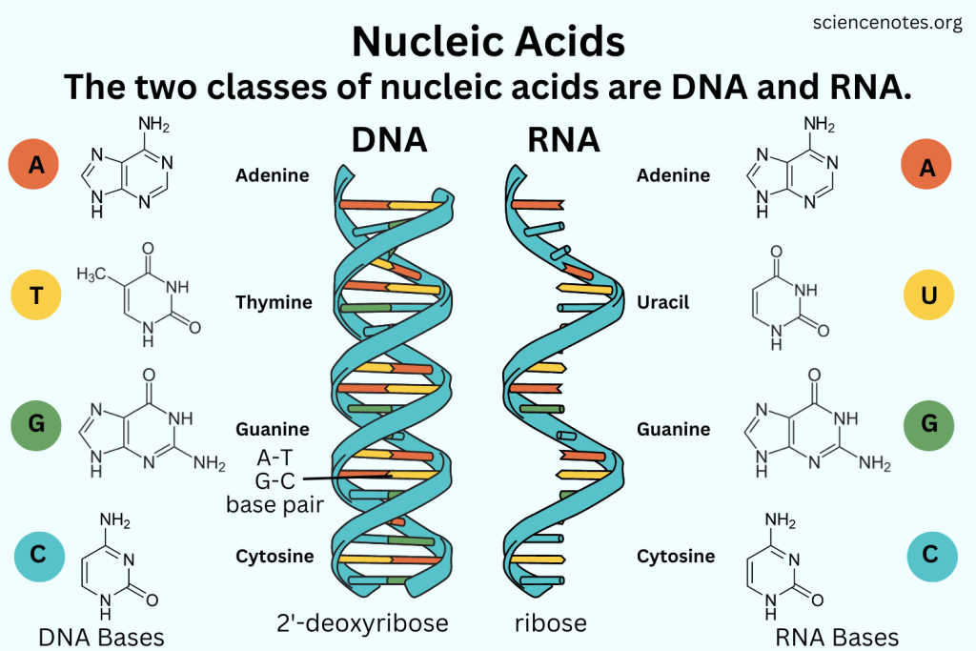
The Rawalpindi Medical Collage

Slide 9
Physiology of Nucleic Acids
The Rawalpindi Medical Collage
Nucleic acids, deoxyribonucleic acid (DNA) and ribonucleic acid (RNA), carry genetic information which is read in cells to make the RNA and proteins by which living things function. The well-known structure of the DNA double helix allows this information to be copied and passed on to the next generation.
Horizontal Integration

Slide 10
Core Concept

Slide 11
The Rawalpindi Medical Collage
Nucleic acids
Nucleic acids were first discovered in
Nucleic of pus cells 1868 Friedrich
Sperm heads 1872 Miescher
They can reproduce
They can under go mutations
Core Concept

Slide 12
The Rawalpindi Medical Collage
Types :
2 main Types
I ) DNA
ii ) RNA
Core Concept

Slide 13
The Rawalpindi Medical Collage
The Rawalpindi Medical Collage
Biomedical importance
They are carriers of genetic information
DNA- almost all organisms
RNA- viruses e.g. Tobacco mosaic virus
Influenza virus
2. Mutations are primarily changes in the structure of DNA.
They are important in evolution of new varieties and species.
Many mutations are harmful and produce diseases.
Core Concept

Slide 14
The Rawalpindi Medical Collage
3. All viruses are nucleoproteins and contain DNA or RNA as genetic material.
DNA – Bacterial and Animal viruses
Vaccinia virus
Herpes simplex virus
RNA – All plant viruses
Bacterial and animal viruses Poliomyelitis
Influenza
Human immunodeficiency syndrome virus (HIV) (AIDs)

Slide 15
The Rawalpindi Medical Collage
4. Nucleic acids direct the synthesis of proteins including enzymes.
Single gene controls the synthesis of single poly peptide chain
5. Cancer research involves an extensive study of nucleic acids.
6. Disease like Gout and Orotic- aciduria are inborn errors of Purine and Pyramidine metabolism respectively.

Slide 16
The Rawalpindi Medical Collage
7. By advanced techniques called Genetic engineering and DNA recombinant technology genes can be synthesized and incorporated into the genome of selected host cells, which starts producing specific proteins under direction of the newly incorporated genes.

Slide 17
The Rawalpindi Medical Collage
. Defective genes are localized in DNA before birth by studies on fetal cells which are obtained from amniotic fluid.
9. Genomic libraries have been prepared - DNA finger printing (Blood, Seminal fluid)
10. Gene therapy for genetic disorders.

Slide 18
The Rawalpindi Medical Collage
Significance
Treatment of Genetic diseases
Production of Antigens
Production of Antibodies
Production of Hormones e.g. Insulin
Production of Therapeutic agents
Production of Diagnostic reagents

Slide 19
The Rawalpindi Medical Collage
Components of Nucleic Acids
Nitrogenous Base
2. Sugar
3. Phosphoric acid

Slide 20
The Rawalpindi Medical Collage
Nitrogenous bases
1.Purines
Adenine A
Guanine G
2. Pyrimidines
(i) Cytosine C
(ii) Uracil U
(iii) Thymine T

Slide 21
The Rawalpindi Medical Collage

Slide 22
The Rawalpindi Medical Collage
Sugar
Ribose
Deoxy ribose

Slide 23
The Rawalpindi Medical Collage
Nucleoside
Combination of nitrogenous base with a sugar is known as Nucleoside
Ribonucleoside ------ Ribose
Deoxyribonucleoside ---------Deoxyribose

Slide 24
The Rawalpindi Medical Collage

Slide 25
The Rawalpindi Medical Collage
Adenine, Guanine and Cytosine can combine with ribose as well as deoxyribose
Uracil only combines with ribose
3. Thymine only combines with deoxyribose

Slide 26
The Rawalpindi Medical Collage
DNA -Deoxyribo Nucleic Acid
It is a Polynucleotide having a thread like structure
Contains the genetic information that gives rise to chemical and physical properties of living organisms
DNA is responsible for Heredity-----1944

Slide 27
The Rawalpindi Medical Collage
The size of DNA molecule show great variations
Size Base pairs
Simian virus-40 1.7µm 5243
E.coli 1.7mm 4639221
Human 2 m 3.2x10⁹

Slide 28
The Rawalpindi Medical Collage
Composition
Nitrogenous bases
Purines - Adenine and Guanine
Pyrimidines – Cytosine and Thymine
2. Deoxy ribose sugar
3. Phosphoric acid

Slide 29
The Rawalpindi Medical Collage
Linkage
Nucleotides are linked to each other by Phospho diester bond between two sugars
C₃ of one and C₅ of other

Slide 30
The Rawalpindi Medical Collage
Shape of DNA molecule
It is present in form of a Double helix –
Watson and Crick 1953
Also known as coil of life
It is a spiral stair case wound around a cylindrical axis
The bases are on inside of the helix and deoxy ribose and phosphates on the out side

Slide 31
The Rawalpindi Medical Collage
2 strands of DNA are wound on each other to form a double helix
The bases are separated by 0.34 nm
Each base is rotated 36º in relation to the previous base.
The helical structure repeats at intervals of 3.4 nm and there are 10 base pairs in each completed helix.
The helix is 2 nm in diameter.

Slide 32
The Rawalpindi Medical Collage
Grooves
The molecule shows a minor and a major groove
These grooves wind along the DNA molecule parallel to the phospho diester backbones
These grooves serve to accommodate proteins which bind with specific nucleotide sequences without disturbing the basic pairing of the double helical DNA molecule
These proteins are concerned with expression of specific genes
The bases are inclined 20º from horizontal plane

Slide 33
The Rawalpindi Medical Collage

Slide 34
The Rawalpindi Medical Collage
The two strands of DNA are anti parallel to each other.
Two strands are joined to each other by H-bonds which are formed between nitrogenous bases.
Sequence of bases represents Primary structure of DNA.
Helical structure is called Secondary structure of DNA.
The nitrogenous bases are on the inside of helix and deoxy ribose PO₄ on the outside

Slide 35
The Rawalpindi Medical Collage
The chromosomal DNA may be linear or circular but the molecule do not exist in an extended form in either case.
Both rod and circle portions are twisted forming super circles or super coils or coiled coils.
The super coiling of DNA is an intrinsic property of DNA - Tertiary structure.
The super coiling enables a several thousand fold condensation of the DNA in a chromosome or the head of a virus.

Slide 36
The Rawalpindi Medical Collage
The DNA molecule can be visualized as a staircase
The steps of which are made up of complementary bases and sides are made up of phospho diester backbone .
The sequence of bases which are attached to sugar phosphate backbone determines the information content of the DNA.
Core Concept

Slide 37
The Rawalpindi Medical Collage
Types of DNA
6 Types
A to E and Z
B form is usually found under physiological conditions.
Core Concept

Slide 38
The Rawalpindi Medical Collage
A form
Right handed
Dehydrated DNA
Becomes more compact and wider
Nucleotides per turn of helix---11
Diameter ---2.6 nm
The major groove becomes deeper , while the minor groove becomes shallower.
Core Concept

Slide 39
The Rawalpindi Medical Collage
Z form
Left handed
Nucleotides per turn ---12
The molecule is slender and elongated.
The major groove is much less prominent while the minor groove is narrow and deep .
Z DNA is seen in short tracts normally and it may have some role in gene expression and in genetic recombination.
Core Concept

Slide 40
The Rawalpindi Medical Collage
Under certain conditions DNA can have unusual structures e.g. instead of double helix (duplex)
it can be a triple helix (triplex)---3 strands or even tetraplex --- 4 strands.
This is due to a non- Watson Crick pairing called Hoogsteen pairing.
Core Concept

Slide 41
The Rawalpindi Medical Collage
Denaturation and Renaturation of DNA
DNA can be denatured by heat and extremes of pH (below 4 and above 10)
Tm - It is the temperature at which 50% of the DNA double helix is unwound.
DNA rich in GC pairs has a higher Tm than DNA which has more AT pairs.
Mammalian DNA contains 40% GC pairs and has a Tm of about 87⁰ C.
Core Concept

Slide 42
The Rawalpindi Medical Collage
In denaturation of DNA the two strands of DNA are separated by rupture of H- bonds between the purines and pyrimidines facing each other.
In this process molecular weight is halved, viscosity and optical activity of it’s solution is greatly decreased and absorbance at 260 nm is increased (hyper chromic effect).
Denatured form is also called the melted form.
Core Concept

Slide 43
The Rawalpindi Medical Collage
Denatured form can be reconverted to the original helical also called native form by carefully slow cooling of the heat denatured DNA solution.
Renaturation of DNA is also called Anneling.
Agents like Urea and Formamide disrupts H bonds, lower Tm and facilitate denaturation at lower temperatures.
This minimize breakage of strands that occur at high temperatures.
Formamide is used to separate the two strands of DNA and DNA-RNA hybrids.
Core Concept

Slide 44
The Rawalpindi Medical Collage
VERTICAL INTEGRATION

Slide 45
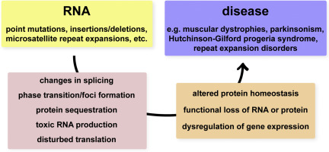
The Rawalpindi Medical Collage
Vertical Integration

Slide 46
Family Medicine
The Rawalpindi Medical Collage
Family Medicine plays important role in
diagnosis of diseases related to genetic disorder
in following manner:
1.It helps in diagnosis and treatment of wide range of diseases
2.It helps to promote preventive care and well being
Spiral Integration

Slide 47
The Rawalpindi Medical Collage
Family Medicine
One example is of GENETIC TESTING which involves
analyzing a persons DNA to identify specific variations
or mutations that may be associated with certain disease
For example CYSTIC FIBROSIS for which a genetic
test can be carried out for prediagnosis and better
treatment by physician
Spiral Integration

Slide 48
Artificial Intelligence
The Rawalpindi Medical Collage
Artificial Intelligence can be useful in following ways:
1.AI algorithms can analyze large amount of data
2.Identify patterns and mutations using machine learning techniques
3.For example AI can analyze DNA sequencing data to identify genetic variations that contribute to cancer development
Spiral Integration

Slide 49
Biomedical Ethics
The Rawalpindi Medical Collage
Biomedical Ethics plays a crucial role in field of nucleic acid chemistry it involves:
Addressing ethical considerations and dilemmas that arise from the use of nucleic acid
Safeguard the sensitive data is essential to protect individuals from discrimination or stigmatization
Spiral Integration

Slide 50
The Rawalpindi Medical Collage
Suggested Research Article

Slide 51
Suggested Research Article
The Rawalpindi Medical Collage
ABSTRACT:
Invitro selection allows rare functional RNA or DNA molecules to be isolated from pools of over 1015 different sequences. This approach has been used to identify RNA and DNA ligands for numerous small molecules, and recent three-dimensional structure solutions have revealed the basis for ligand recognition in several cases. By selecting high-affinity and -specificity nucleic acid ligands for proteins, promising new therapeutic and diagnostic reagents have been identified. Selection experiments have also been carried out to identify ribozymes that catalyze a variety of chemical transformations, including RNA cleavage, ligation, and synthesis, as well as alkylation and acyl-transfer reactions and N-glycosidic and peptide bond formation. The existence of such RNA enzymes supports the notion that ribozymes could have directed a primitive metabolism before the evolution of protein synthesis. New in vitro protein selection techniques should allow for a direct comparison of the frequency of ligand binding and catalytic structures in pools of random sequence polynucleotides versus polypeptides.
Link:annualreviews.org
Journal Name:Annual Review of Biochemistry
Title:In Vitro Selection Of Functional Nucleic Acids
Author Name:David S.Wilson and Jack W.Szostak
Latest Research Article
Spiral Integration

Slide 52
The Rawalpindi Medical Collage
Learning Resources
Lippincott , Biochemistry (Eight Edition)
Chapter 30, pg#459
Google scholar
Google images

Slide 53
The Rawalpindi Medical Collage
Thank you

