Slide 1


Slide 2
Motto Vision; The Dream/Tomorrow
To impart evidence based research oriented medical education
To provide best possible patient care
To inculcate the values of mutual respect and ethical practice of medicine
Wisdom
Truth
Service

Slide 3


1st Year MBBS
(Respiratory Module)
Large Group Interactive Session (LGIS) pH, Pka, Handerson Hasselbalch Equation
Dr. Uzma Zafar
Biochemistry Department
Delivering date
21-10-2024

Slide 4
Learning Objectives
At the end of this session, students will be able to:
Define pH, pKa, body buffer
Explain henderson hasselbalch equation

Slide 5

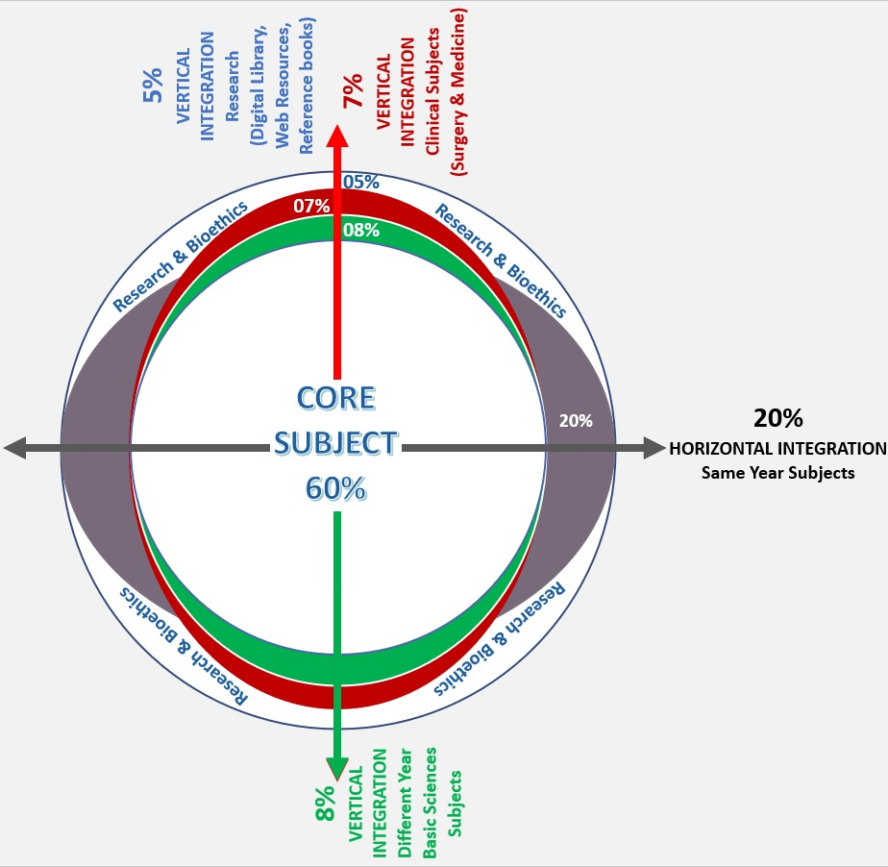
Professor Umar Model of Integrated Lecture
60%
Core Subject
20%
Horizontal
Integration
Physiology
Anatomy
8%
Vertical Integration
Pathology
Pharmacology
7%
Vertical Integration
Clinical Integration
5%
Vertical Integration
Research, Professionalism
Ethics
Digital library

Slide 6
Horizontal Integration

Slide 7

Physiology of Buffers
Buffers resist changes in pH when small amounts of acid or base are added, helping to maintain a stable environment for biochemical reactions.
Buffers neutralize excess hydrogen ions (H⁺) or hydroxide ions (OH⁻) to prevent significant changes in pH.
Enzymes have optimal pH ranges, and buffers help maintain the pH necessary for proper enzyme function.
Buffers help control the ionization state of molecules, affecting their solubility and biological activity, especially important for weak acids and bases.

Slide 8
              Core Concept

Slide 9
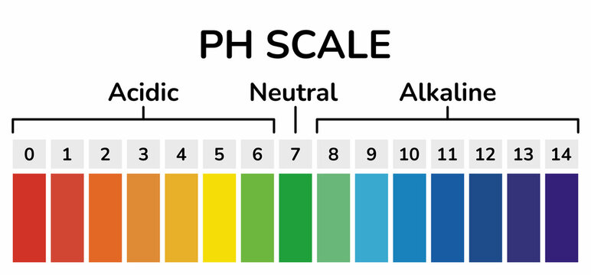
pH
pH is the measure of acidity or basicity of a solution
Pure water is said to be neutral with a pH=7.0
Solutions with pH less than 7.0 are called acidic and solutions with pH greater than 7.0 are called basic or alkaline

Slide 10
Definition of pH
pH is defined as negative log of the hydrogen ion concentration
The term pH was first introduced by Sorensen in 1909
pH= -log [H+]
To calculate the pH of a solution:
Calculate hydrogen concentration[H+]
Calculate the base 10 logarithm of [H+]
pH is the negative of the value found in step 2

Slide 11
pH of Pure Water
pure water at 25 degree centigrade
pH= -log [H+]
[H+] = 10^{-7 calculated altready}
pH= -log 10⁻⁷
PH= -(-7)= 7.0

Slide 12
pKa
The pH value at which a chemical specie will take or donate a proton is known as the pKa The negative base-10 logarithm of a solution’s acid dissociation constant (Ka) is pKa.
pKa Definition:
The negative logarithm of Ka is denoted by pKa.
The acid dissociation constant is denoted by the symbol Ka.
Some acids are powerful, while others are weak.
In aqueous solutions, strong acids totally break down into their ions.
Weak acids, on the other hand, partially dissociate, resulting in a balance between the acid and its conjugate base.

Slide 13
Cont….
Let us consider a weak acid HA
HA ⇆ A– + H⁺
The acid dissociation constant of this equilibrium is
Ka = [A–][H⁺] / [HA]
[A–] = Concentration of the conjugate base
[H⁺] = Concentration of H⁺ ions
[HA] = Concentration of Acid present
Then the pKa value of the acid dissociation constant can be indicated as below.
pKa = – log₁₀[Ka]

Slide 14
Cont…
We can determine whether an acid is a strong acid or a weak acid by looking at its pKa value.
The acid is weak if the pKa value is high.
Because a greater pKa number suggests that Ka is low, this is the case.
The value of [A–][H⁺] should be lower than the value of [HA] in order for Ka to be low.
This indicates that the acid has been partially dissociated. However, if the value of [A–][H⁺] is more than [HA], the Ka will be large and the pKa will be low. This shows that the acid is potent.

Slide 15
Difference between pKa & pH
Based on | pKa | pH
Definition | pKa is the negative value of the logarithm of Ka. | pH is the logarithmic value of the inverse of H⁺ concentration.
Indication of Acidity | pKa indicates whether an acid is a strong acid or a weak acid. | pH indicates whether a system is acidic or alkaline.
Values | If the pKa of an acid is high, it is a weak acid, and if the pKa of an acid is low, it is a strong acid. | If the pH of a system is high, the system is alkaline, but if the pH is low, that system is acidic.
Effect of Other Parameters | pKa is dependent on the concentration of acid, conjugate base and H⁺. | pH depends on the H⁺ concentration.
Henderson-Hasselbalch equation | Both pH and pKa are related by the Henderson-Hasselbalch equation. pH = pKa + log ([A–] / [HA])

Slide 16
Henderson-Hasselbalch Equation

Slide 17
Henderson-Hasselbalch Equation

Slide 18
Henderson-Hasselbalch Equation

Slide 19
Buffers
Resist changes in pH from addition of acid or base
are important for proper functioning of cells and blood
In blood, maintain a pH close to 7.4
Components of buffer:
Can be a weak acid with a salt of its conjugate base
Can also be a weak base with a salt of its conjugate acid

Slide 20
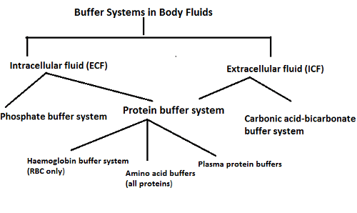
The major body buffer systems

Slide 21
Vertical Integration

Slide 22
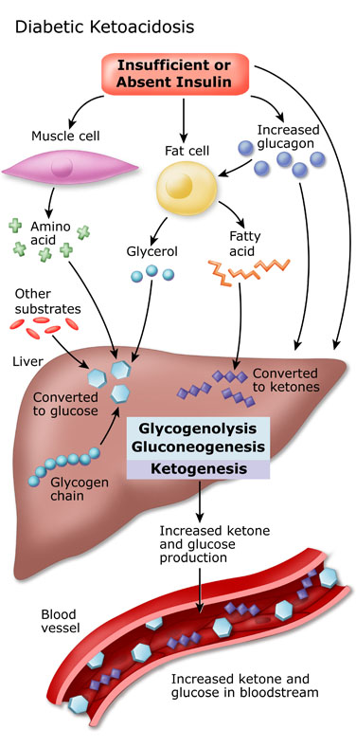
Diabetic Ketoacidosis

Slide 23
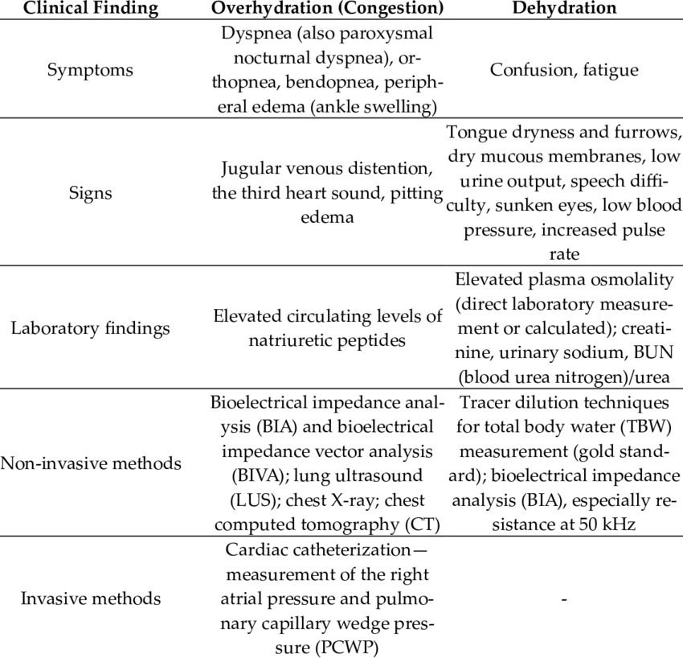
CLINICAL INTEGRATION
DEHYDRATION AND OVERHYDRATION

Slide 24
              Spiral Integration

Slide 25
FAMILY MEDICINE
Family Medicine plays important role in following manner:
Take a comprehensive medical history and physical examination: signs and symptoms of dehydration and overhydration
Order appropriate laboratory tests:Blood CP, serum elecrolytes and complete urine examination
Refer patients to a specialist for further evaluation and treatment

Slide 26
ARTIFICIAL INTELLIGENCE
Artificial Intelligence plays role in following aspects:
Diagnosis: AI can be used to develop new diagnostic tools. For example, AI powered algorithms could be used to analyze medical images such as blood tests, CT scan and MRI.
Risk Assessment: AI can be used to develop new prognostic tools. AI powered algorithms could be used to analyze patient’s data to predict the risk of recurrence or complications
Treatment Planning: AI can be used to develop personalized treatment plans for such patients

Slide 27


SUGGESTED RESEARCH ARTICLE
Link: https://link.springer.com/article/
10.1007/s00394-020-02296-z
Journal Name:
European Journal of Nutrition
Issue Date : April 2021
Abstract:

Slide 28
Family Medicine
Family Medicine plays important role in following manner:
Diagnosis
Education
Dietary Guidance
Monitoring
Refer to Specialists

Slide 29
How To Access Digital Library
Steps to Access HEC Digital Library
Go to the website of HEC National Digital Library.
On Home Page, click on the INSTITUTES.
A page will appear showing the universities from Public and Private Sector and other Institutes which have access to HEC National Digital Library HNDL.
Select your desired Institute.
A page will appear showing the resources of the institution
Journals and Researches will appear
You can find a Journal by clicking on JOURNALS AND DATABASE and enter a keyword to search for your desired journal.

Slide 30
Assessment

Slide 31
MCQS
1. In the Henderson-Hasselbalch equation, which of the following correctly describes the relationship between pH, pKa, and the ratio of protonated to deprotonated forms of a molecule?
A. pH = pKa + log ([HA]/[A⁻])
B. pH = pKa + log ([A⁻]/[HA])
C. pH = pKa + log ([H⁺]/[A⁻])
D. pH = pKa + log ([A⁻]/[H⁺])
E. pH = pKa - log ([HA]/[A⁻])

Slide 32
MCQS
2. What happens to a weak acid with a pKa of 6.0 as it moves from a compartment with a pH of 4.0 to one with a pH of 7.4?
A. It becomes more protonated and less ionized.
B. It becomes less protonated and more ionized.
C. It becomes less ionized and less protonated.
D. It remains 50% ionized.
E. It becomes more protonated and more ionized.

Slide 33
MCQS
3. If the concentration of bicarbonate (HCO₃⁻) to carbonic acid (H₂CO₃) is 20:1, what is the blood pH, assuming the pKa of carbonic acid is 6.1?
A. 6.1
B. 7.1
C. 7.4
D. 7.6
E. 6.8

Slide 34
MCQS
4. At which of the following pH values will a weak base with a pKa of 9.0 be mostly protonated?
A. pH 2.0
B. pH 4.0
C. pH 7.0
D. pH 9.0
E. pH 12.0

Slide 35
MCQS
5. What is the Henderson-Hasselbalch equation used to calculate?
pH of a buffer solution
B) pKa of an acid
C) Concentration of a base
D) Volume of a solution
E) Temperature of a reaction

Slide 36
MCQS KEY
1. B
2. B
3. C
4. A
5. A

Slide 37


