Slide 2
Motto Vision; The Dream/Tomorrow
To impart evidence based research oriented medical education
To provide best possible patient care
To inculcate the values of mutual respect and ethical practice of medicine
Wisdom
Truth
Service

Slide 3
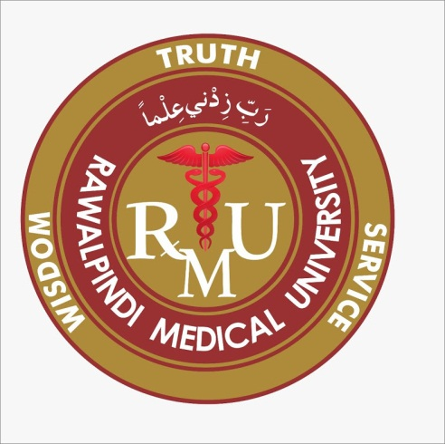
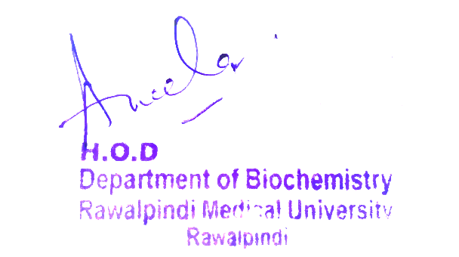
1st Year MBBS MSK-1 Module Large Group Interactive Session (LGIS) Trace Minerals and Ultra trace Minerals
Updated Date: 10-02-2024
Delivered Date: 22-04-2024
Dr. Uzma Zafar
Biochemistry Department

Slide 4
Sequence of LGIS
Learning Objectives
Horizontal Integration
Core Concept
Vertical Integration
Spiral Integration
Learning Resources

Slide 5
Learning Objectives
At the end of the lecture, Students will be able to
Differentiate between Trace minerals and ultra trace minerals.
Describe the role of minerals in the body as a cofactor for various enzymes.
Describe their dietary sources, deficiency and toxicity.
Understand the examples of enzymes that require these minerals.

Slide 6
Professor Umar Model of Integrated Lecture
60%
Core Subject
20%
Horizontal
Integration
Physiology
Anatomy
8%
Vertical Integration
Pathology
Pharmacology
7%
Vertical Integration
Clinical Integration
5%
Vertical Integration
Research, Professionalism
Ethics
Digital library

Slide 7
Horizontal Integration

Slide 8
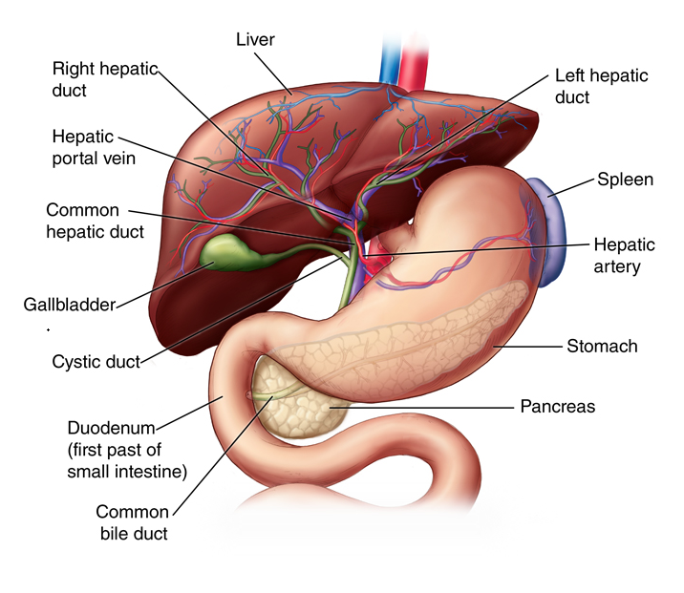
Anatomy of liver

Slide 9
Functions Of Minerals
The body contains many different minerals.
Minerals by themselves are inactive chemical elements, like the iron in a pan or calcium in a rock. But in the body, calcium is used to make the bones and teeth, and iron is used to make the hemoglobin in red blood cells.

Slide 10
Functions Of Minerals
The body uses this iron to carry oxygen to its cells. Additional minerals help in many other body processes:
Minerals become part of tissue structure, like in bone and teeth.
Minerals help maintain acid-base balance, to keep the body pH neutral.
Minerals help regulate body processes, such as in enzyme systems.
Minerals function in nerve impulse transmission and muscle contraction.
Horizontal Integration

Slide 11
Core Concept

Slide 12
Copper
Copper Cu is a key component of several enzymes that play critical functions in the body.
These include ferroxidases such as the ceruloplasmin and Hephaestein involved in the oxidation of ferrous iron (Fe 2+ ) to the ferric form (Fe 3+ ) that is required for its intracellular storage or transport through blood.

Slide 13
Copper Cont.
Meat, shellfish, nuts, and whole grains are good dietary sources of Cu. Dietary deficiency is uncommon.
If a deficiency does develop, anemia may be seen because of the effect on Fe metabolism. Toxicity from dietary sources is rare (UL = 10 mg/day).
Menkes syndrome and Wilson disease are genetic causes of Cu deficiency and Cu overload, respectively.
Core Concept

Slide 14
Menkes syndrome
In Menkes syndrome (“kinky hair” disease), a rare X-linked (1:140,000 males) disorder, efflux of dietary Cu out of intestinal enterocytes into the circulation by a Cu-transporting ATPase (ATP7A) is impaired.
This results in systemic Cu deficiency.
Urinary and serum-free (unbound) Cu are low, as is the concentration of ceruloplasmin, which carries over 90% of the Cu in the circulation.
Progressive neurologic degeneration and connective tissue disorders are seen, as are changes to hair.
Parenteral administration of Cu has been used as a treatment.
Core Concept

Slide 15
Wilson Disease
In Wilson disease, an autosomal-recessive (AR) disorder affecting 1:35,000 live births, efflux of Cu from the liver by ATP7B is impaired.
Cu accumulates in the liver; leaks into the blood; and is deposited in the brain, eyes, kidneys, and skin.
In contrast to Menkes syndrome, urinary and serum-free Cu are high.
Hepatic dysfunction and neurologic and psychiatric symptoms are seen.
Kayser– Fleischer rings (corneal deposits of Cu) may be present.
Life-long use of Cu-chelating agents, such as penicillamine, is the treatment.
Core Concept

Slide 16
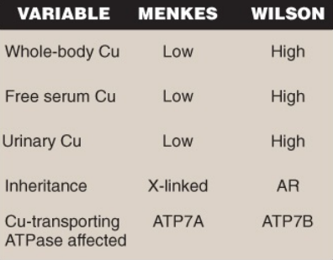
Comparison of Menkes syndrome and Wilson disease.
Core Concept

Slide 17
Zinc
Zn plays important structural and catalytic functions in the body.
Zinc fingers are super secondary structures in proteins (e.g., transcription factors) that bind to DNA and regulate gene expression.
Hundreds of enzymes require Zn for activity. Examples include alcohol dehydrogenase, which oxidizes ethanol to acetaldehyde; carbonic anhydrase. ALA dehydratase (porphobilinogen synthase) of heme synthesis, which is inhibited by lead (lead replaces the zinc; and the isoform of superoxide dismutase (SOD), which also requires Cu.
Core Concept

Slide 18
ZINC con.
Dietary sources of Zn include meat, fish, eggs, and dairy products.
Phytates (phosphate storage molecules in plants such as grains, seeds, legumes, some nuts) irreversibly bind Zn in the intestine, decreasing its absorption, and can result in a deficiency.
Symptoms include rashes around the orifices and in the limbs, slowed growth and development, diarrhea, and immune deficiencies.
Vision problems may also occur because Zn is needed in the metabolism of vitamin A.)
Core Concept

Slide 19
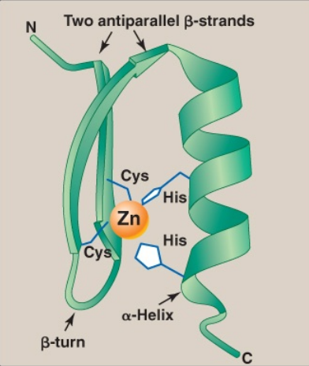
Zinc Finger
Zinc
Core Concept

Slide 20
Manganese
Mn is important for the function of several enzymes.
Whole grains, legumes (e.g., beans and peas), nuts, and tea (especially green tea) are good sources of the mineral.
Consequently, Mn deficiency in humans is rare.
Toxicity from foods and/or supplements is also rare (UL = 11 mg/day for adults).
Core Concept

Slide 21
Other microminerals
Chromium (Cr) and fluorine (F) also play roles in the body.
Cr potentiates the action of insulin by an unknown mechanism.
It is found in fruits, vegetables, dairy products, and meat.
F (as fluoride [F − ]) is added to water in many parts of the world to reduce the incidence of dental caries.
F − replaces the hydroxyl group of hydroxylapatite, forming fluoroapatite that is more resistant to the enamel-dissolving acid produced by mouth bacteria.

Slide 22
ULTRA TRACE MINERALS

Slide 23
Ultra Trace Minerals
The ultra trace minerals include
iodine (I)
selenium (Se)
molybdenum (Mo)

Slide 24
Iodine
Iodine is utilized in the synthesis of the thyroid hormones triiodothyronine (T3 ) and thyroxine (T4 ) that are required for development, growth, and metabolism.
Circulating iodide (I − ) is taken up (“trapped”) and concentrated in the epithelial follicular cells of the thyroid gland.
It then is sent into the colloid of the follicular lumen where it is oxidized to iodine (I₂ ) by thyroperoxidase (TPO).
TPO then uses I₂ to iodinate selected tyrosine residues in thyroglobulin (Tg), forming monoiodinated tyrosine (MIT) and diiodinated tyrosine (DIT)
The coupling of two DIT on Tg gives T4 , whereas coupling one MIT and one DIT gives T3.

Slide 25
Iodine
The iodinated Tg is endocytosed and stored in follicular cells until needed, at which time it is proteolytically digested to release T3 and T4 , which are secreted into the circulation.
Under normal conditions, approximately 90% of secreted thyroid hormone is T4 that is carried by transthyretin.
In target tissues (e.g., the liver and developing brain), T4 is converted to T3 (the more active form) by Se-containing deiodinases.
T3 binds to a nuclear receptor that binds DNA at thyroid response elements and functions as a transcription factor.

Slide 26
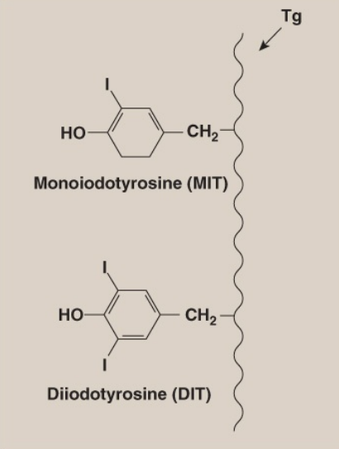
Iodine Cont.
Ultra trace Minerals Iodine
Iodination of thyroglobulin
(Tg) with production of MIT
and DIT.
Core Concept

Slide 27
Synthesis of T3 and T4
Iodination of thyroglobulin (Tg) with
production of MIT and DIT.
Ultra trace Minerals Iodine
Core Concept

Slide 28
Ultra trace Minerals Iodine
Hypothyroidism
Under ingestion of iodine (I) can result in goiter, an enlargement of the thyroid in response to excessive stimulation by TSH.
More severe deficiency results in hypothyroidism that is characterized by fatigue, weight gain, decreased thermogenesis, and decreased metabolic rate.
If hormone deficiency occurs during fetal and infant development, irreversible intellectual disability (formerly called “cretinism”), hearing loss, spasticity, and short stature can result.
Dairy products, seafood, and meat are the primary sources of Iodine.
Core Concept

Slide 29
Iodine Cont.
Hyperthyroidism
This condition is the result of overproduction of thyroid hormone.
Although it can be caused by over ingestion of I-containing supplements (UL = 1.1 g/day for adults), the most common cause of hyperthyroidism is Graves disease, in which an antibody that mimics the effect of TSH is produced, resulting in dysregulated production of thyroid hormone.
This can cause nervousness, weight loss, increased perspiration and heart rate, protruding eyes, and goiter.
Core Concept

Slide 30
Selenium
Selenium (Se) is present in approximately 25 human proteins (selenoproteins) as a constituent of the amino acid selenocysteine, which is derived from serine.
Selenoproteins include glutathione peroxidase that oxidizes glutathione in the reduction of hydrogen peroxide, a ROS, to water; thioredoxin reductase that reduces thioredoxin, a coenzyme of ribonucleotide reductase; and deiodinases that remove iodine from thyroid hormones.
Toxicity (selenosis) caused by over ingestion of supplements causes brittle nails and hair. Cutaneous and neurologic effects may also be seen (UL = 400 μg in adults).
Core Concept

Slide 31
Molybdenum
Molybdenum (Mo) functions as a cofactor for a small number of mammalian oxidases.
Legumes are important dietary sources.
No dietary deficiency syndromes are known.
Mo has low toxicity in humans (UL = 2 mg/day in adults).
Core Concept

Slide 32
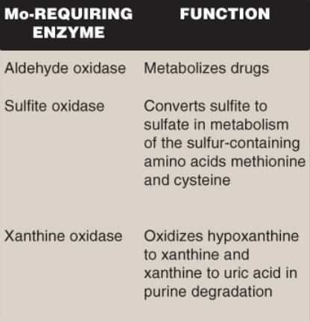
Ultra trace Minerals Molybdenum
Enzymes (oxidases) that
require molybdenum (Mo)
Core Concept

Slide 33
Vertical Integration

Slide 34
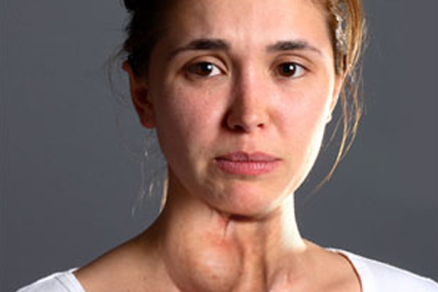
Goiter

Slide 35
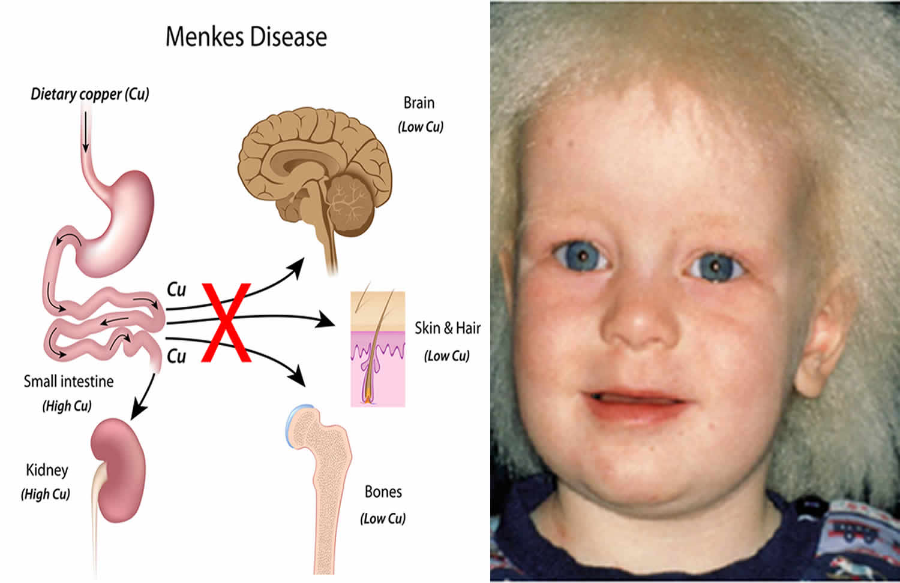
Menkes Disease
In Menkes syndrome (“kinky hair” disease), a rare X-linked (1:140,000 males) disorder, efflux of dietary Cu out of intestinal enterocytes into the circulation by a Cu-transporting ATPase (ATP7A) is impaired. Progressive neurologic degeneration and connective tissue disorders are seen.

Slide 36
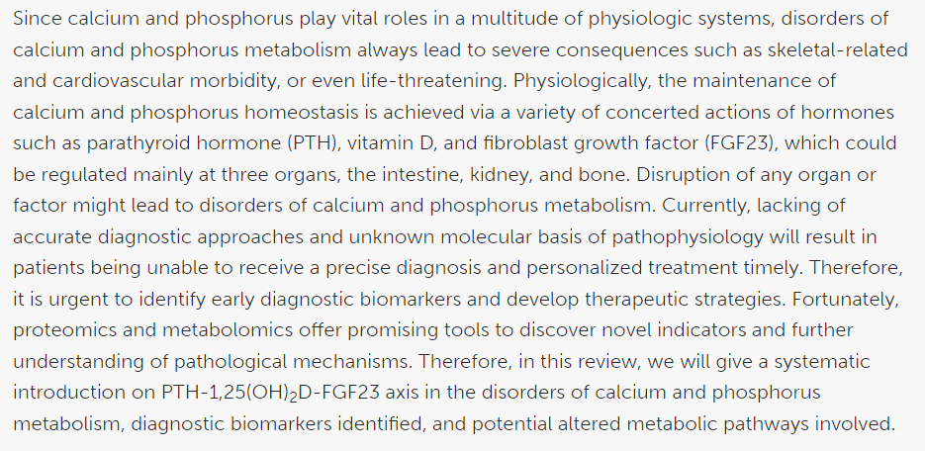
Suggested Research Article
Link:
https://www.frontiersin.org/articles/10.3389/fcell.2020.576110/full
Journal Name:
frontiers
Title:
Disorders of Calcium and Phosphorus Metabolism and the Proteomics/Metabolomics-Based Research
Author Name:
Meiheng Sun

Slide 37
Family Medicine
Family Medicine plays important role in following manner:
Diagnosis
Education
Dietary Guidance
Monitoring
Refer to Specialists

Slide 38
Artificial Intelligence
AI plays a significant role by enhancing various aspects of mineral analysis, diagnosis, and treatment monitoring.
Data Analysis
Diagnostic Support
Predictive Modeling
Drug Development
Personalized Medicine
Real-time Monitoring
Quality Control

Slide 39
Bioethics
Health Impacts
Environmental Impact
Labor Rights
Resource Distribution
Climate Change

Slide 40
How To Access Digital Library
Steps to Access HEC Digital Library
Go to the website of HEC National Digital Library.
On Home Page, click on the INSTITUTES.
A page will appear showing the universities from Public and Private Sector and other Institutes which have access to HEC National Digital Library HNDL.
Select your desired Institute.
A page will appear showing the resources of the institution
Journals and Researches will appear
You can find a Journal by clicking on JOURNALS AND DATABASE and enter a keyword to search for your desired journal.

Slide 41
References
Lippincott Illustrated Reviews: Biochemistry Chapter#29, page # 449.
Google Images.

Slide 42
Assessment

Slide 43
Assessment
1. Oxide minerals are composed primarily of:
a. Oxygen and sulfur
b. Oxygen and carbon
c. Oxygen and silicon
d. Oxygen and metal ions
e. Oxygen and Nitrogen

Slide 44
Assessment
2.Blood Calcium
a)Consist entirely of diffusible calcium ions
b)Is involved in neuromuscular activity
c)Adult RDA of calcium 200mg/day
d)Concentration is controlled by hormonal action
e)Calcium doesn’t bind to calmodulin protein

Slide 45
Assessment
3. A deficiency of copper affects the formation of normal collagen by reducing the activity of which of the following enzyme?
a. Prolyl hydroxylase
b. Lysyl oxidase
c. Lysyl hydroxylase
d. Glucosyl transferase
e. Galactosyl transferase

Slide 46
Assessment
4. All the following statements regarding calcium are correct except:
a. It diffuses as a divalent cation
b. It freely diffuses across the endoplasmic reticulum of muscle cells
c. It can exist in the blood as ionic form and also protein bound
d. It is found in high concentration in bones
e. Required as a cofactor in some of reactions

Slide 47
Assessment
5. The normal route of calcium excretion is:
a. Kidney
b. Kidney and liver
c. Kidney and intestine
d. Kidney, intestine and pancreas
e. Pancreas, liver and kidney.

Slide 48
Key
D
D
B
B
C

