Slide 2
Motto Vision; The Dream/Tomorrow
To impart evidence based research oriented medical education
To provide best possible patient care
To inculcate the values of mutual respect and ethical practice of medicine
Wisdom
Truth
Service

Slide 3
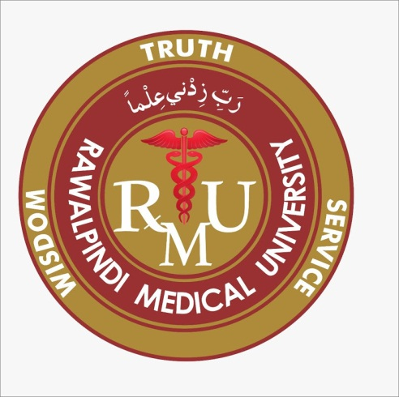
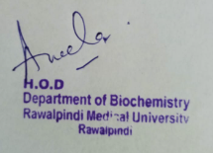
1st Year MBBS Foundation Module LGIS Introduction and Classification of Enzymes
Dr. Raja Khalid Yaqub
Biochemistry Department
Updated Date: 00-0-2025
Delivered Date: 00-

Slide 4
Sequence of LGIS
Learning Objectives
Horizontal Integration
Core Concept
Vertical Integration
Spiral Integration
Learning Resources

Slide 5
Learning Objectives
At the end of the lecture, students will be able to:
Understand classification and functions of enzymes.
Differentiate between coenzyme, cofactor and holoenzyme .
Discuss isoenzymes with suitable examples.

Slide 6
Professor Umar Model of Integrated Lecture
60%
Core Subject
20%
Horizontal
Integration
Physiology
Anatomy
8%
Vertical Integration
Pathology
Pharmacology
7%
Vertical Integration
Clinical Integration
5%
Vertical Integration
Research, Professionalism
Ethics
Digital library

Slide 7
Horizontal Integration

Slide 8
Physiology of Enzymes
Enzymes provide support for many important processes within the body. For example, the digestive system enzymes, DNA replication enzymes, liver enzymes, etc.
Other activities in which enzymes help include:
Hormone production
Cell regulation
Creating movement to make the muscle contract
Transporting materials around a cell

Slide 9
Core Concept

Slide 10
Introduction to Enzymes
Enzymes may be defined as biocatalysts synthesized by living cells.
They are protein in nature (exception – RNA acting as ribozyme), colloidal and thermolabile in character, and specific in their action.

Slide 11
Functions of Enzymes
Enzymes provide support for many important processes within the body. Some examples include:
The digestive system: Enzymes help the body break down larger complex molecules into smaller molecules, such as glucose, so that the body can use them as fuel.
DNA replication: Each cell in the body contains DNA. Each time a cell divides, the cell needs to copy its DNA. Enzymes help in this process by unwinding the DNA coils.

Slide 12
Functions of Enzymes
Liver enzymes: The liver breaks down toxins in the body. To do this, it uses a range of enzymes the facilitate the process of destroying the toxins.
Other activities enzymes help with include the hormone production, cell regulation, creating movement to make the muscle contract, transporting materials around a cell and respiration.

Slide 13
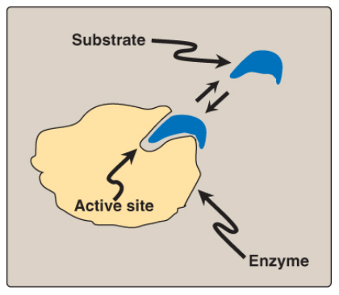
Enzymes
Enzymes are proteins that act as biological catalysts by accelerating chemical reactions, without being changed in the overall process.
An enzyme combines with the substrate at its active site and converts the substrate into product.
Schematic representation of an enzyme with one active site binding a substrate molecule.

Slide 14
Coenzyme, Cofactor and Holoenzyme
An apoenzyme is an inactive enzyme, activation of the enzyme occurs upon binding of an organic or inorganic cofactor.
If the nonprotein component is a metal ion, such as zinc (Zn²⁺) or iron (Fe²⁺), it is called a cofactor. If it is a small organic molecule, it is termed a coenzyme (NAD⁺, NADP⁺, FAD derived from vitamins)
The term holoenzyme refers to the protein component of the enzyme along with its nonprotein component. It is the enzyme's catalytically active form.
Holoenzyme = Apoenzyme + Cofactor

Slide 15
Coenzyme, Cofactor and Holoenzyme

Slide 16
Isoenzymes
Isoenzymes are variant forms of the same enzyme that catalyze the same reaction but have slightly different physical properties because of genetically determined differences in amino acid sequence.

Slide 17
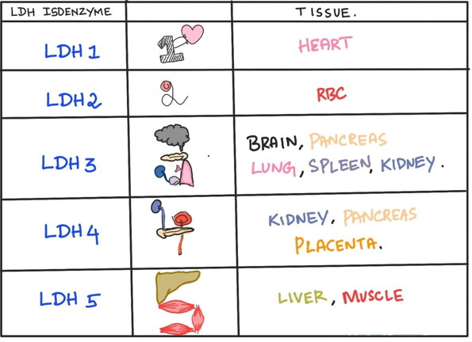
Lactate Dehydrogenase (LDH) Isoenzyme
Five isoenzyme forms of LDH exist in various body tissues.

Slide 18
Creatine Kinase (CK) Isoenzymes
CK occurs as three isoenzymes.
Each CK isoenzyme is a dimer composed of two polypeptide subunits (called B and M subunits for brain and skeletal muscle) associated in one of three combinations:
CK1 = BB (Brain)
CK2 = MB (Myocardium)
CK3 = MM (Skeletal muscle, cardiac muscle)
Each CK isoenzyme shows a characteristic electrophoretic mobility.

Slide 19
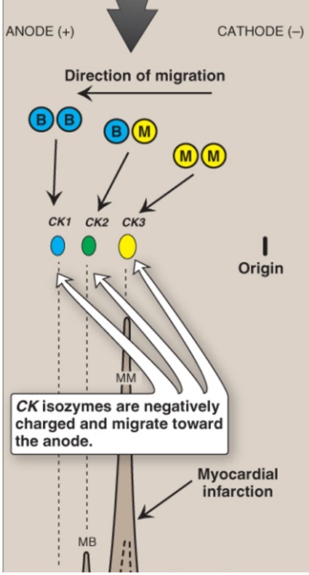
Clinical Importance of Isoenzymes
Different organs commonly contain particular proportions of different isoenzymes.
The pattern of isoenzymes found in the blood plasma can serve as a means of identifying the site of tissue damage.
The plasma levels of various isoenzyme forms of LDH and of creatine kinase (CK) vary under different disease states.
Subunit composition, electrophoretic mobility, and enzyme activity of
creatine kinase (CK) isoenzymes.

Slide 20
Classification of Enzymes
Enzymes involved in oxidation-reduction reactions.

Slide 21
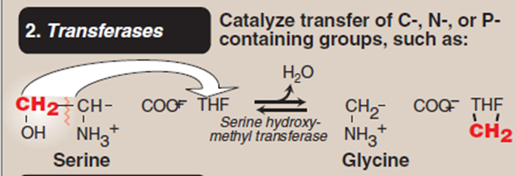
Classification of Enzymes
Enzymes that catalyze the transfer of functional groups.

Slide 22
Classification of Enzymes
Enzymes that bring about hydrolysis of various compounds.

Slide 23
Classification of Enzymes
Enzymes specialized in the addition or removal of water, ammonia, CO2 etc.

Slide 24
Classification of Enzymes
Enzymes involved in all the isomerization reactions.

Slide 25
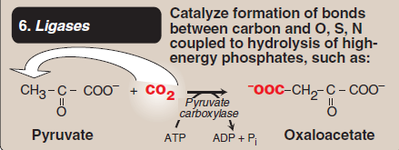
Classification of Enzymes
Enzymes catalyzing the synthetic reactions (Greek : ligate—to bind) where two molecules are joined together, and ATP is used.

Slide 26
Vertical Integration

Slide 27
Vertical Integration
Albinism:
Albinism refers to a group of conditions in which a defect in tyrosine metabolism results in a deficiency in the production of melanin.
It may be inherited by one of several modes: autosomal recessive (primary mode), autosomal dominant, or X linked.
Total absence of pigment from the hair, eyes, and skin, tyrosinase-negative oculocutaneous albinism (type 1 albinism), results from an absent or defective copper-requiring tyrosinase.

Slide 28
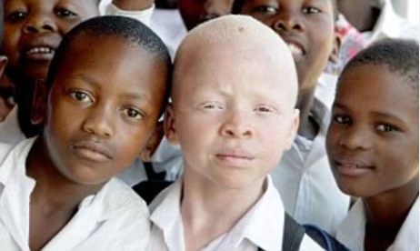
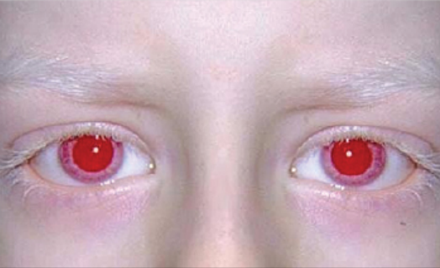
Vertical Integration
Albinism:

Slide 29
Family Medicine
Here's how a family medicine doctor would approach the care of a patient with albinism:
Medical Assessment: The doctor would conduct a thorough medical assessment, including a review of the patient's medical history, family history, and any specific concerns related disorders.
Vision Care: The doctor might refer the patient to an ophthalmologist for regular eye exams and vision correction as needed.
Skin Protection: The doctor would advise the patient on proper sun protection measures, such as wearing sunscreen, protective clothing, and seeking shade since they have a higher risk of sun damage.

Slide 30
Artificial Intelligence
AI can assist in several ways to support individuals with albinism.
Diagnostic assistance: AI-powered image recognition and analysis tools can aid in the early detection of skin conditions such as skin cancer, which individuals with albinism are at higher risk for.
Vision Assistance: AI-powered vision enhancement technologies can help individuals with albinism compensate for vision impairments.
Personalized Healthcare: AI algorithms can analyze genetic data to provide personalized healthcare recommendations based on an individual's genetic predispositions and medical history

Slide 31
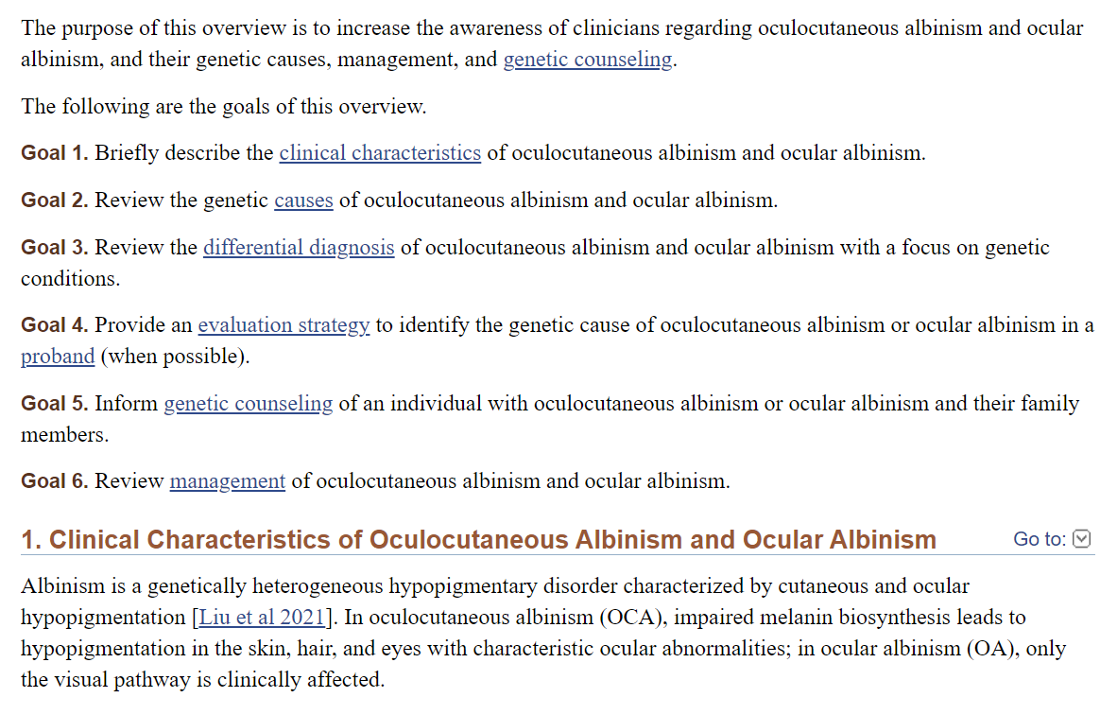
Suggested Research Article
Link: https://www.ncbi.nlm.nih.gov/books/NBK590568/
Title: Oculocutaneous Albinism and Ocular Albinism Overview
Author Name: Mervyn G Thomas, MBChB, PhD, FRCOphth, Jonathan Zippin, MD, PhD, and Brian P Brooks, MD, PhD.

Slide 32
Bioethics
Informed consent
Doctor-patient confidentiality
Proper explanation of the treatment options
Nutritional support
Access to health care
Spiral Integration

Slide 33
Learning Resources
Textbook of Biochemistry, Lippincott 8th edition, chapter no. 5 (Page 57) and chapter 20 (page 303)
Google scholar
Google images

