Slide 2
Motto Vision; The Dream/Tomorrow
To impart evidence based research oriented medical education
To provide best possible patient care
To inculcate the values of mutual respect and ethical practice of medicine
Wisdom
Truth
Service

Slide 3
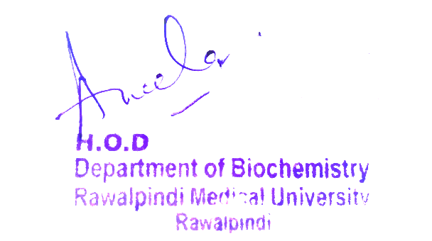
2nd Year MBBS Introduction to Carbohydrate Metabolism and Glycolysis Large Group Interactive Session (LGIS)
Dr. Uzma Zafar
Biochemistry Department
Updated Date: 10-02-2024
Delivered Date: 26-02-2024

Slide 4
Sequence of LGIS
Learning Objectives
Horizontal Integration
Core Concept
Vertical Integration
Spiral Integration
Learning Resources

Slide 5
Learning Objectives
At the end of the lecture, students will be able to:
Understand metabolic pathways.
Discuss Glucose entry into the cells.
Explain types, reactions and regulation of Glycolysis.

Slide 6
Professor Umar Model of Integrated Lecture
60%
Core Subject
20%
Horizontal
Integration
Physiology
Anatomy
8%
Vertical Integration
Pathology
Pharmacology
7%
Vertical Integration
Clinical Integration
5%
Vertical Integration
Research, Professionalism
Ethics
Digital library

Slide 7
Horizontal Integration

Slide 8
Anatomy of Liver

Slide 9
Carbohydrate Metabolism
Carbohydrate metabolism involves a series of biochemical reactions within cells to process carbohydrates for energy production and storage (Glycogen).
Through processes like glycolysis, the Krebs cycle, and oxidative phosphorylation, carbohydrates are broken down into smaller molecules such as ATP, which is used to power cellular functions.
Carbohydrate metabolism helps to regulate blood glucose levels, ensuring they remain within a narrow range.

Slide 10
Core Concept

Slide 11
Metabolism
Metabolism is the sum of all the chemical changes occurring in a cell, a tissue, or the body.
Metabolites are intermediate products of metabolism
In a pathway, the product of one reaction serves as the substrate of the subsequent reaction.
Most pathways can be classified as either catabolic (degradative) or anabolic (synthetic).

Slide 12
Catabolism
Three stages of catabolism
CoA = coenzyme A;
TCA = tricarboxylic Acid
CO2 = carbon dioxide.

Slide 13
Anabolism
Anabolism is a divergent process in which a few biosynthetic precursors (such as amino acids) form a wide variety of polymeric, or complex products.
Anabolic reactions are endergonic, while Catabolic reactions generate energy and are exergonic.
Anabolic reactions often involve chemical reductant NADPH.

Slide 14
Glucose Transporters into Cells

Slide 15
Glucose Transport into Cells
Glucose cannot diffuse directly into cells but enters by one of two transport systems:
A sodium (Na+ )- and ATP-independent transport system or
A sodium (Na+ )- and ATP-dependent cotransport system.

Slide 16
Glucose Transport into Cells
A. Sodium- and ATP-independent transport system:
This passive system is mediated by a family of 14 glucose transporter (GLUT) isoforms found in cell membranes.
They are designated GLUT-1 to GLUT-14.
B. Sodium- and ATP-dependent cotransport of glucose:
This type of glucose cotransport with sodium occurs in the epithelial cells of the intestine, the renal tubules, and the choroid plexus that transports glucose against (up) its concentration gradient, from low extracellular concentrations to higher intracellular concentrations.

Slide 17
Glucose Transport into Cells
Schematic representation of the facilitated transport of glucose through a cell membrane.

Slide 18
Glycolysis
Glycolysis is at the hub of carbohydrate metabolism because virtually all sugars, whether from the diet or from catabolic reactions in the body, can be converted to glucose.
Pyruvate is the end product of glycolysis in cells with mitochondria and an adequate supply of O2.

Slide 19
Types of Glycolysis
This series of 10 reactions is called aerobic glycolysis because O2 is required to reoxidize the NADH formed during the oxidation of glyceraldehyde 3-phosphate.
Alternatively, pyruvate is reduced to lactate as NADH is oxidized to NAD+.
This conversion of glucose to lactate is called anaerobic glycolysis because it can occur without the participation of O2.

Slide 20
Hexokinase
Hexokinase have low Km and therefore high affinity for glucose, this permits the efficient phosphorylation and subsequent metabolism of glucose even when tissue concentrations of glucose are low.
In liver it is saturated under normal conditions and so acts at a constant rate to provide glucose-6-phosphate to meet the liver’s needs.

Slide 21
Glucokinase
It is present in liver parenchymal cell and beta cells of the pancreas.
Glucokinase functions as the glucose sensor, determining the threshold for insulin secretion.
In the liver ,the enzyme facilitates glucose phosphorylation durning hyperglycemia.

Slide 22
Kinetics of Glucokinase
Regulation of glucokinase activity by glucokinase regulatory protein. GLUT = glucose transporter.

Slide 23
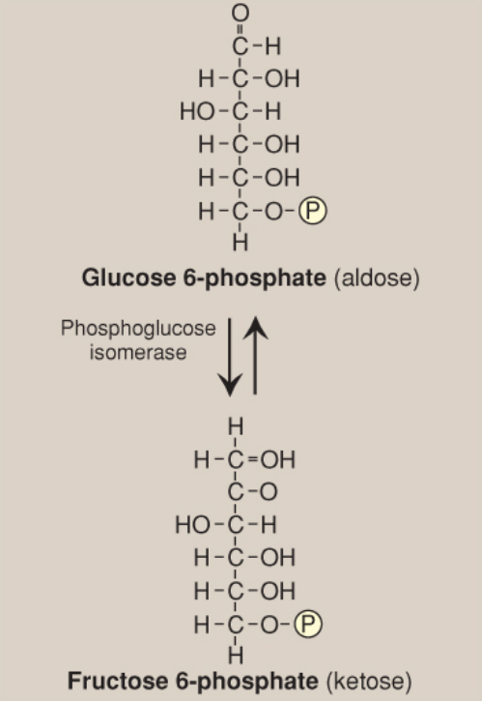
Reactions of Glycolysis
Aldose-ketose isomerization of glucose 6-phosphate to fructose 6- phosphate.

Slide 24
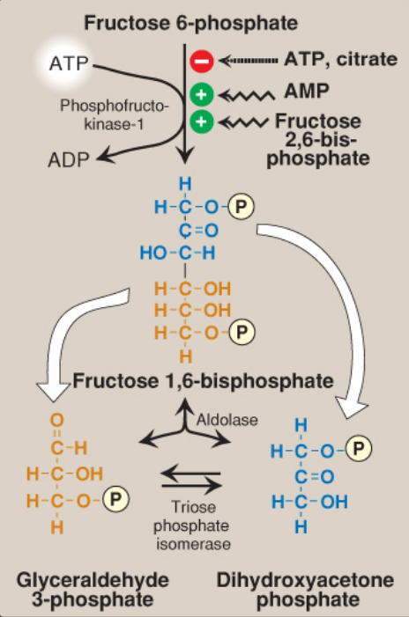
Reactions of Glycolysis
Energy-investment phase (continued): conversion of fructose 6-phosphate to triose phosphates.

Slide 25
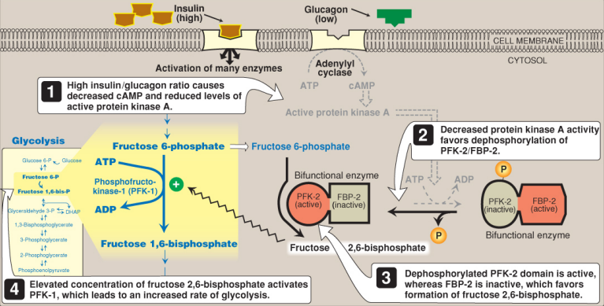
Insulin Effect on fructose 2,6-bisphosphate
Effect of elevated insulin concentration on the intracellular concentration of fructose 2,6-bisphosphate in the liver.

Slide 26
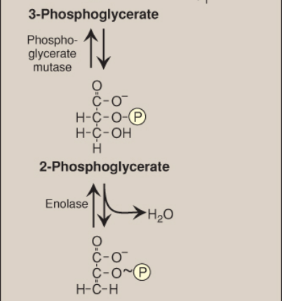
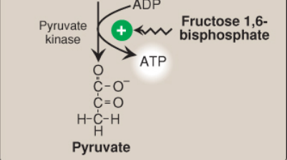
Energy-Generating Phase
conversion of glyceraldehyde 3- phosphate to pyruvate
Core Concept

Slide 27
Pyruvate Reduction to Lactate
Interconversion of pyruvate and lactate by lactate dehydrogenase (LDH). NAD(H) = nicotinamide adenine dinucleotide.

Slide 28
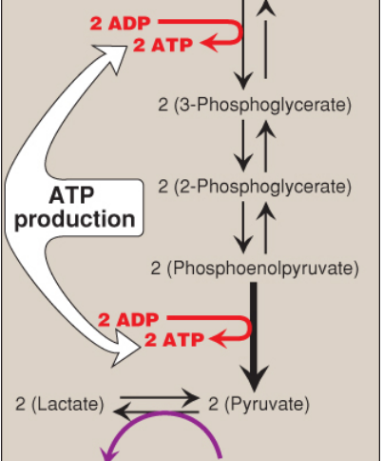
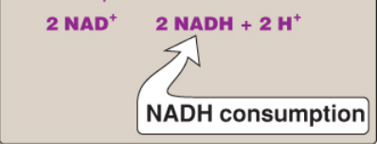
Summary of Glycolysis

Slide 29
Energy Yield from Anaerobic Glycolysis
A net of 2 molecules of ATP are generated for each molecule of glucose converted to 2 molecules of lactate
There is no net production or consumption of NADH

Slide 30
Energy Yield from Aerobic Glycolysis
The generation of ATP is the same as in anaerobic glycolysis that is a net gain of 2 ATP per molecule of glucose
2 molecules of NADH are also produced per molecule of glucose
Each NADH produces 3 ATP by passing through ETC

Slide 31
Vertical Integration

Slide 32
Pyruvate kinase deficiency
Alterations observed with various mutant forms of pyruvate kinase.

Slide 33
Pyruvate kinase deficiency

Slide 34
Family Medicine
Family Medicine plays important role in following manner:
Supportive care
Make appropriate tests to confirm diagnosis
Counsel the patient about the autosomal recessive disorder
Management of the blood transfusion depending upon the severity of disorder
Refer to Specialists for further management

Slide 35
Artificial Intelligence
Artificial Intelligence plays role in following aspects:
Diagnosis
Treatment optimization
Personalized care

Slide 36
How To Access Digital Library
Steps to Access HEC Digital Library
Go to the website of HEC National Digital Library.
On Home Page, click on the INSTITUTES.
A page will appear showing the universities from Public and Private Sector and other Institutes which have access to HEC National Digital Library HNDL.
Select your desired Institute.
A page will appear showing the resources of the institution
Journals and Researches will appear
You can find a Journal by clicking on JOURNALS AND DATABASE and enter a keyword to search for your desired journal.

Slide 37
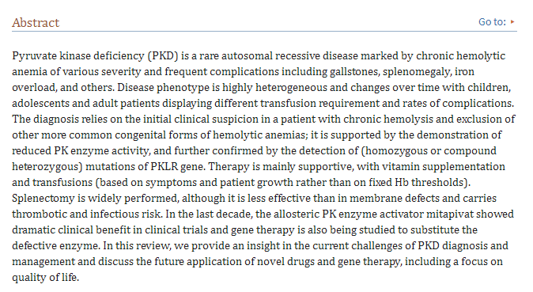
Suggested Research Article
Link:
https://www.ncbi.nlm.nih.gov/pmc/articles/PMC9444143/#:~:text=Pyruvate%20kinase%20deficiency%20(PKD)%20is%20a%20congenital
Journal Name:
PubMed Central
Title:
Pyruvate Kinase Deficiency: Current Challenges and Future Prospects
Author Name:
Bruno Fattizzo et al.
Abstract:

Slide 38
Bioethics
Informed consent
Ethical consideration regarding genetic testing, new born screening and treatment options
Nutritional support
Access to health care
Spiral Integration

Slide 39
Assesment

Slide 40
MCQS
1. Which of the following is NOT a product of glycolysis?
A. ATP
B. NADH
C. Pyruvate
D. CO₂
E. None of them

Slide 41
MCQS
2. Which enzyme is NOT involved in the glycolytic pathway?
A. Hexokinase
B. Phosphofructokinase-1
C. Pyruvate kinase
D. Citrate synthase
E. None of them

Slide 42
MCQS
3. Which of the following steps in glycolysis is NOT reversible?
A. Glucose → Glucose-6-phosphate
B. Fructose-6-phosphate → Fructose-1,6-bisphosphate
C. Glyceraldehyde-3-phosphate → 1,3-Bisphosphoglycerate
D. Phosphoenolpyruvate → Pyruvate
E. None of them

Slide 43
MCQS
4. Which molecule is NOT required as a substrate or coenzyme in glycolysis?
A. Glucose
B. NAD⁺
C. ADP
D. FAD
E. None of them

Slide 44
MCQS
5. Which of the following is NOT a regulatory enzyme of glycolysis?
A. Hexokinase
B. Phosphofructokinase-1
C. Pyruvate kinase
D. Glucose-6-phosphatase
E. None of them

Slide 45
MCQS KEY
1. d
2. d
3. b
4. d
5. d

Slide 46
Learning Resources
Text book of Biochemistry, Lippincott 8th edition, chapter no. 08 , page no. 100
Google scholar
Google images

