Slide 2
Motto Vision; The Dream/Tomorrow
To impart evidence based research oriented medical education
To provide best possible patient care
To inculcate the values of mutual respect and ethical practice of medicine
Wisdom
Truth
Service

Slide 3
2nd Year MBBS Gastrointestinal Tract Module Large Group Interactive Session (LGIS) Gluconeogenesis
Date: 20-03-2023
Updated: 10-02-2024
Delivering Date:
Dr. Romessa Naeem
Biochemistry Department

Slide 4
Learning Objectives
At the end of the LGIS, students will be able to:
Explain Gluconeogenesis
Describe regulation of Gluconeogenesis

Slide 5
Sequence of LGIS
Horizontal Integration
Location of Gluconeogenesis
Steps of gluconeogenesis
Energetics
Cori’s Cycle
Regulation
Vertical Integration

Slide 6
Professor Umar Model of Integrated Lecture
60%
Core Subject
20%
Horizontal
Integration
Physiology
Anatomy
8%
Vertical Integration
Pathology
Pharmacology
7%
Vertical Integration
Clinical Integration
5%
Vertical Integration
Research, Professionalism
Ethics
Digital library

Slide 7
Horizontal Integration

Slide 8
Anatomy of Liver

Slide 9
Physiology of Liver

Slide 10
Core Concept

Slide 11
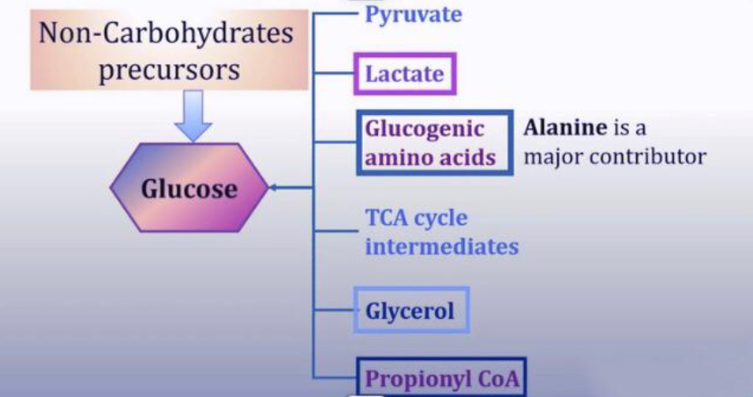
Gluconeogenesis

Slide 12
Site of Gluconeogenesis

Slide 13
Significance of Gluconeogenesis

Slide 14
4 Key Reactions of Gluconeogenesis

Slide 15
4 Key Reactions of Gluconeogenesis

Slide 16
Energy Consumption of Gluconeogenesis

Slide 17
Cori’s Cycle

Slide 18
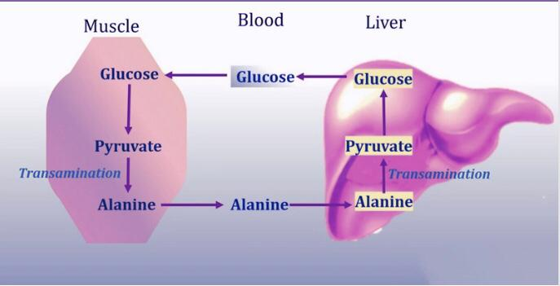
Glucose Alanine Cycle

Slide 19
Gluconeogenesis from Glucogenic Amino Acids

Slide 20
Gluconeogenesis From Glycerol

Slide 21
Gluconeogenesis From Propionyl CoA

Slide 22
Regulation of Gluconeogenesis

Slide 23
Vertical Integration

Slide 24
Pyruvate Carboxylase Deficiency

Slide 25
Family Medicine

Slide 26
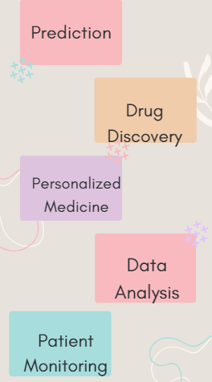
Artificial Intelligence

Slide 27
Bioethics
Spiral Integration

Slide 28
How To Access Digital Library
Steps to Access HEC Digital Library
Go to the website of HEC National Digital Library.
On Home Page, click on the INSTITUTES.
A page will appear showing the universities from Public and Private Sector and other Institutes which have access to HEC National Digital Library HNDL.
Select your desired Institute.
A page will appear showing the resources of the institution
6. Journals and Researches will appear
7. You can find a Journal by clicking on JOURNALS AND DATABASE and enter a keyword to search for your desired journal.

Slide 29
Suggested Research Article
Abstract: Gluconeogenesis is a critical biosynthetic process that helps maintain whole-body glucose homeostasis and becomes altered in certain medical diseases. We review gluconeogenic flux in various medical diseases, including common metabolic disorders, hormonal imbalances, specific inborn genetic errors, and cancer. We discuss how the altered gluconeogenic activity contributes to disease pathogenesis using data from experiments using isotopic tracer and spectroscopy methodologies. These in vitro, animal, and human studies provide insights into the changes in circulating levels of available gluconeogenesis substrates and the efficiency of converting those substrates to glucose by gluconeogenic organs. We highlight ongoing knowledge gaps, discuss emerging research areas, and suggest future investigations. A better understanding of altered gluconeogenesis flux may ultimately identify novel and targeted treatment strategies for such diseases.
Link : https://pubmed.ncbi.nlm.nih.gov/37603427/#full-view-affiliation-1
Journal Name :
Annu Rev Nutr
Title: Gluconeogenesis Flux in Metabolic Disease -
Author Name: Ankit Shah ¹, Fredric E Wondisford

Slide 30
Assessment
Q1: A child with low blood glucose is unable to do glycogenolysis or gluconeogenesis. Which of the following enzyme is missing in the child?
Fructokinase
Glucokinase
Glucose 6 Phosphatase
Transketolase
Pyruvate carboxylase

Slide 31
MCQ
Q2: Phosphofructokinase-1 is activated by all except:
5’AMP
Fructose 2, 6 Bisphosphate
Fructose 6 Phosphate
Citrate
AMP

Slide 32
MCQ
Q3: Common enzyme for gluconeogenesis and glycolysis is:
Glyceraldehyde 3 PO4 dehydrogenase
Hexokinase
Pyruvate kinase
Pyruvate carboxylase
Transketolase

Slide 33
MCQ
Q4: During prolong fasting, rate of gluconeogenesis is determined by:
Essential Fatty Acid in liver
Alanine in liver
Decreased c GMP
ADP in liver
Glycerol

Slide 34
MCQ
Q5: Which of the following is not a gluconeogenic substrate?
Alanine
Acetyl-CoA
Pyruvate
Glycerol
Phosphofructokinase

Slide 35
Key
Q1: c
Q2: d
Q3: a
Q4: b
Q5: b

Slide 36
Learning Resources
Text Book of Biochemistry, Lippincott 8th edition, chapter no,10 page #128-134
Google scholar
Google images

