Slide 2
Motto Vision; The Dream/Tomorrow
To impart evidence based research oriented medical education
To provide best possible patient care
To inculcate the values of mutual respect and ethical practice of medicine
Wisdom
Truth
Service

Slide 3
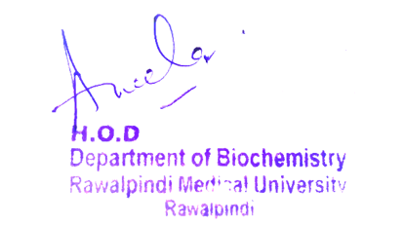
2nd Year MBBS Gastrointestinal tract module Module Large Group Interactive Session (LGIS) Gastric Juice
Date: 18-03-2023
Delivering date: 9-03-2024
Dr. Almas
Biochemistry Department
RMU

Slide 4
Sequence of LGIS
Learning Objectives
Horizontal Integration
Core Concept
Vertical Integration
Spiral Integration
Learning Resources

Slide 5
Learning Objective
At the end of the session the students must have gained:
Understanding of the following aspects of Gastric Juice:
1.composition
2.function
3.formation
4.related disorders
Applied knowledge of Peptic ulcer disease

Slide 6
Professor Umar Model of Integrated Lecture
60%
Core Subject
20%
Horizontal
Integration
Physiology
Anatomy
8%
Vertical Integration
Pathology
Pharmacology
7%
Vertical Integration
Clinical Integration
5%
Vertical Integration
Research, Professionalism
Ethics
Digital library

Slide 7
Horizontal Integration

Slide 8
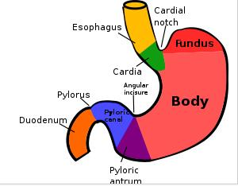
Stomach

Slide 9
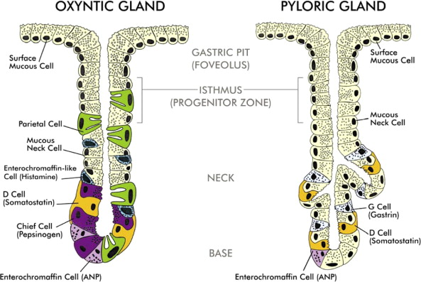

Slide 11
Core Concept

Slide 12
Gastric Juice
Physical Properties
Clear pale yellow fluid
Volume : 1200 mL/day - 1500 mL/day, however the daily secretion may reach upto 2500 ml/day.
Reaction : highly acidic with pH of 0.9 - 1.2 (due to HCl), pH is generally between 1.0 — 2.0
Specific gravity : 1.002 to 1.004
Always small quantity of gastric juice present in stomach, even when it contains no food, known as fasting juice
Secretion reaches maximum level about 1 hour after meal
Declines to fasting level after about 4 hours of meal

Slide 13
Composition
Water – 99%, Solids – 1%,
Organic Solid Matter
Inorganic Solid Matter
Cations
Na⁺
K⁺
Mg ²⁺
H⁺
Anions
PO₄³⁻
SO₄²⁻
HCO₃
Mucin
Pepsinogen
Intrinsic factor
Gastric Lipase
Gelatinase
Rennin
Traces of Lactic acid

Slide 14
Functions of Gastric Juice
Water further liquefies food swallowed
Acidification of food by HCl
Kills ingested microbes; non specific defence against microbes
Temporary storage allowing time for digestive enzymes to act
Chemical digestion breaks proteins into polypeptides
Mechanical breakdown
Limited absorption
Preparation of Fe for absorption
Production & and secretion of intrinsic factors needed for absorption of vit.B₁₂
Regulation of passage of gastric contents into duodenum.

Slide 15
Functions of Gastric Juice
Protection of mucosa
Mucus
Bicarbonate
Digestion & absorption of food, control of motility
Acid
Gastrin
Pepsinogen
Cholecystokinin
Intrinsic factor
Histamine

Slide 16
Mechanism of HCL Secretion
Secretion of HCl is an active process, requires energy, provided by ATP
H⁺ actively secreted into canaliculus in exchange for K⁺
Active exchange process catalysed by , H⁺- K ⁺ ATPase known as "proton pump“. It is the key player in acid secretion and is located in canalicular membrane.
CO₂ (produced by result of cell metabolism or diffused from blood into oxyntic /parietal cells) combines with H₂O
Hydration of CO₂ results in formation of H₂CO₃, catalysed by carbonic anhydrase
Parietal cells are rich in this enzyme
CO₂ + H₂O →→→ H₂CO₃
Carbonic acid formed dissociates into HCO⁻₃ & H⁺ ions
HCO₃⁻ is transported out of basolateral membrane in exchange for Cl-
Cl⁻ , most abundant anion present in interstitial fluid

Slide 17
Mechanism of HCL Secretions
K+ enters parietal cell through exchange of Na+ by Na/K ATPase
Carbonic anhydrase catalyses reaction between CO₂ & H₂O to form H₂CO₃ which dissociates into H⁺ & HCO₃⁻
H⁺ leave cell through H+/K+ ATPase antiporter pumps
Na+ actively reabsorbed, indicating majority of secreted K+ & Na+ return to cytoplasm

Slide 18
Mechanism of HCL Secretions
H+ is pumped out of cell, into the lumen, in exchange for K+ through action of proton pump (K effectively recycled)
Accumulation of osmotically active H+ in canaliculus generates osmotic gradient across membrane, resulting in outward diffusion of water
Key substrate in production of gastric acid is CO₂; diffusion of CO₂ through basal surface of parietal appears to be rate limiting step in acid synthesis

Slide 19
Mechanism of HCl Secretion
Parietal cells of gastric glands secrete HCl with pH of 0.87 parietal cells secrete H⁺ ions against more than 2 million fold concentration gradient across cell membrane of thickness 5nm. In apical membrane of parietal cells pumps H⁺ ions against concentration gradient of such steep magnitude
Chloride & hydrogen ions are secreted separately from cytoplasm of parietal cells and mixed in canaliculi
Gastric acid then secreted into lumen of gastric gland and gradually reaches main stomach lumen

Slide 20
Function of HCl
HCl activates pepsinogen to pepsin, inactive at pH above 5
HCl has antiseptic action, kills many ingested bacteria & prevents growth of microorganism in stomach
Hypochlorhydria (lack of HCl in gastric juice) or Achlorhydria (total absence of HCl in gastric juice) leads to increased microbial growth in stomach shown by increased level of lactic acid in gastric juice
HCl stimulates flow of bile & pancreatic juice through secretin (hormone produced by intestinal cells in response to low pH of chyme)
Helps in Fe absorption & converts Fe from ferric (Fe⁺³) to ferrous (Fe⁺²) form which is easily absorbed
Helps in releasing Fe from its bound form in food

Slide 21
HCL Secretion
Stimulates of HCL Secretion
Depressants OF HCL Secretion
include :
parasympathetic nervous stimulation & Ach
alcohol
nicotine
gastrin
proteins
histamine
food flavors
Ca ions
medications(cholinergic drugs)
caffeine
include :
fats
acids
alkalis
parasympatholytic drugs
proton pump inhibitor
prostaglandin
somatostatin

Slide 22
Regulation of HCl Secretion
Regulated by:
Autonomic Nervous System :
PNS via vagus nerve
Several Hormones :
Hormone gastrin stimulate parietal cell to produce gastric acid, directly acting on parietal cells and indirectly through stimulation of secretion of histamine from ECL cells
Vasoactive intestinal peptide, cholecystokinin & secretin all inhibit production

Slide 23
Histamine
Most important stimulant of gastric juice secretion
Released/Secreted from Enterochromaffin Cells (ECL) lying in deep recess of oxyntic glands, releasing Histamine in direct contact with parietal cells of glands
Acts directly on the parietal cells through H2 receptors to act synergistically with gastrin & acetylcholine to stimulate acid production
H2 receptors increase intracellular camp by activating adenylyl cyclase, which activates protein kinase, stimulating Proton Pump
Release is stimulated by the action of both gastrin and acetylcholine on the ECL itself

Slide 24
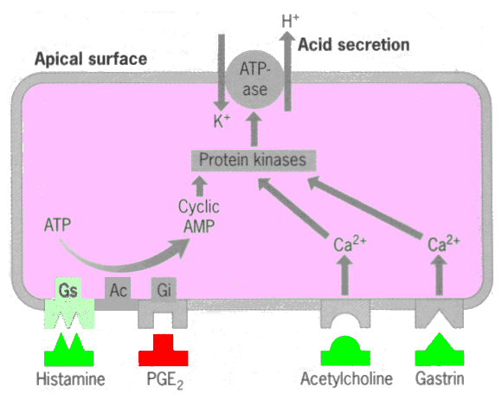

Slide 25
Gastrin
Gastrin is a hormone secreted by gastrin cells (G cells), located in the pyloric glands in the distal end of the stomach.
Gastrin is a large polypeptide
Protein rich food reaches the antrum & stimulates the G cells in the pyloric glands causing release of gastrin into the blood, it is transported to the ECL cells of the stomach. This causes release of Histamine directly into the deep oxyntic glands. Histamine acts to stimulate gastric HCl secretion
Net result of gastrin secretion is increased acid production through two mechanisms
direct stimulation of parietal cells
trophic action on parietal cells increasing their number
Acts Mainly through ECL cells by
releasing histamine
increasing intracellular Ca⁺⁺ (some extent directly

Slide 26
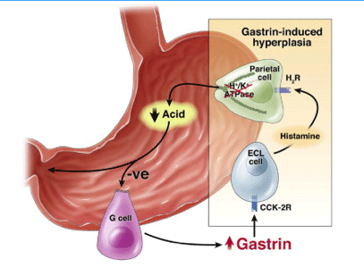

Slide 27
Gastric juice
Prostaglandin
PG, especially E series, inhibits acid secretion by decreasing camp formation
Stimulate mucus and bicarbonate secretion
Somatostatin
Inhibits release of Histamine through ECL
Secretion gets decreased by Acetylcholine

Slide 28
Enzymes
Pepsin
Acid stable endopeptidase is secreted by serous cells of stomach
Potent proteolytic enzyme, secreted as inactive zymogen form, pepsinogen
99% poured in gastric juice as pepsinogen, remaining 1 % is secreted in blood
Ultimately excreted in urine as uropepsin

Slide 29
Pepsin
Optimum pH for pepsin is 1.6- 2.3
Pepsinogen with mol. wt. of 42,500 is split to form pepsin with mol. wt . of 35,000
Pepsin is mainly of 2 types with different compositions & optimum values
Derived from different precursors called Pepsinogen I & II or Pepsinogen A & B
Secreted in the inactive Zymogen form, which is initially activated to pepsin by the HCl in the gastric juice. Activation occurs rapidly at a pH below 2 by the loss of peptide on the side containing free amino (NH2) group
Once pepsin is formed, rapidly activates pepsinogen
Process is known as “autocatalysis"

Slide 30
Pepsin
Pepsin is a powerful proteinase, it converts proteins to smaller fragments i.e. polypeptides by hydrolyzing specific peptide bonds
Eg……
Active on peptide bond which connects carboxyl group of aromatic amino acid like
Phenylalanine
Tyrosine
Tryptophan
Pepsin can hydrolyze peptide bonds of
Methionine & Leucine
Leucine & Glutamic Acid
Glutamic acid & Asparagine
Leucine & Valine
Valine & Cysteine

Slide 31
Pepsin
Pepsin curdles milk
Hydrolyses soluble phosphor-protein of milk, casein, to produce paracasein & proteose (whey protein )
Paracasein is then precipitated as calcium paracaseinate which is digested by pepsin to peptones
Pepsin is not essential for protein digestion as its absence doesn't cause any marked impairment of protein digestion & absorption

Slide 32
Gastric Lipase
Gastric Lipase is secreted by gastric mucosa
Optimum pH of 4.0 - 6.0
Relatively acid stable
Hydrolyses TAG molecule (particularly those containing fatty acids of short or medium chain length; less than 12 C FA as found in milk)
Gastric Lipase activity requires presence of Ca⁺⁺
Plays important role in lipid digestion in neonates
30% of dietary fat may be digested in stomach

Slide 33
Rennin
Absent in adult human
Certain amount of Rennin activity is seen in infants
Optimum pH for its activity is 4.0
Prevents rapid passage of milk from the stomach
In presence of calcium, Rennin changes casein of milk to paracasein digested by pepsin
Gelatinase
Liquefies gelatin
Not found in adults
Gastric juice has urease activity which produces to some extent ammonia from urea

Slide 34
Mucin
Mucinmucus is made up of glycoproteins called Mucins that form flexible gel coating mucosa
Much of HCO₃_ is trapped in mucus gel, establishing pH gradient that ranges from pH 1.0 - 2.0 at luminal side to pH of 6.0 - 7.0 at mucosal surface

Slide 35
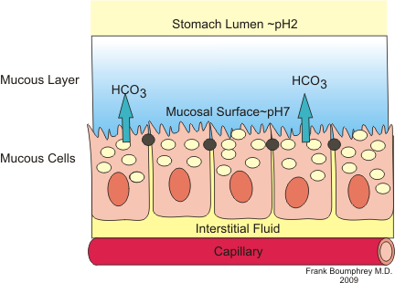

Slide 36
Mucin
Acid in gastric juice is concentrated enough to cause tissue damage, auto digestion
If mucus is not continuously secreted in conjunction with HCO₃⁻, mucosa is at risk of damage from digestive action of gastric juice
Without combination of mucus & HCO₃⁻, mucus layer alone could only resist diffusion of H+ ions for about 10 minutes

Slide 37
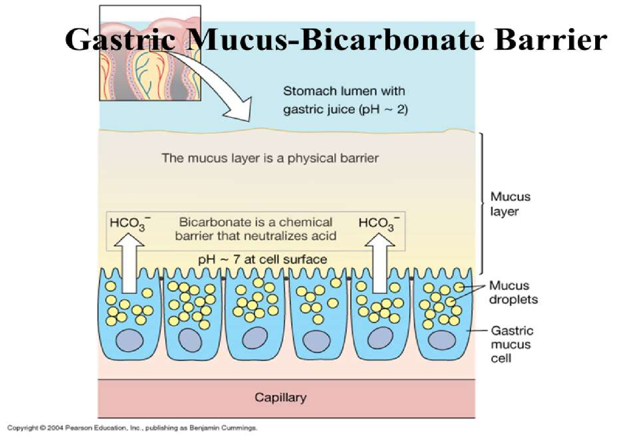

Slide 38
Mucin
Several types
Some resistance to auto digestion also provided by Trefoil Peptides present in mucosa. Trefoil peptides are mainly synthesized & secreted by the mucin secreting epithelial cells lining the GIT
Trefoil Peptides play role in mucosal integrity/defence, repair of lesions, limiting epithelial cell proliferation & protection of epithelium from broad range of toxic chemicals & drugs
Heat, acid and enzyme resistant
Cells in epithelium of stomach are bound by tight epithelial junctions which play role in protection of stomach lining

Slide 39
Glycoprotein secreted by parietal cells in gastric mucosa
Binds Cyanocobalamine (Vit. B₁₂) & is necessary for its absorption from ileum
Formation of Intrinsic Factor is only function of stomach that is essential for health & life
Upon entry into stomach, vitamin B₁₂ becomes bound to ‘haptocorrin’ (R factor), glycoprotein with resulting complex entering duodenum, where pancreatic enzymes digest haptocorrin
In less acidic environment of small intestine, B₁₂ binds to intrinsic factor
Complex of vitamin B₁₂ & IF travels to ileum, where special epithelial cells endocytose it
Complex is taken up by cubilin receptors in distal ileum
Inside cell, B₁₂ dissociates once again & binds to another protein, transcobalamin II
New complex can exit epithelial cells to enter liver

Slide 41
Cyanocobalamin (Vit B12) deficiency is caused by
Gastrectomy. In a patient of total gastrectomy, IF deficiency must be circumvented by parental administration of Vit B₁₂
Pernicious anemia. (Autoimmune destruction of parietal cells)

Slide 42
Vertical Integration

Slide 43
Helicobacter Pylori infections disrupt mucosal barrier
prolonged excessive secretions of acid as in gastrinomas (Zollinger Ellisons Syndrome)
Increased liberation of Histamine in body (severe burns) leads to increased HCl secretions causing Curlings ulcers (acute gastric erosions due to Cx of severe burns when reduced plasma vol leads to ischaemia & cell necrosis of the gastric mucosa

Slide 44
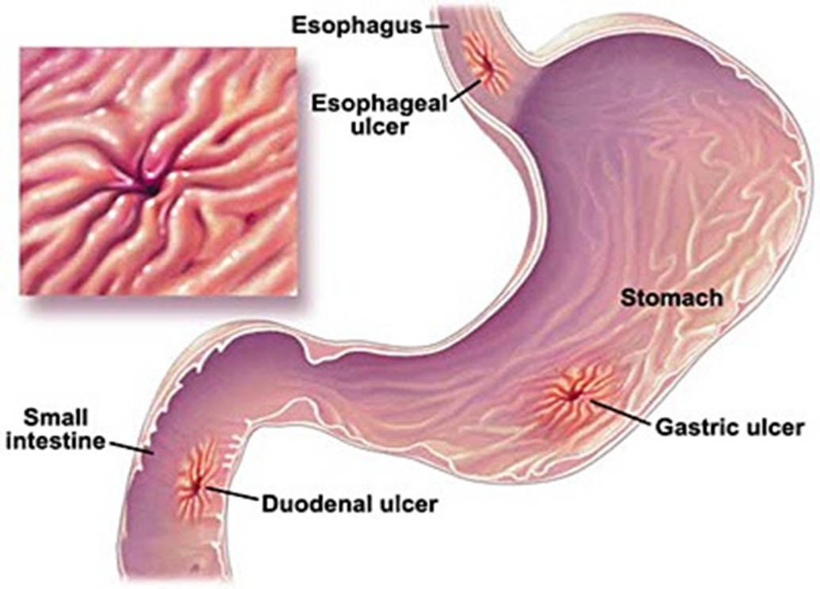

Slide 45
Family Medicine
Family medicine plays an important role in following manner:
Diagnosis should be made patients with mild peptic ulcer disease should be manage at near by family health clinics antacids should be given
Early fluid resuscitation
Vital sigh should be monitored and stabilized
If no improvement than refer the patient to the specialists

Slide 46
Artificial Intelligence
Artificial Intelligence plays role in following aspects :
Machine learning models have shown promise in improving diagnostic accuracy and predicting outcomes for peptic ulcer disease
Al algorithms demonstrate significant promise in diagnosing and prognosticating peptic ulcer often surpassing traditional methods

Slide 47
Suggested Research Article
Abstract:
Gastric juice is a unique combination of hydrochloric acid (HCl), lipase, and pepsin. Acidic gastric juice is found in all vertebrates, and its main function is to inactivate microorganisms. The phylogenetic preservation of this energy-consuming and, at times, hazardous function (acid-related diseases) reflects its biological importance. Proton pump inhibitors (PPIs) are one of the most widely used drugs in the world. Due to the reduced prevalence of Helicobacter pylori infection as well as the increased use of inhibitors of gastric acid secretion, the latter has become the most important cause of gastric hypoacidity. In the present manuscript, we review the microbiological consequences of removing gastric acidity. The resulting susceptibility to infections has not been studied extensively, and focus has mainly been restricted to bacterial and parasitic agents only. The strongest evidence concerning the relationship between hypochlorhydria and predisposition to infections relates to bacterial infections affecting the gastrointestinal tract. However, several other clinical settings with increased susceptibility to infections due to inhibited gastric acidity are discussed. We also discuss the impact of hypochlorhydria on the gut microbiome.
Link : https://www.ncbi.nlm.nih.gov/pmc/articles/PMC6928904/
Journal Name :National Institute of Health
Title : Gastric Juice
Author Name : David S.Wilson and Jack W.Szos

Slide 48
Bioethics
Informed consent of treatment
Access to healthcare
Privacy of personal information
Doctor-patient confidentiality
Spiral Integration

Slide 49
Assessment
Q1. What is gastric juice ?
Q2. What are the function of gastric juice ?
Q3. What is the function of HCL?
Q4. What is gastrin ?
Q5. What is the function of pepsin?

Slide 50
Learning Resources
Essentials of Medical Biochemistry by Mushtaq Ahmed. Ninth edition, Vol 1, chapter 10, page 210.
Guyton and Hall Textbook of Medical Physiology by John E. Hall, Michael E. Hall. Fourteenth edition, Unit XII, chapter 65, page 811

