Slide 1


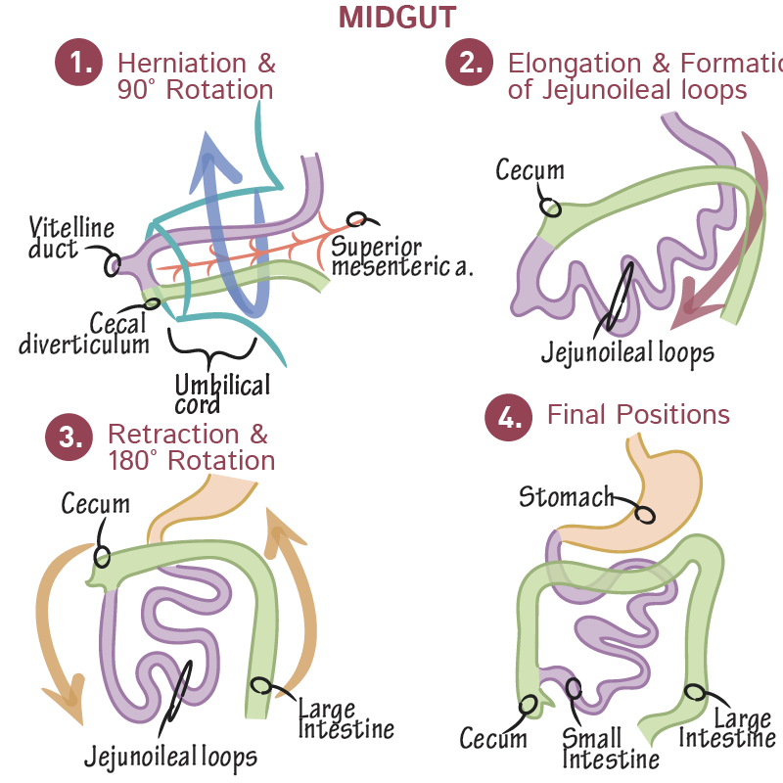
Gastrointestinal Tract (GIT) Module
2nd Year MBBS(LGIS)
Development of Small Intestine
Presenter: Prof.Dr. Ifra Saeed Date: 23-01-25

Slide 2
Learning objectives
At the end of the session, student will be able to
Describe development of small intestine (Core Concept)
Discuss rotation of midgut(Core Concept)
Functions of small Intestine (Horizontal Integration)
Discuss congenital abnormalities of small intestine(Vertical Integration
Correlate and build core knowledge on the basis of latest research(Spiral Integration)
Approach to patient of ventral body wall defects (Family Medicine, Spiral integration)
Artificial Intelligence techniques to monitor fetus (Artificial Intelligence, Spiral Integration)

Slide 3
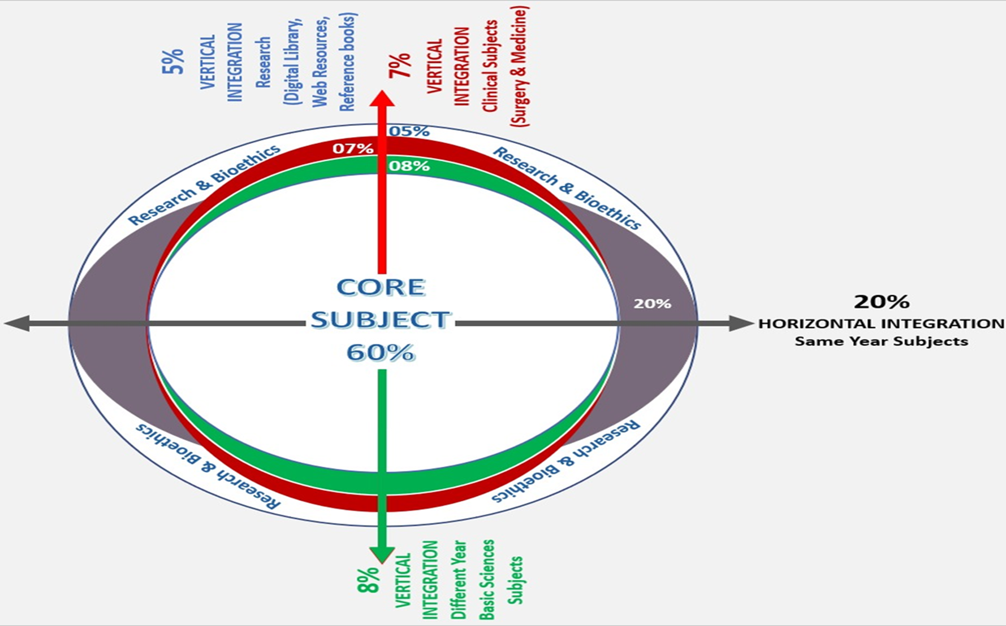
Prof Umar’s model of clinically oriented integrated lecture First and Second year MBBS
Core subject | 70%
Horizontal integration ( Same year subjects) Anatomy, Biochemistry, Physiology | 10%
Vertical Integration (Basic sciences subjects of different years(Forensic Medicine, Pharmacology, Community medicine | 8%
Vertical Integration Clinical Subjects (Medicine, Surgery, Gynae/Obs etc) | 7%
Longitudinal/ ongoing integration ( Bioethics, Research, Artificial Intelligence, Family Medicine | 5%

Slide 4
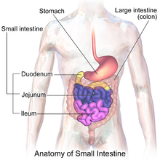

Development of Small intestine
Duodenum
Jejunum
Ileum

Slide 5
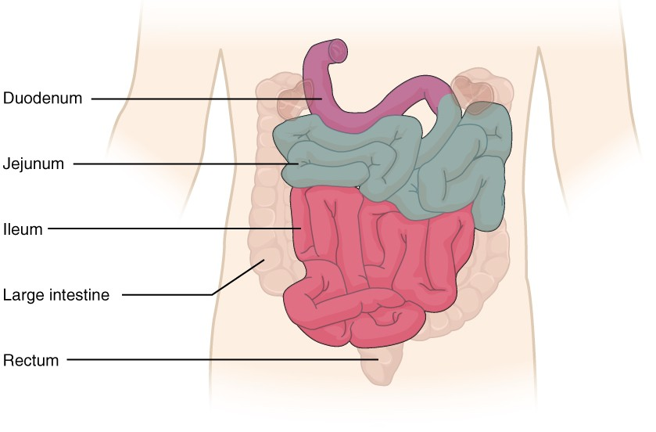
Gross Anatomy
The small intestine is about five times longer than the large intestine but has a smaller diameter (about 2.54cm versus 7.62cm), which is why it is called 'small'.
It comprises the duodenum (25cm), jejunum (around 2.5m) and ileum (around 3.5m).
Core Knowledge

Slide 6
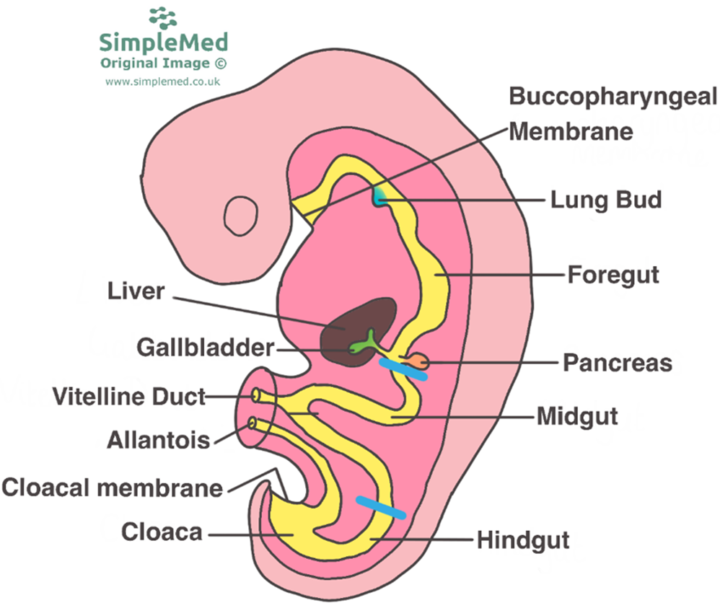


Slide 7
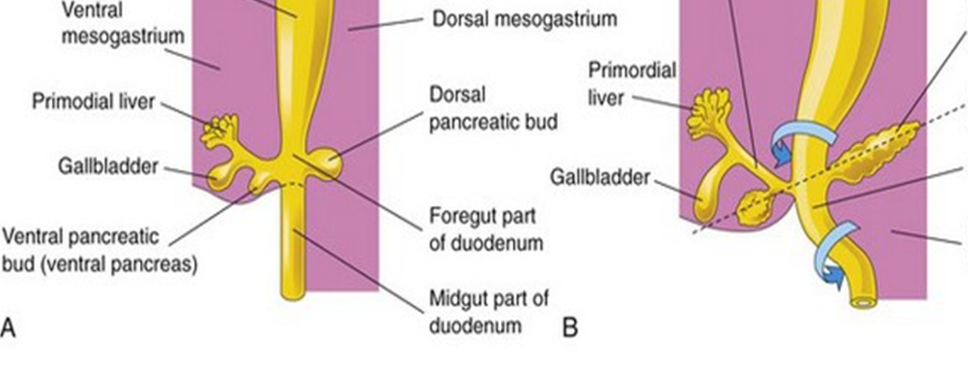
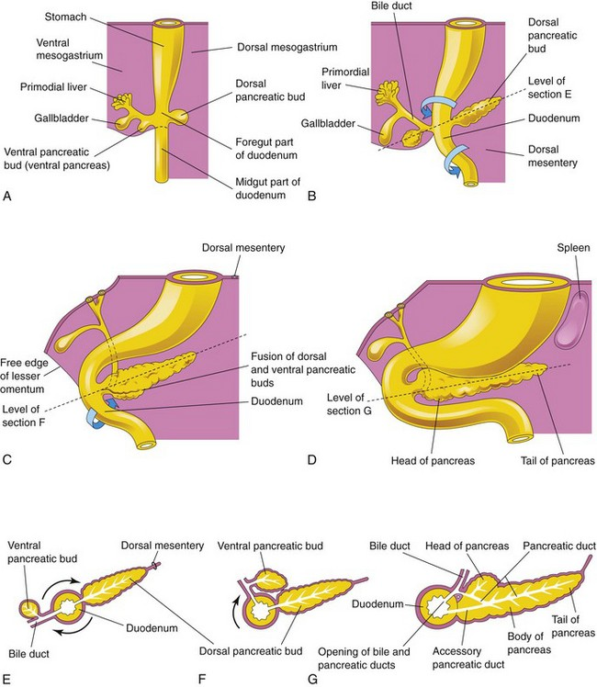
Development of Small intestine (duodenum)
Fourth week
develops from
i. Distal part of the foregut
ii. Proximal part of the midgut
iii. Splanchnic mesenchyme

Slide 8
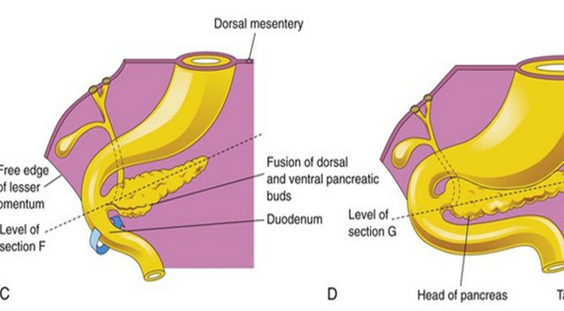
The junction of the two parts of the duodenum is just distal to the origin of the bile duct
The developing duodenum grows rapidly, forming a C-shaped loop that projects ventrally

Slide 9
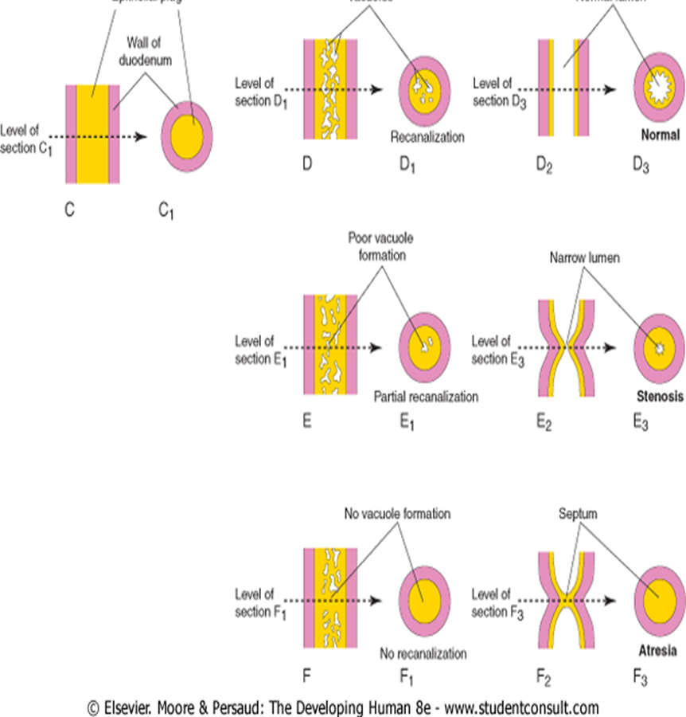
As the stomach rotates, the duodenal loop rotates to the right and comes to lie retroperitoneally (external to peritoneum).
Blood supply of duodenum
During the fifth and sixth weeks, the lumen of the duodenum is temporarily obliterated
Recanalization by end of embryoic period
Most of the ventral mesentery of the duodenum has disappeared.

Slide 10
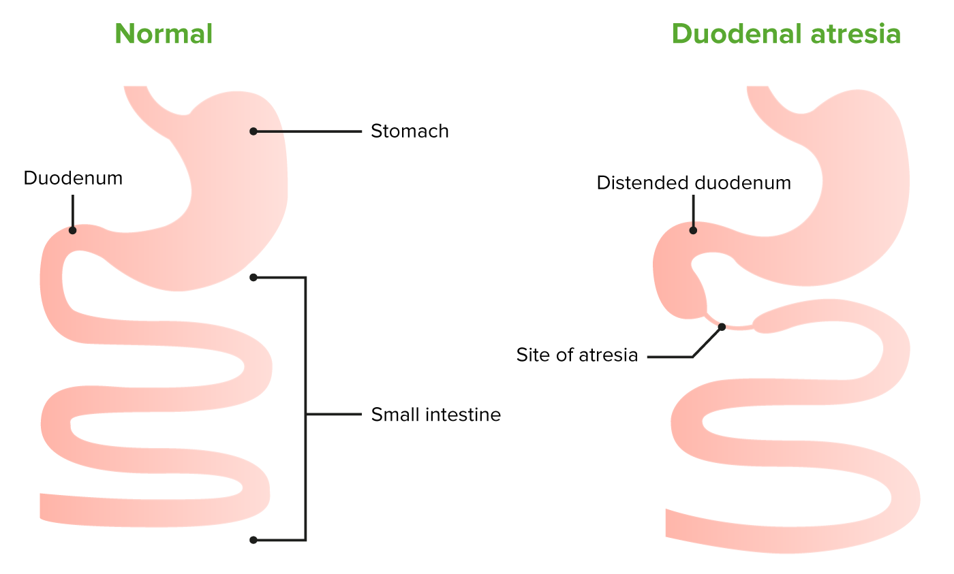
Duodenal Atresia
Complete occlusion of the lumen of the duodenum-duodenal atresia is not common. During early duodenal development, the lumen is completely occluded by epithelial cells. If recanalization of the lumen fails to occur a short segment of the duodenum is occluded Sites : nearly always at the junction of the bile and pancreatic ducts the horizontal (third) part of the duodenum. Investigation of families with familial duodenal atresia suggests an autosomal recessive inheritance.
Vertical integration

Slide 11
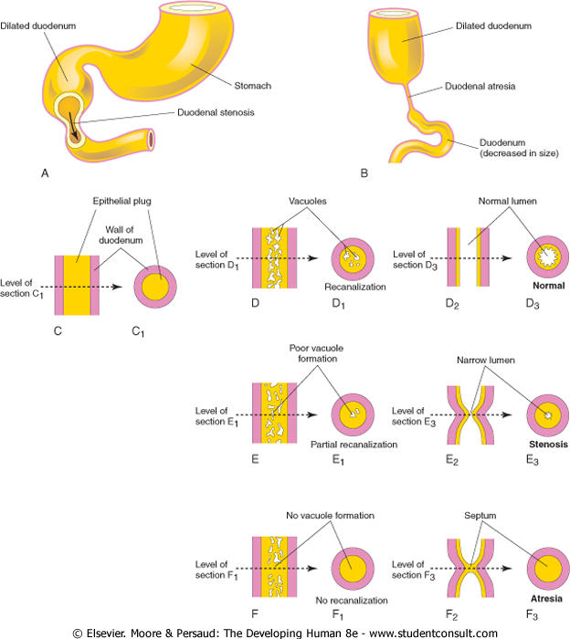

Duodenal Stenosis
Partial occlusion of the duodenal lumen-duodenal stenosis -usually results from incomplete recanalization of the duodenum resulting from defective vacuolization Most stenoses involve the horizontal (third) and/or ascending (fourth) parts of the duodenum. Because of the stenosis, the stomach's contents (usually containing bile) are often vomited.

Slide 12


Development of Mid Gut
The derivatives of the midgut
The small intestine, including the duodenum distal to the opening of the bile duct
The cecum, appendix, ascending colon, and the right half to two thirds of the transverse colon

Slide 13
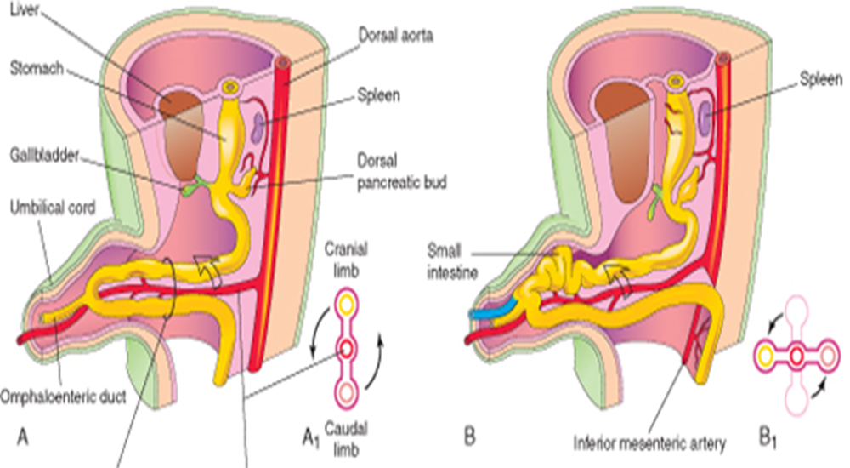
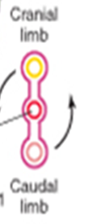
Physiological herniation of midgut
The midgut elongates, it forms a ventral, U-shaped loop of gut-the midgut loop of the intestine
6th week
projects into proximal part of the umbilical cord.

Slide 14
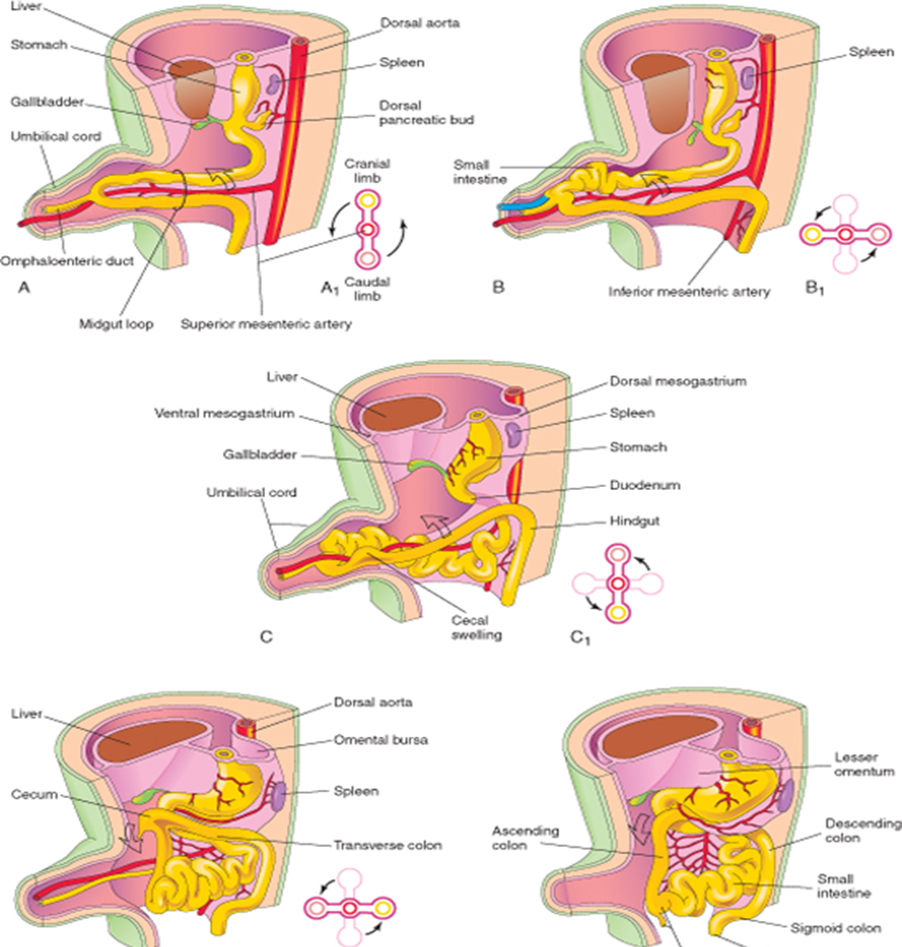
The cranial limb grows rapidly,
but the caudal limb undergoes very little change except for development of the cecal swelling.

Slide 15
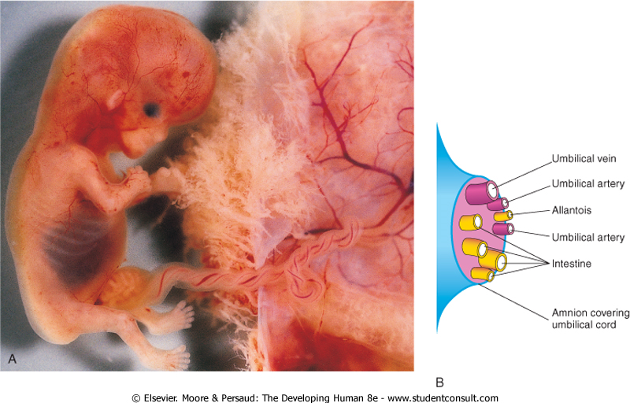

Slide 16
Rotation of Midgut
While it is in the umbilical cord, the midgut loop rotates 90 degrees counterclockwise
This brings the cranial limb of the midgut loop to the right and the caudal limb to the left.
During rotation, the cranial limb elongates and forms intestinal loops

Slide 17
Return of the Midgut to the Abdomen
During the 10th week,
the intestines return to the abdomen
Due to the enlargement of the abdominal cavity, and the relative decrease in the size of the liver and kidneys
The small intestine returns first, and occupies the central part of the abdomen.

Slide 18
Second rotation
As the large intestine returns, it undergoes a further 180-degree counterclockwise rotation
Later it comes to occupy the right side of the abdomen.
The ascending colon becomes recognizable as the posterior abdominal wall progressively elongates

Slide 19
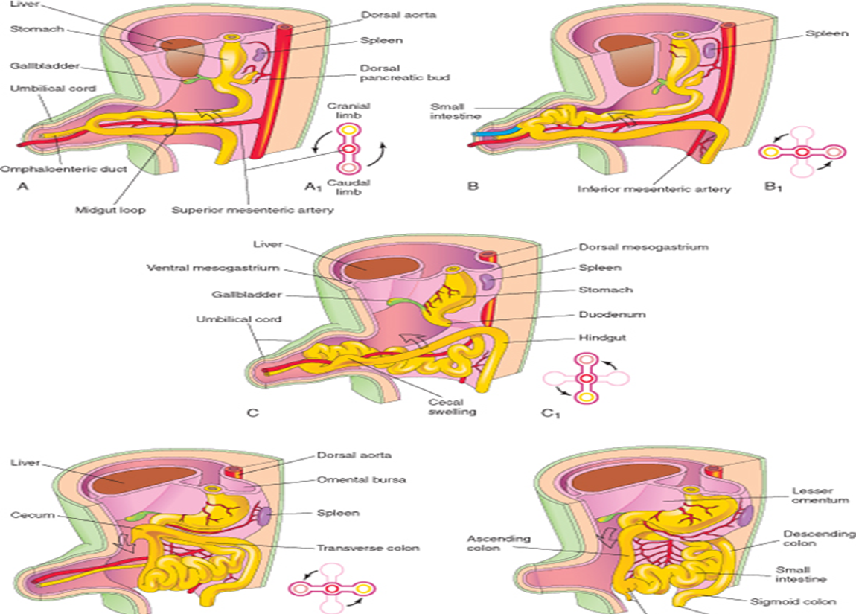
Rotation of Gut

Slide 20
Development Of Cecum And Appendix
The primordium of the cecum and wormlike appendix-the cecal swelling (diverticulum)-appears in the sixth week as an elevation on the antimesenteric border of the caudal limb of the midgut loop
The apex of the cecal swelling does not grow so the appendix is initially a small diverticulum
The appendix increases rapidly in length so that at birth it is a relatively long tube arising from the distal end of the cecum
After birth, the wall of the cecum grows unequally, with the result that the appendix comes to enter its medial side.
The appendix is subject to considerable variation in position

Slide 21
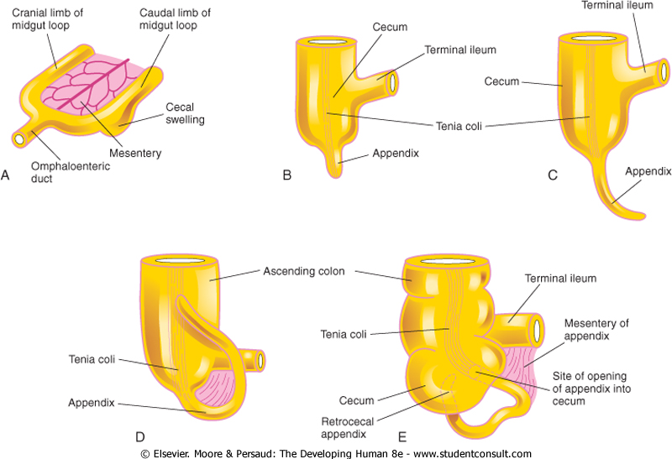
Development of Cecum and Appendix

Slide 22
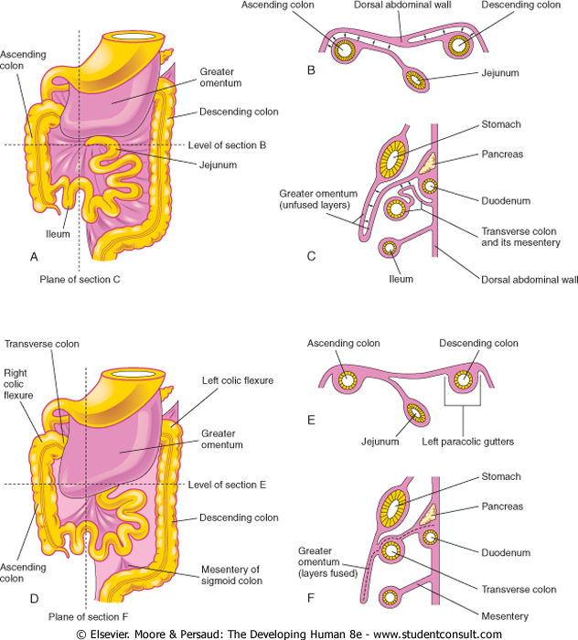
Mesenteries

Slide 23

Video

Slide 24

Functions of small intestine
(secretion and absorption)
The epithelial cells of the small intestine secrete enzymes which digest chyme into the smallest particles, making them available for absorption.
Concurrently the duodenum functions to mix food with bile and pancreatic enzymes to continue the digestion of carbohydrates, fats, and proteins.

Slide 25
Absorption
Concerning absorption, carbohydrates and proteins are absorbed in the duodenum and jejunum respectively. The jejunum also functions to absorb most fats.
The ileum function involves absorption of vitamin B12, bile salts and all digestion products which were not absorbed in duodenum and jejunum.
All three small intestine segments absorb water and electrolytes.
Horizontal Integration

Slide 26
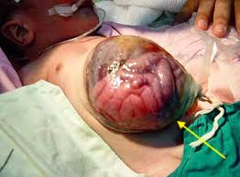
Omphalocele
Persistence of the herniation of abdominal contents into the umbilical cord
occurs in approximately 1 in 5000 births.
The abdominal cavity is proportionately small
Omphalocele results from impaired growth of the four components of the abdominal wall.
The covering of the hernial sac is the epithelium of the umbilical cord, a derivative of the amnion.

Slide 27
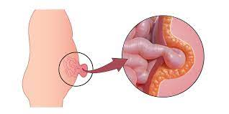
Umbilical hernia
When the intestines return to the abdominal cavity during the 10th week and then herniate through an imperfectly closed umbilicus, an umbilical hernia forms. .
In an umbilical hernia, the protruding mass is covered by subcutaneous tissue and skin.
The defect through which the hernia occurs is in the linea alba
Surgery is performed unless the hernia persists to the age of 3 to 5 years.

Slide 28
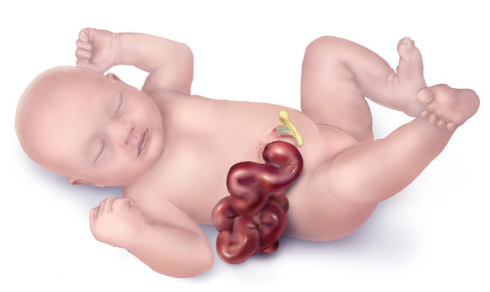
Gastroschisis
This anomaly is a relatively uncommon Gastroschisis results from a defect lateral to the median plane of the anterior abdominal wall.
The linear defect permits extrusion of the abdominal viscera without involving the umbilical cord. The viscera protrude into the amniotic cavity and are bathed by amniotic fluid.
The defect usually occurs on the right side lateral to the umbilicus and is more common in males than females.

Slide 29
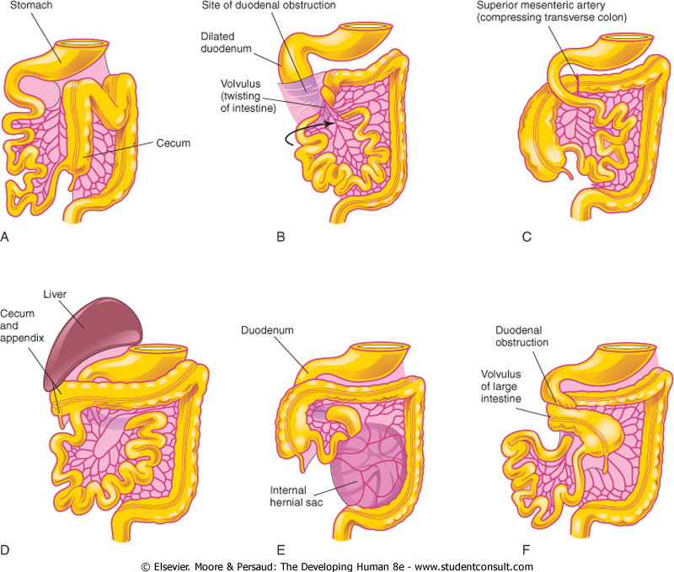
Anomalies of midgut rotation. A, Nonrotation. B, Mixed rotation and volvulus. C, Reversed rotation. D, Subhepatic cecum and appendix. E, Internal hernia. F, Midgut volvulus.

Slide 30
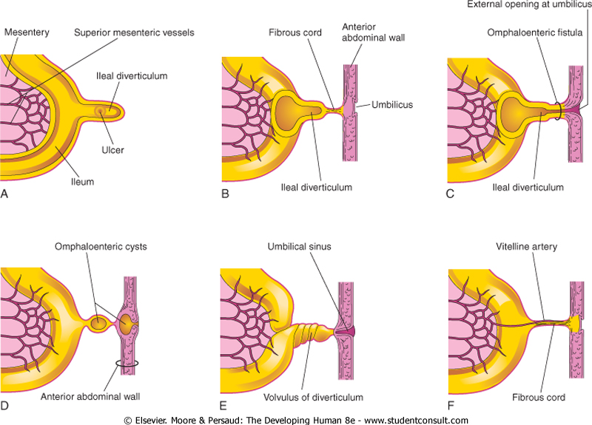
Ileal diverticulum, commonly referred to clinically as a Meckel diverticulum

Slide 31
Utility of human induced pluripotent stem cell-derived small intestinal epithelial cells for pharmacokinetic, toxicological, and immunological studies
Imakura Y, Mima S, Yamazaki N, Inomata A, Mochizuki S, Iwao T, Matsunaga T. Utility of human induced pluripotent stem cell-derived small intestinal epithelial cells for pharmacokinetic, toxicological, and immunological studies. Biochemical and Biophysical Research Communications. 2024 Jan 15;692:149356.
Abstract This study presents investigations into the utility of human induced pluripotent stem cell-derived small intestinal epithelial cells (hiSIECs) for pharmacokinetic, toxicological, and immunological studies
Overall, hiSIECs hold promise as an in vitro model for assessing pharmacokinetics, toxicity, and effects on the intestinal immunity of pharmaceuticals, functional foods, supplements, and intestinal bacteria.
Research
Spiral
Integration

Slide 32
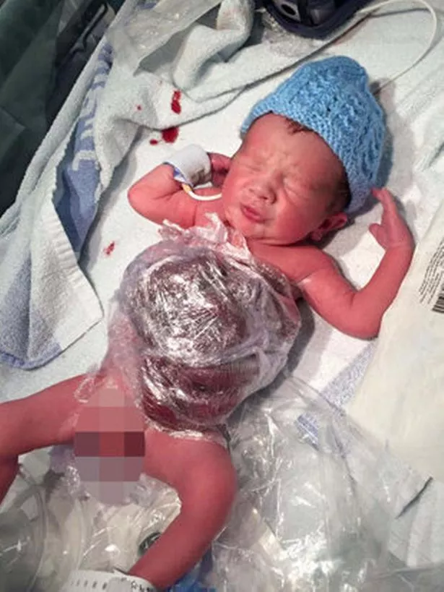

Approach to patient of gastroschisis
Initial management includes protecting the exposed bowel by placing the lower half of the infant into a bowel bag.
This maneuver allows the protection of the bowel as well as visualization of the blood flow and perfusion of the bowel. An orogastric tube should be inserted to decompress the stomach and shift the patient to hospital
Family Medicine

Slide 33
A systematic survey on artificial intelligence techniques to monitor fetus via ultrasound images
Study reported findings using the guidelines for PRISMA.
conducted a comprehensive search of eight bibliographic databases. Out of 1269 studies 107 are included. It was found that 2D ultrasound images were more popular (88) than 3D and 4D ultrasound images (19). Classification is the most used method (42), followed by segmentation (31), classification integrated with segmentation (16) and other miscellaneous methods such as object-detection, regression, and reinforcement learning (18).
The most common areas that gained traction within the pregnancy domain were the fetus head (43), fetus body (31), fetus heart (13), fetus abdomen (10), and the fetus face (10).
This survey will promote the development of improved AI models for fetal clinical applications.
Reference: iScience. 2022 Aug 19; 25(8): 104713.
Published online 2022 Jul 3. doi: 10.1016/j.isci.2022.104713
Artificial Intelligence

Slide 34


