Slide 1
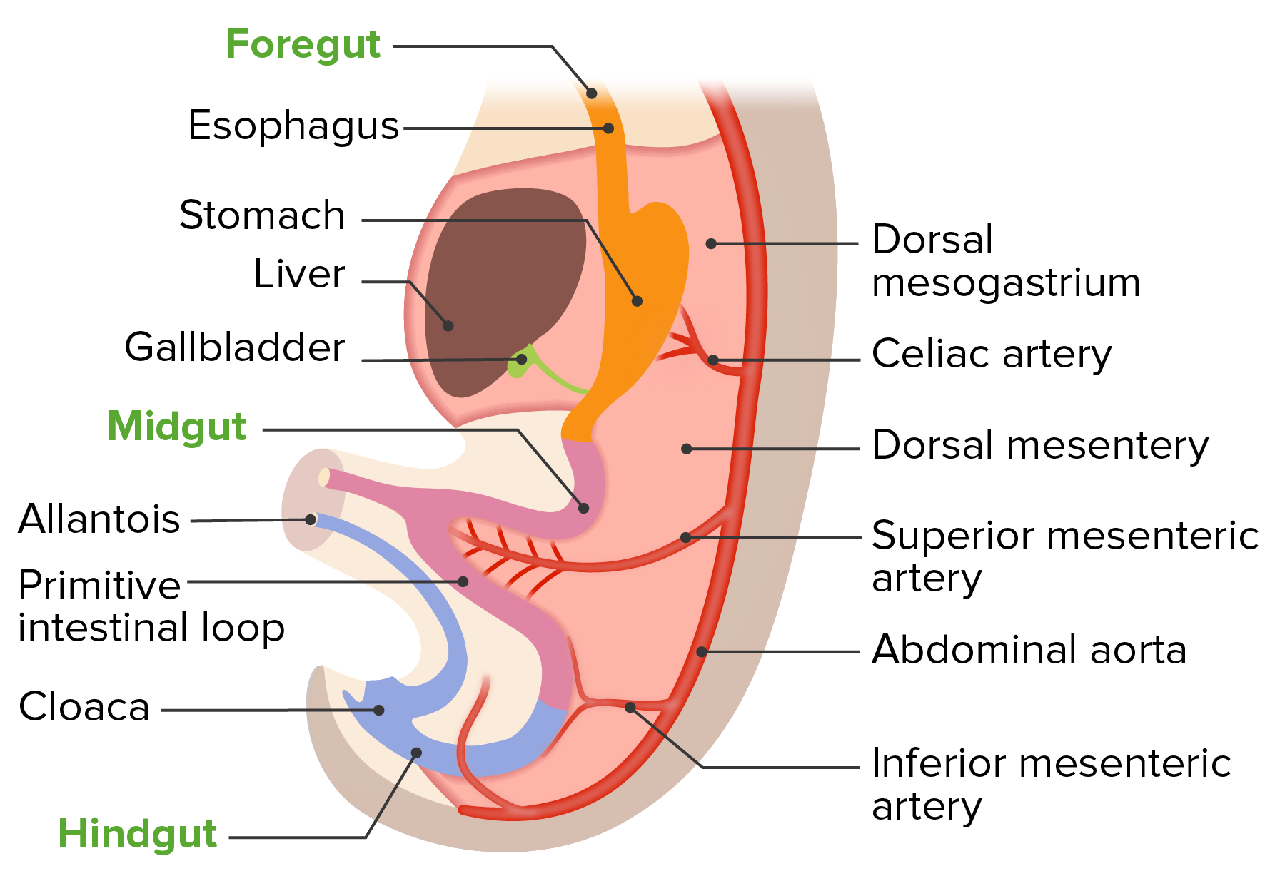
Gastrointestinal Tract (GIT) Module 2nd Year MBBS(LGIS) Development of Hind Gut
Presenter: Prof.Dr. Ifra Saeed Date: 23-01-25

Slide 2
Motto, Vision; The Dream/Tomorrow
To impart evidence based research oriented medical education
To provide best possible patient care
To inculcate the values of mutual respect and ethical practice of medicine
Wisdom
Truth
Service

Slide 3
Prof Umar’s model of clinically oriented integrated lecture First and Second year MBBS
Core subject | 60%
Horizontal integration ( Same year subjects) Anatomy, Biochemistry, Physiology | 20%
Vertical Integration (Basic sciences subjects of different years(Forensic Medicine, Pharmacology, Community medicine | 8%
Vertical Integration Clinical Subjects (Medicine, Surgery, Gynae/Obs etc) | 7%
Longitudinal/ ongoing integration ( Bioethics, Research, Artificial Intelligence, Family Medicine | 5%

Slide 4
Learning objectives At the end of the session, student will be able to
Describe development of hind gut
Discuss role of urorectal septum in development of rectum and anal canal
Relate physiology and biochemistry with development of hindgut
Discuss congenital abnormalities of large intestine
Correlate and build core knowledge on the basis of latest research,Bioethics, Family Medicine and Artificial Intelligence

Slide 5
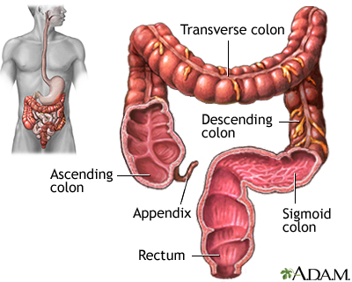
Development of Large intestine
Colon
Rectum
Anal canal

Slide 6
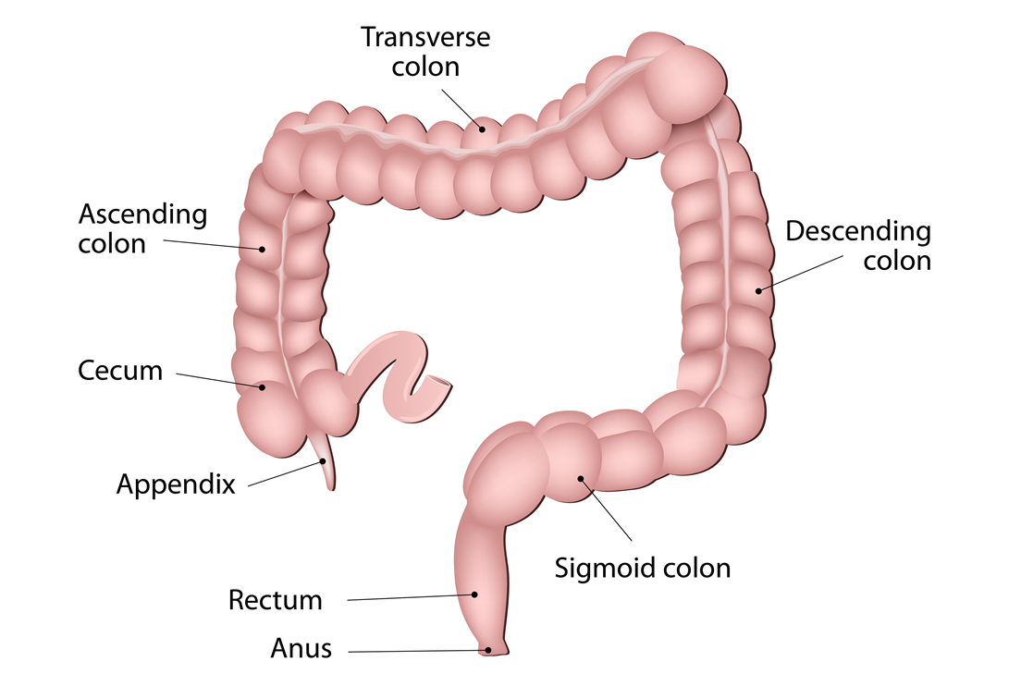
Gross Anatomy Derivatives of Hindgut
The derivatives of the hindgut are
The left one third to one half of the transverse colon,
the descending colon
sigmoid colon,
the rectum,
and the superior part of the anal canal
Inferior part of anal canal????
The epithelium of the urinary bladder and most of the urethra
Core Knowledge

Slide 7
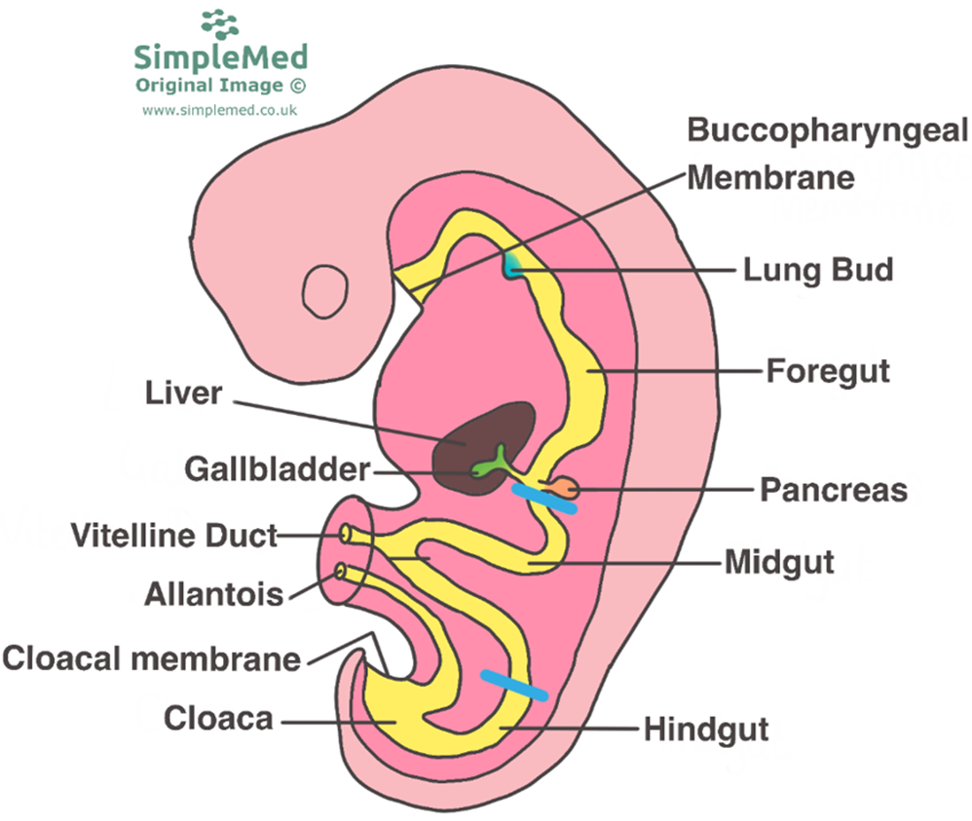
Cloaca
The expanded terminal part of the hindgut, the cloaca, is an endoderm-lined chamber that is in contact with the surface ectoderm at the cloacal membrane.

Slide 8
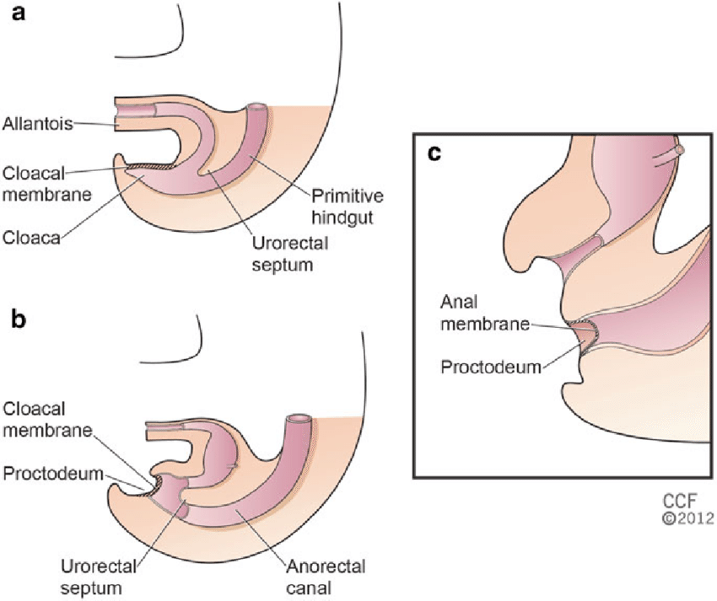
Cloacal Membrane
Composition
endoderm of the cloaca and ectoderm of the proctodeum or anal pit.
The cloaca receives the allantois ventrally, which is a fingerlike diverticulum.

Slide 9
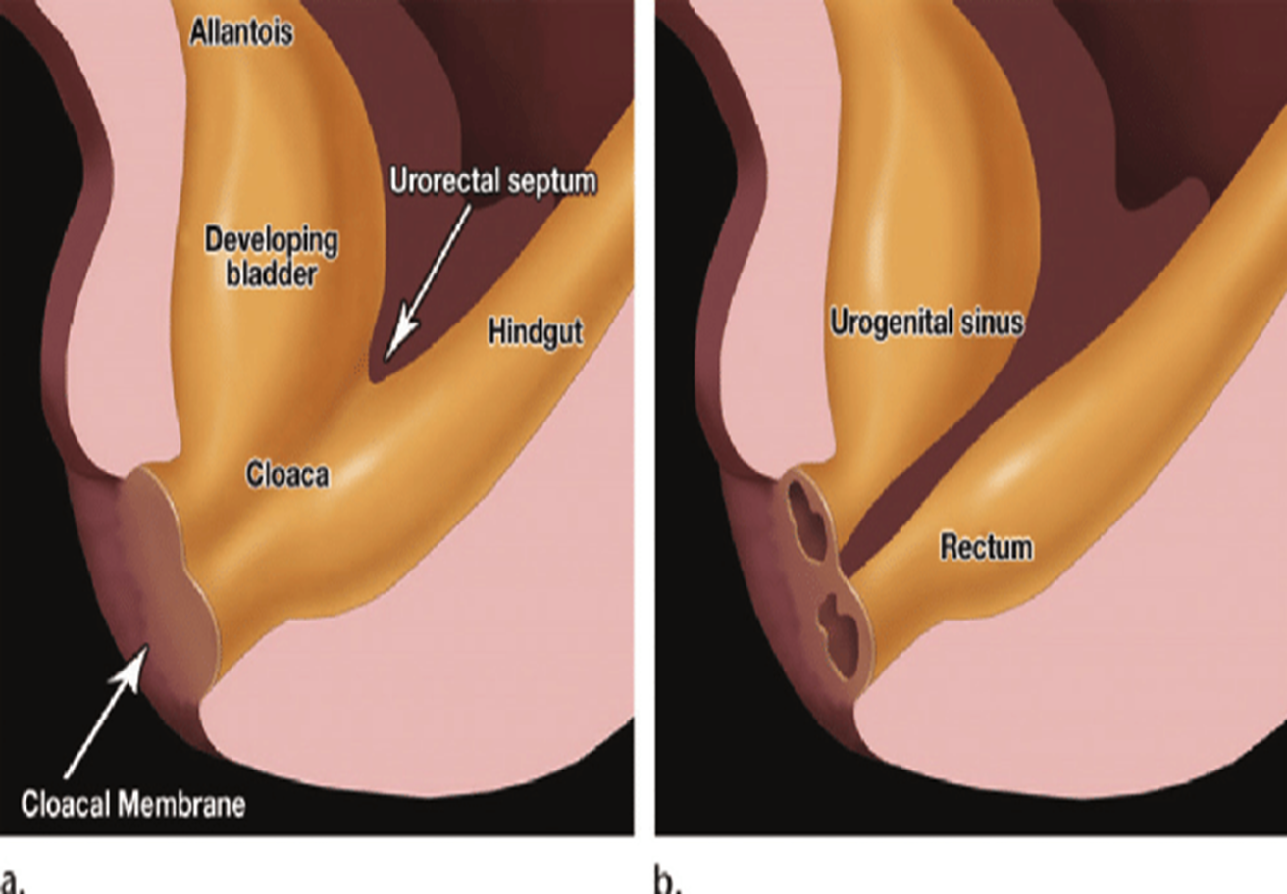
Partitioning of the Cloaca
The cloaca is divided into dorsal and ventral parts by a wedge of mesenchyme-the urorectal septum grows toward the cloacal membrane, and develops forklike extensions
These folds grow toward each other divides the cloaca into two parts
The rectum and cranial part of the anal canal dorsally
The urogenital sinus ventrally

Slide 12
By the seventh week, the urorectal septum has fused with the cloacal membrane
The area of fusion of the urorectal septum with the cloacal membrane the perineal body

Slide 13
The urorectal septum also divides the cloacal sphincter into anterior and posterior parts. The posterior part becomes the external anal sphincter,
the anterior part develops into the superficial transverse perineal, bulbospongiosus, and ischiocavernosus muscles

Slide 14
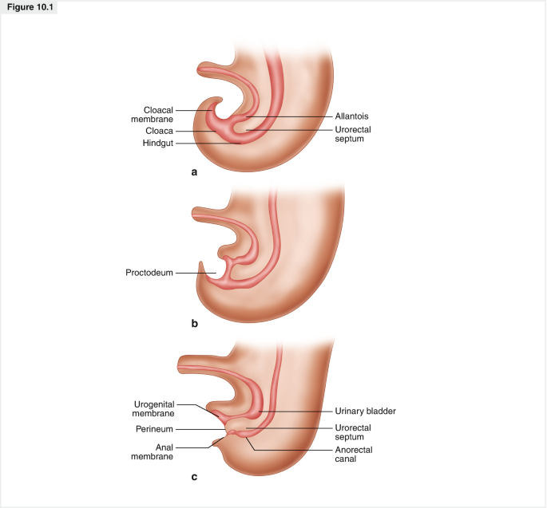
Mesenchymal proliferations produce elevations of the surface ectoderm around the anal membrane.
this membrane is soon located at the bottom of an ectodermal depression-the proctodeum or anal pit.
usually ruptures at the end of the eighth week

Slide 15
Development of anal canal
The superior two thirds (25 mm) of the adult anal canal are derived from the hindgut; the inferior one third (13 mm) develops from the proctodeum
pectinate line,
2 cm superior to the anus is an anocutaneous line

Slide 16
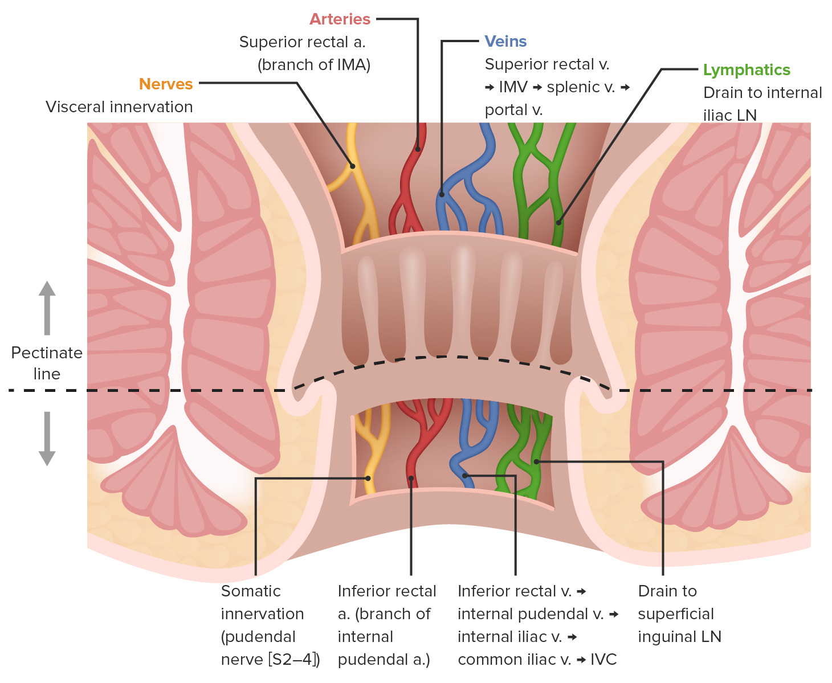
Blood supply of anal canal
Venous drainage of anal canal
Lymphatic drainage of anal canal

Slide 17
Functions of Large intestine
Absorbing water and electrolytes,
producing and absorbing vitamins,
and forming and propelling feces toward the rectum for elimination.
Horizontal integration

Slide 18
Physiology Of Defecation And Continence
The anorectal area is a complex area where autonomic and somatic structures coordinate to maintain continence and to regulate defecation.
The fecal bolus entering the rectum is perceived, and by a reflex mechanism,
the internal anal sphincter relaxes and allows the content to enter the proximal anal canal,
Horizontal integration

Slide 19
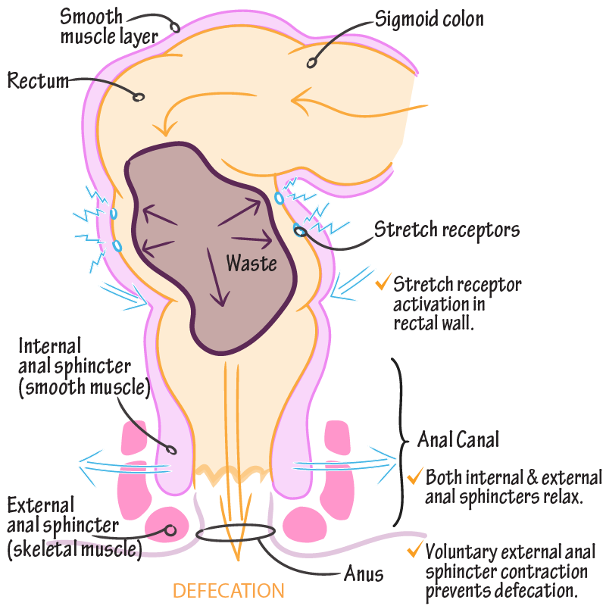

Slide 20
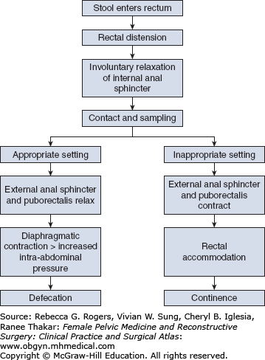

Slide 21
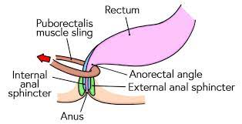
Vertical integration
Most anomalies of the hindgut are located in the anorectal region and result from abnormal development of the urorectal septum.
High and low anomalies depending on whether the rectum terminates superior or inferior to the puborectal sling
Vertical Integration

Slide 22
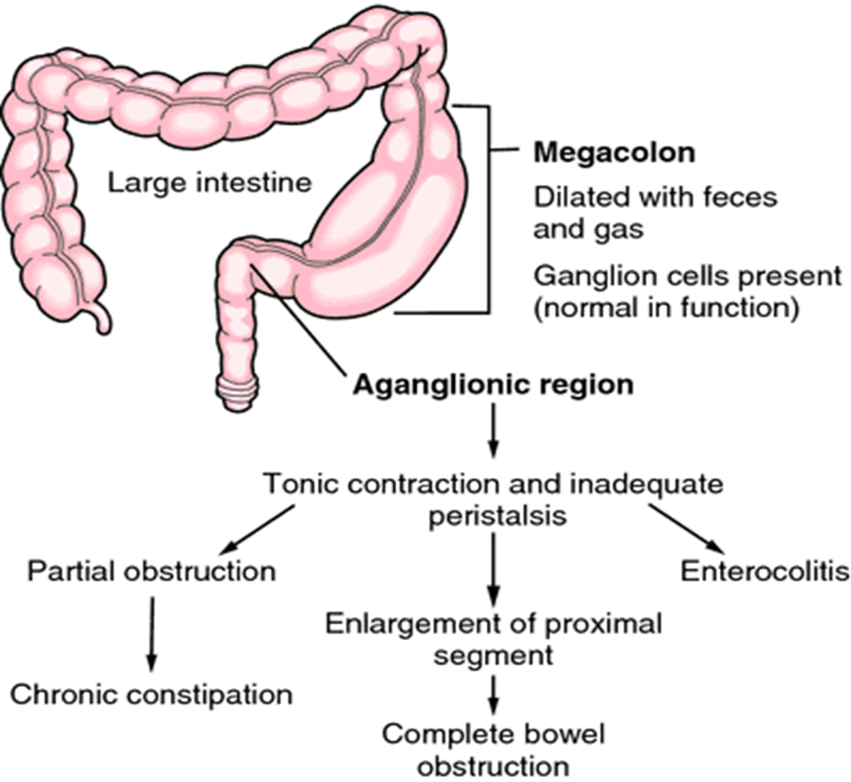
Congenital Megacolon or Hirschsprung Disease
Congenital megacolon is the most common cause of neonatal obstruction of the colon
males to females ratio (4:1)
results from failure of neural crest cells to migrate into the wall of the colon during the fifth to seventh weeks and failure of parasympathetic ganglion cells to develop in the Auerbach and Meissner plexuses.

Slide 23
Imperforate Anus
Imperforate anus occurs approximately once in every 5000 newborn infants and is more common in males

Slide 24
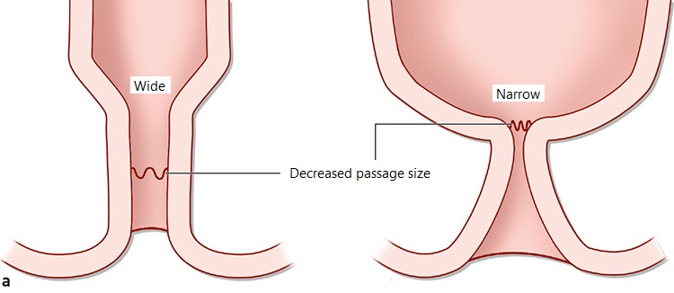
Anal Stenosis
The anus is in the normal position, but the anus and anal canal are narrow
caused by a slight dorsal deviation of the urorectal septum as it grows caudally to fuse with the cloacal membrane.
As a result, the anal canal and anal membrane are small.

Slide 25
Membranous Atresia of Anus
The anus is in the normal position, but a thin layer of tissue separates the anal canal from the exterior
The anal membrane is thin, to bulge on straining and appears blue
This anomaly results from failure of the anal membrane to perforate at the end of the eighth week.

Slide 26
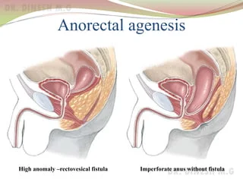
Anorectal Agenesis, with or without a Fistula
The rectum ends superior to the puborectalis muscle when there is anorectal agenesis.
Accounts for approximately two thirds of anorectal defects.

Slide 27
Anal Agenesis, with or without a Fistula
The anal canal may end blindly or there may be an ectopic anus or an anoperineal fistula that opens into the perineum
The abnormal canal may, however, open into the vagina in females or the urethra in males
results from incomplete separation of the cloaca by the urorectal septum.

Slide 28
There is usually a fistula to the bladder (rectovesical fistula) or urethra (rectourethral fistula) in males or to the vagina (rectovaginal fistula) or the vestibule of the vagina (rectovestibular fistula) in females

Slide 29
Prenatal Evaluation for Detection of Anorectal Atresia: Value of Ultrasound
Journal of ultrasound medicineVolume38, Issue6 June 2021. Pages 1501-1509 https://doi.org/10.1002/jum.14836
Abstract
Identifying the abnormal appearance or absence of the fetal anal canal and rectum on preclusive US anomaly scans is useful for prenatal diagnosis or exclusion of anorectal atresia, which may help improve the detection of isolated anorectal atresia. Furthermore, a combined evaluation of the longitudinal and axial appearances of the fetal anal canal and rectum can improve diagnostic accuracy.
Research

Slide 30
Approach to a patient of anorectal malformation
The majority of patients with anorectal malformations receive their diagnosis as newborns. A full newborn physical exam is vital in these patients as is a thorough work up as approximately 60% of patients will have an associated anomaly
In addition to a perineal/anal exam, a full physical newborn examination includes listening to heart sounds to see if a murmur can be auscultated, examining the limbs for any anatomic abnormality, and a full genitourinary exam.
Reference Smith CA, Avansino J. Anorectal Malformations. [Updated 2023 Aug 8]. In: StatPearls [Internet]. Treasure Island (FL): StatPearls Publishing; 2024 Jan-. Available from: https://www.ncbi.nlm.nih.gov/books/NBK542275
Family Medicine

Slide 31
Role of AI in colorectal Carcinoma
Due to the explosion of clinical data, and groundbreaking research in ML,, AI has shown a great application potential in various clinical aspects of CRC, such as colorectal polyp detection, qualitative and staging diagnosis of CRC, therapeutic assessment, as well as recurrence and survival prediction.
The power of AI is poised to make practice-changing impacts on the clinical field of CRC.
AI is still in its infancy with regard to its actual clinical application in CRC. Several challenges include the validation of the clinical predictive models, the construction of interpretable models, concerns over prospective and multicenter evaluation, and the safe management and use of clinical data. We believe that in the near future.
Reference Qiu H, Ding S, Liu J, Wang L, Wang X. Applications of Artificial Intelligence in Screening, Diagnosis, Treatment, and Prognosis of Colorectal Cancer. Curr Oncol. 2022 Mar 7;29(3):1773-1795. doi: 10.3390/curroncol29030146. PMID: 35323346; PMCID: PMC8947571.
Artificial Intelligence

