Slide 1
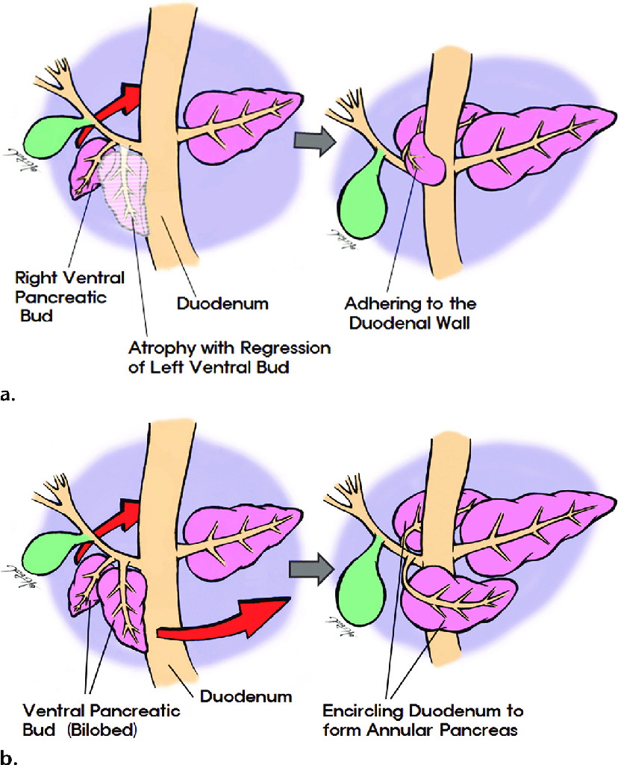
Gastrointestinal Tract (GIT) Module 2nd Year MBBS(LGIS) Development of Pancreas
Presenter: Prof.Dr. Ifra Saeed
Date: 23-01-25

Slide 2
Motto Vision; The Dream/Tomorrow
To impart evidence based research oriented medical education
To provide best possible patient care
To inculcate the values of mutual respect and ethical practice of medicine
Wisdom
Truth
Service

Slide 3
Learning Objectives
At the end of the lecture, students will be able to
Describe gross anatomy of Pancreas
Describe development of Pancreas during intrauterine life
Discuss physiological and biochemical aspects of Pancreas
Vertically integrate pathology of Pancreas (Adenocarcinoma)
Discuss congenital abnormalities of Pancreas
Correlate and build core knowledge on the basis of latest research

Slide 4
Professor Umar Model of Integrated Lecture
60%
CORE SUBJECT
20%
HORIZONTAL
INTEGRATION
Physiology
biochemistry
8%
VERTICAL INTEGRATION
Pathology
pharmacology
7%
VERTICAL INTEGRATION
Clinical integration
5%
VERTICAL INTEGRATION
Research, professionalism
Ethics
Digital library

Slide 5
DEVELOPMENT OF FOREGUT
ESOPHAGUS
STOMACH
DUODENUM
LIVER & GALLBLADDER
PANCREAS

Slide 6
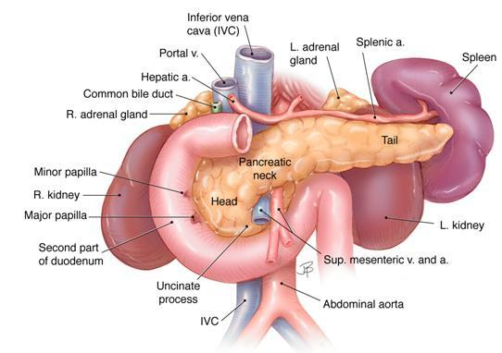
Gross Anatomy
The pancreas is an extended, accessory digestive gland that is found retroperitoneally, crossing the bodies of the L1 and L2 vertebrae on the posterior abdominal wall. The pancreas lies transversely in the upper abdomen between the duodenum on the right and the spleen on the left.

Slide 7
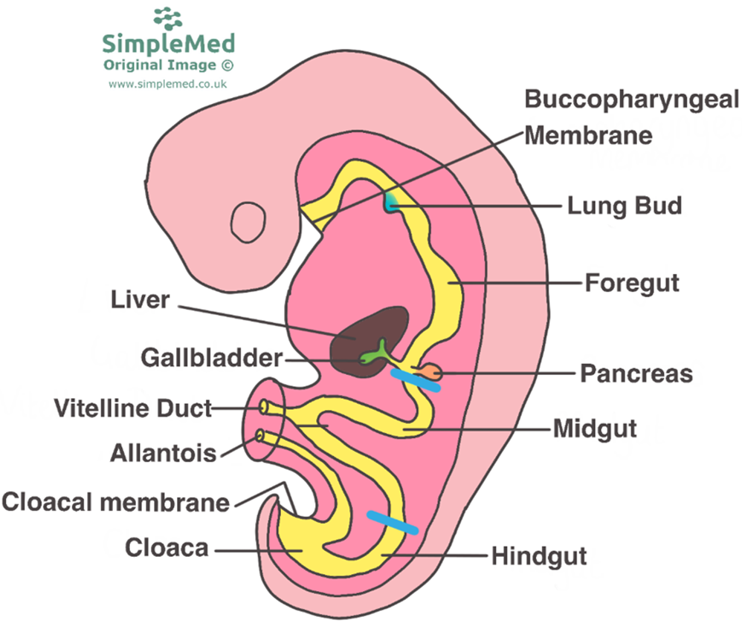

Slide 9
Development of Pancreas
The pancreas develops dorsal and ventral pancreatic buds of endodermal cells, which arise from the caudal part of the foregut
Most of the pancreas is derived from the dorsal pancreatic bud.
The larger dorsal pancreatic bud appears first and develops a slight distance cranial to the ventral bud.

Slide 10
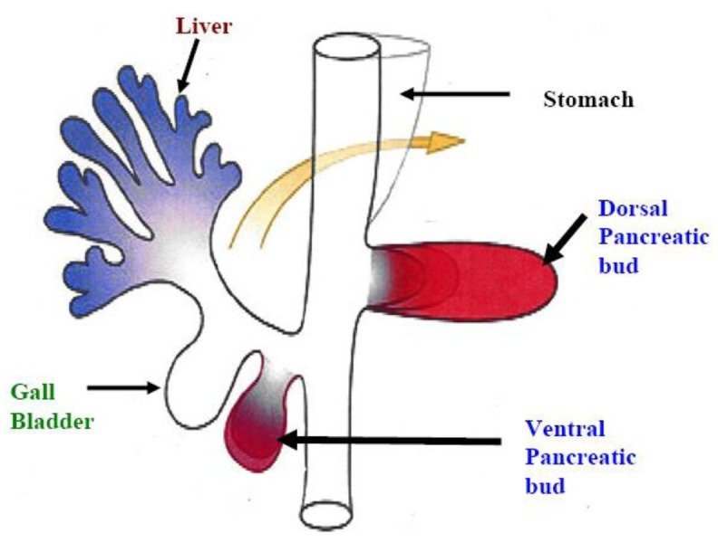
Ventral pancreatic bud
The ventral pancreatic bud develops near the entry of the bile duct into the duodenum and grows between the layers of the ventral mesentery.

Slide 11
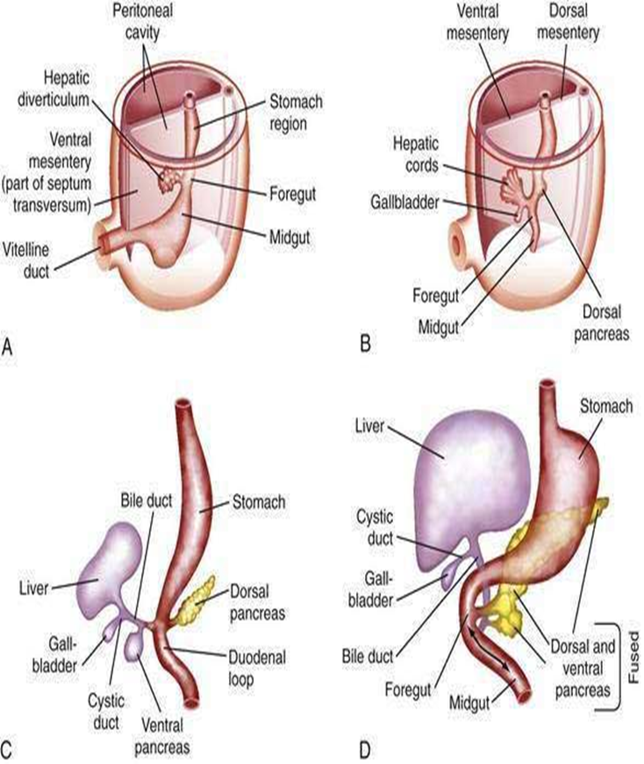

Slide 12
Fusion Of Buds
As the duodenum rotates to the right and becomes C shaped, the ventral pancreatic bud is carried dorsally with the bile duct
It soon lies posterior to the dorsal pancreatic bud and later fuses with it.

Slide 13
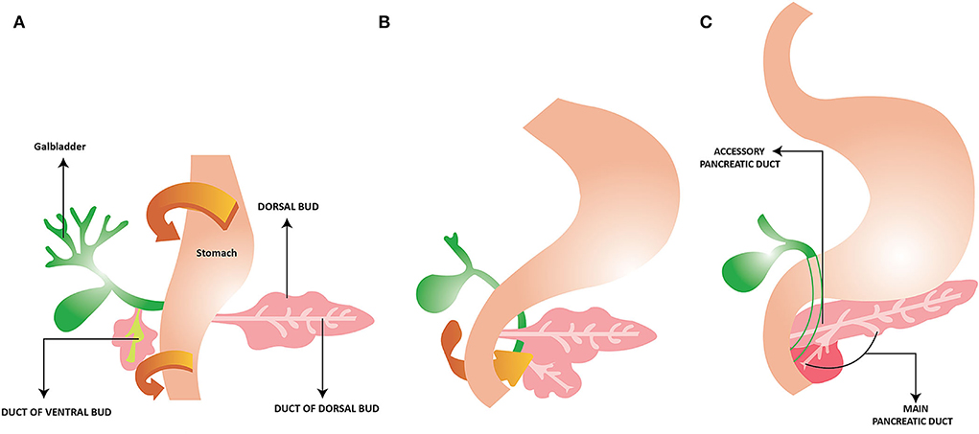
RECAP

Slide 14
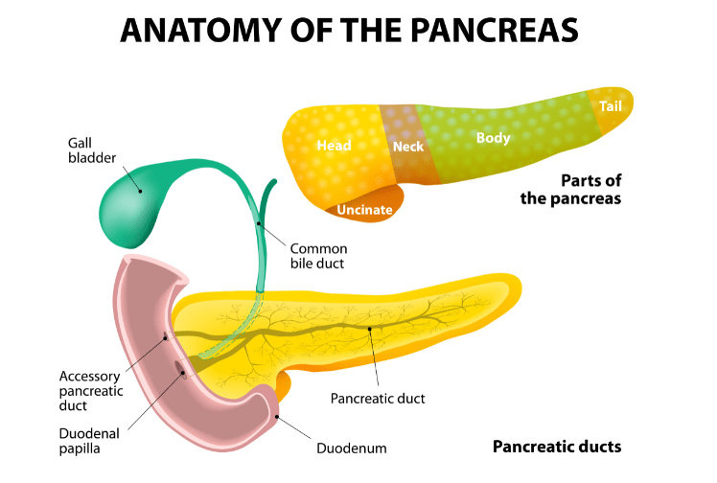
The ventral pancreatic bud forms the uncinate process and part of the head of the pancreas.
As the stomach, duodenum, and ventral mesentery rotate, the pancreas comes to lie along the dorsal abdominal wall.

Slide 15
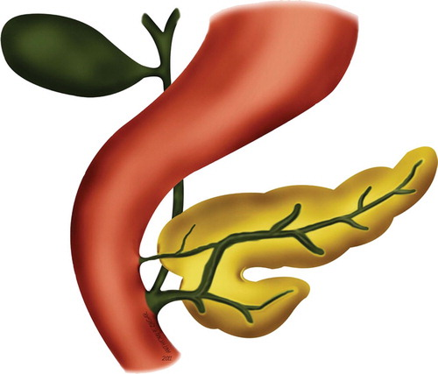
As the pancreatic buds fuse, their ducts anastomose.
The pancreatic duct forms from the duct of the ventral bud and the distal part of the duct of the dorsal bud
Accessory Pancreatic Duct
Accessary Pancreatic Tissue

Slide 16
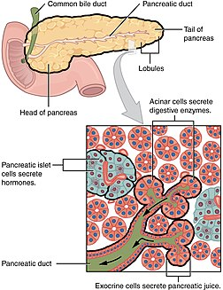
Histogenesis of the Pancreas
The parenchyma of the pancreas
Pancreatic acini begin to develop from cell clusters around the ends of these tubules
The pancreatic islets develop from groups of cells that separate from the tubules and come to lie between the acini.

Slide 17
Insulin secretion begins during the early fetal period (10 weeks). The glucagon- and somatostatin-containing cells develop before differentiation of the insulin-secreting cells.
Glucagon has been detected in fetal plasma at 15 weeks
The connective tissue sheath and interlobular septa of the pancreas develop from the surrounding splanchnic mesenchyme.

Slide 18
Physiological and biochemical aspects of Pancreas
Pancreas plays a large role in digesting food and regulating blood sugar.
This 6- to 10-inch long elongated organ is located in upper left abdomen, right behind stomach.
By producing enzymes and hormones, pancreas helps body break down food and control blood sugar
Exocrine
Endocrine
Horizontal integration

Slide 19
Pancreas makes about 8 ounces of digestive juices every day. These juices contain enzymes to break down food. These enzymes empty into the upper part of your small intestine and include:
Lipase, which works with bile produced by liver to break down fat
Protease, which breaks down protein in diet and protects from some types of bacteria
Amylase, which breaks down starches into sugar
Horizontal Integration

Slide 20
HORMONES
Horizontal Integration

Slide 21
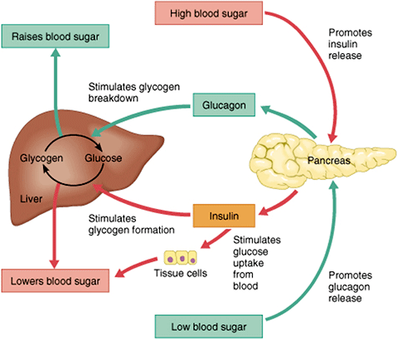
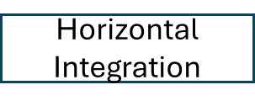
A Blood glucose level above the normal 70 mg/100 ml (70 mg/dl) stimulates release of insulin from beta cells,

Slide 22
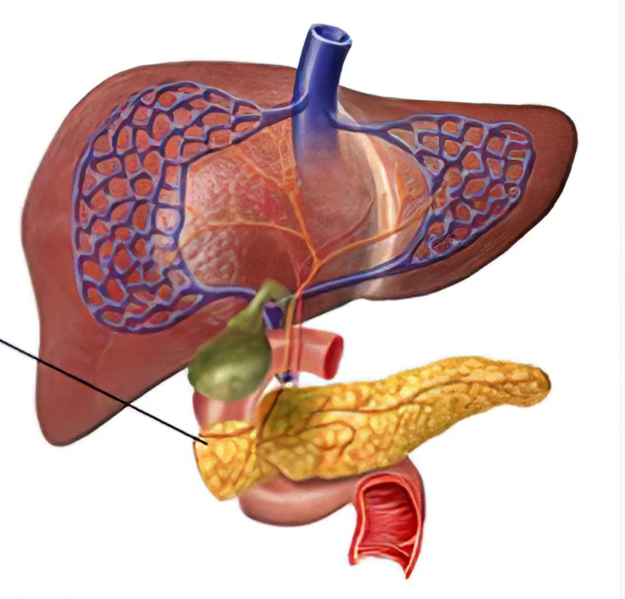
Anular Pancreas
Although an anular pancreas is uncommon, it may cause duodenal obstruction
The ringlike or anular part of the pancreas consists of a thin, flat band of pancreatic tissue surrounding the descending or second part of the duodenum.
Vertical Integration

Slide 23
An anular pancreas may be associated with Down syndrome, intestinal atresia, imperforate anus, pancreatitis, and malrotation.
Males are affected much more frequently than females. An anular pancreas probably results from the growth of a bifid ventral pancreatic bud around the duodenum The parts of the bifid ventral bud then fuse with the dorsal bud, forming a pancreatic ring (Latin, anulus).
Vertical Integration

Slide 25
Risk Factors for Pancreatic Cancer: Emerging Role of Viral Hepatitis
.
Pers. Med. 2022, 12(1), 83; https://doi.org/10.3390/jpm12010083
ABSTRACT
Pancreatic cancer is one of the most aggressive malignant neoplastic diseases.
Identification of risk factors and implementation of screening strategies are essential for a better prognosis.
The risk factors for pancreatic cancer fall into two broad categories, Extrinsic factors include alcohol consumption, smoking, a diet rich in saturated fats, and viral infections such as chronic infection with hepatitis B and C viruses.
The common origin of hepatocytes and pancreatic cells in the multipotent endodermal cells, the common origin of the blood vessels and biliary ducts of the pancreas and the liver, or chronic inflammatory changes may be involved
Research

Slide 26
Ethical dilemma Is it Worthwhile Operating an End-Stage Pancreatic Cancer Patient
Pancreatic cancer is as an aggressive malignancy with low survival rates.
discussion raising concerns regarding the management of severe complications such as acute mesenteric ischemia in patients with progressed pancreatic carcinoma. How ethical is to leave patients untreated? The decisions for management of patients with advanced disease are strongly based on the expected quality of life, ethical principles, different religions and spiritualities, and the burden of healthcare cost.
Reference Acta Med Litu. 2021; 28(2): 325–329.
Published online 2021 Dec 17. doi: 10.15388/Amed.2021.28.2.17
Bioethics

Slide 27
Role of Artificial Intelligence in Ca Pancreas
Pancreatic cancer is more common in developed countries and is one of the leading causes of cancer-related mortality worldwide.
AI is particularly useful for various investigations of pancreatic carcinoma because it has specific radiological features that enable diagnostic procedures without the requirement of a histological study.
Currently, AI models have been created for diagnosing, grading, staging, and predicting prognosis and treatment response.
Artificial Intelligence

Slide 28
Learning Resources
KLM Embryology Developing Human 11th Edition Clinically oriented embryology by Keith Moore, T. V. N. Persaud, Mark Torchia
Langman's Medical Embryology 15th Edition
by Dr. T.W. Sadler PhD
Google scholar
Google images

