Slide 1
A TRIP TO SPECIALITY OF FAMILY MEDICINE
Presented By Dr. Namrah Fatima Mujeeb
MBBS (Shifa College of Medicine)
FCPS Family Medicine (Pak Emirates Military Hospital) 3rd Year Resident
PGD Family Medicine (Rawalpindi Medical University)
Life Member Pakistan Academy of Family Physicians
Certification in Clinical Nutrition (Shifa College of Medicine)

Slide 2
Family Medicine ?
Notes:
Today I was being told to give a brief snapshot of journey of family medicine Diploma Program
As we all know that Family Medicine is the only specialty that holistically deals with all the Patients whether children, adults or elderly people under same roof .

Slide 3
Diploma In Family Medicine
1). Exam conducted by RMU
2). A short interview
3). Commencement of official classes
Notes:
This Journey started >

Slide 4
Modules + Assignments
Our Program was distributed in 6-7 modules
With each modules we were given assignments to complete within due date
Face to Face Classes
Online Classes
Ward Rotations
OPD Rotations
Notes:
It was such a flexible program. Specially our HOD family Medicine Dr. Sadia made it so easy for us. That she used to even ask us for our availability for each session so everyone could attend and participate in all the sessions.

Slide 6
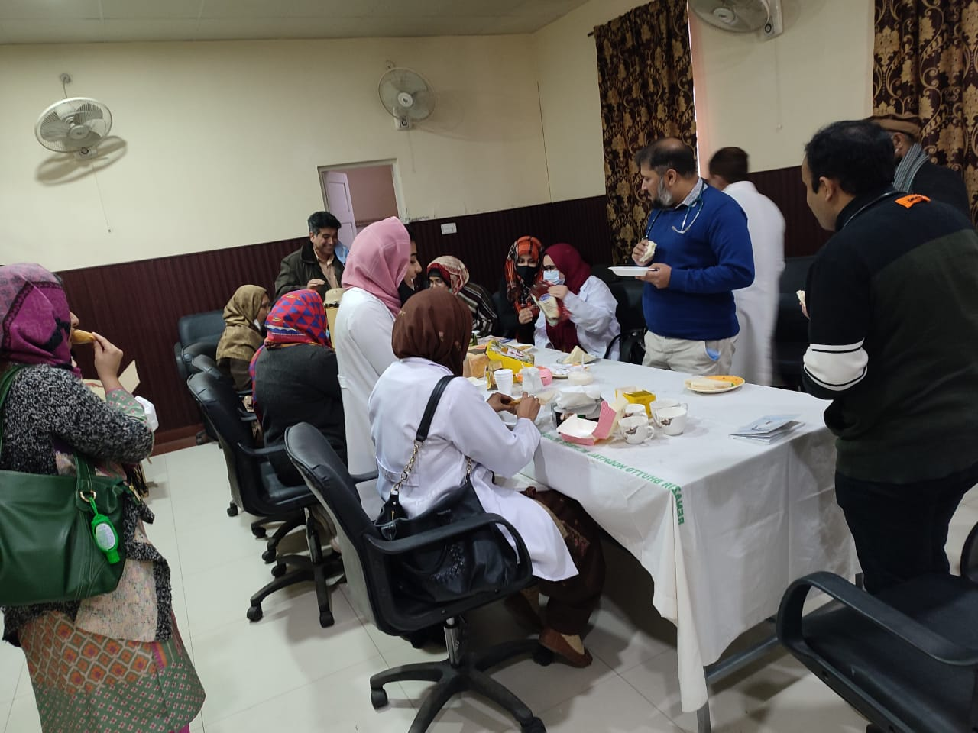
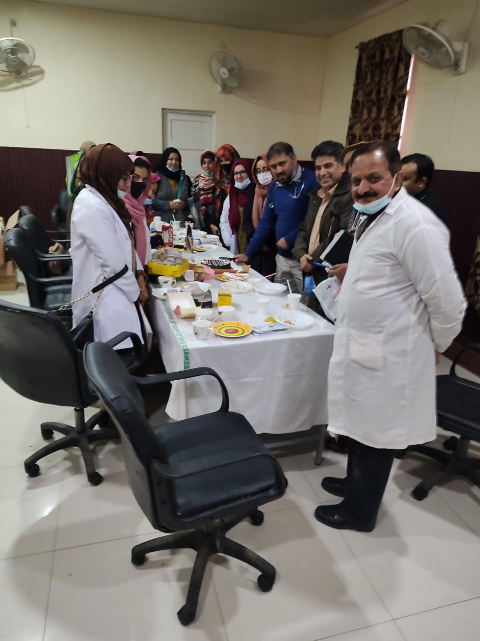
Notes:
The Best Part of this Module Dr. Sadia used to Arrange refreshment for us by the end of each session

Slide 7
Notes:
In the end I would Like to Thank all of my Course Teachers . And This Is a Great Privilege for me Since both of my Supervisors are infront of me . Dr. Sadia HOD family Med from RMU Who introduced me towards what is family medicine and helped us throughout journey of diploma of family medicine and my current supervisor Major Dr. Sadaf Nawaz HOD family medicine in PAK emirates Military hospital who further helped me polished my skills in the field of family Medicne. Thank you so much to both of you.

