Slide 1
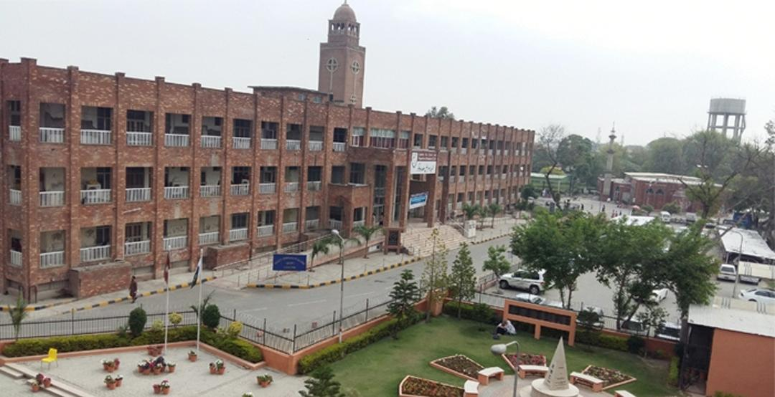
Revamping
A Challenge
22nd October, 2023

Slide 2
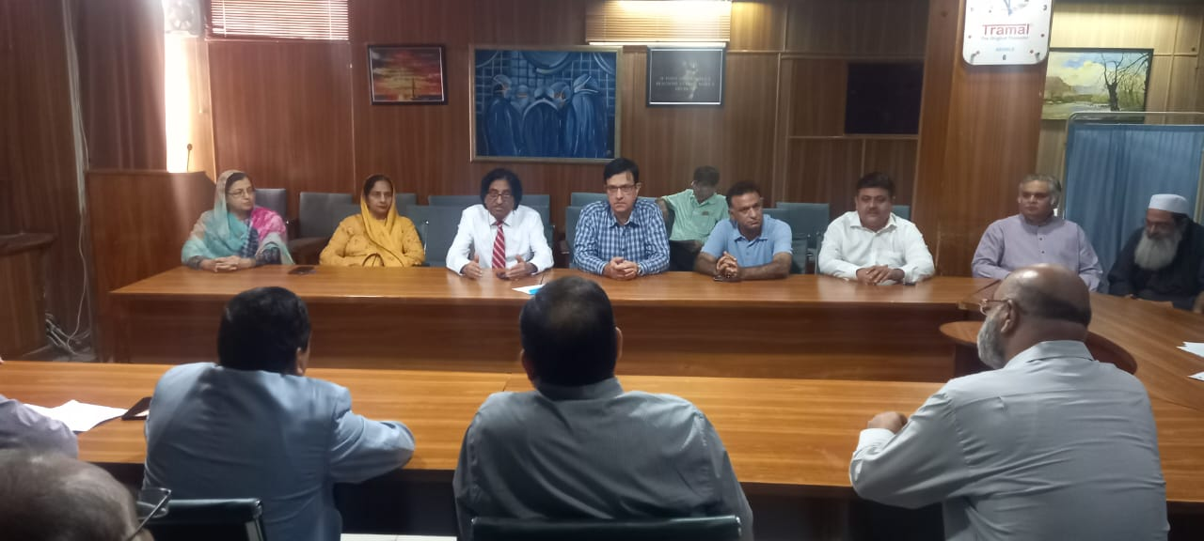
2 dozens meetings Stakeholders meeting, Vice Chancellor, HODs, MSs,
Nursing Superintendent to discuss the Evacuation and relocation plan

Slide 3
Departments Relocation Plan
The present Admin Block will be merged with the existing Gynae and Paeds department for complete mother & child complex. In this way 40 more beds will be available. EYE & ENT will be merged in a single unit and extra medical ward will be developed with 30 beds capacity and 50 more beds will be generated in the basement. Radiology complex ramp will be moved up to second floor so that the patient can shifted easily between the ward and radiology complex.

Slide 4
Sr # | Medical Services Relocation
1 | DID Total Dengue patients are treated in RED Crescent Hospital along with the all the dengue patients of BBH & RTH. 120 beds in Red crescent & 6 beds for ICU in Red Crescent.
2 | Medical Unit 1&2, Nephro, EYE has been shifted to RIUT with 4 ICU beds which can be increased with 40 beds allocation and 4 bedded ICU. Capacity can be increased to 200 Beds.
3 | Surgical Unit 2, Ortho, Gynae Unit 1, CCU, ENT, Paeds Nursery, Orthopedic, Plastic Surgery Burn Services has been shifted to BBH. 60 beds in BBH.
4 | MLC post Mortem are done in BBH & RTH with 60 beds at RTH.
5 | Gynae Unit 2, Surgical Unit-1, Neuro & Peads ward shifted to RTH.
6 | Radiology services provided RIUT, Red Crescent, BBH & RTH.
7 | RIC for Cardiac patients.
8 | Lab services are provided to Dengue Patients in Red Crescent and RIUT for Nephro and Medical Unit 1&2 patients
440 beds are operated by HFH staff in Allied Hospitals i.e BBH, RTH, RIUT & Red Crescent Hospital One additional Gynae filter clinic at committee chowk lined with BBH.

Slide 5
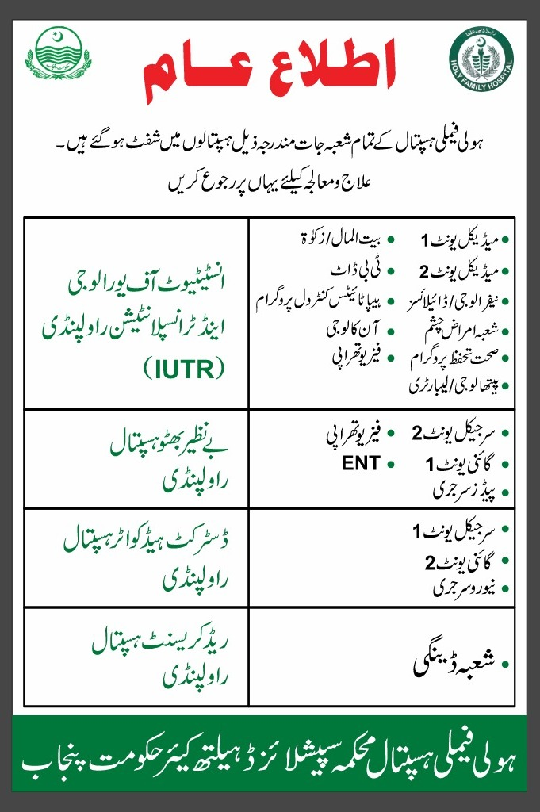

Slide 6
Equipment Relocation
Sr # | Hospital s | Relocation
1 | RIUT | Emergency Medicines, Dialysis medicines & Lab equipment.
2 | BBH | Medicines for Surgical & Gynae Emergency patients, 6 Anesthesia Machines, 100 benches for patients attendant, Linen as per requirement.
3 | RTH | Medicines for Surgical patients, Gynae equipment, 40 beds & Linen as per requirement.
4 | Red Crescent | 50 beds for dengue patients, medicines, lab & ultrasound facility 24/7.

Slide 7
Human Resources
PMO/ PWMO | APMO / APWMO | SRs | SMOs/ SWMOs | PGTs | MOs/ WMOs | Head Nurses | Charge Nurses | Other staff | Support Staff | Total
6 | 8 | 78 | 37 | 300 | 73 | 30 | 377 | 27 | 896 | 1832
Human Resources Relocation
Hospital Name | PMO/ PWMO | APMO / APWMO | SRs | SMOs/ SWMOs | PGTs | MOs/ WMOs | Head Nurses | Charge Nurses | Other staff | Support Staff | Total
HFH | 4 | 2 | 0 | 10 | 0 | 3 | 4 | 32 | 14 | 355 | 424
BBH | 0 | 1 | 37 | 5 | 117 | 33 | 9 | 138 | 5 | 170 | 515
RTH | 0 | 0 | 24 | 2 | 87 | 9 | 5 | 65 | 3 | 94 | 289
RIUT | 2 | 5 | 8 | 5 | 96 | 10 | 5 | 70 | 4 | 108 | 313
Red Crescent | 0 | 0 | 8 | 13 | 0 | 17 | 7 | 60 | 1 | 127 | 233
RMU | 0 | 0 | 1 | 2 | 0 | 1 | 0 | 0 | 0 | 42 | 46
RIC | 0 | 0 | 0 | 0 | 0 | 0 | 0 | 12 | 0 | 0 | 12

Slide 8
Categorization Of Hospital Inventory Items
Sr No | ITEMs | Category | Area/ward/Room
1 | All Types of Medical/Lab Equipment | A | Ward 137,136,132,131
2 | General Store / Equipment Store Items/Medical Store | B | Room 1 to 8 In front of ward(136,132&131)
4 | ICU beds (Electronic/Hydraulic) | C | Ward 237
5 | Computers, Printers Scanners, Photocopy Machines, Telephone sets | D | Ward 236
6 | Record of Wards | E | Room 9-13 In front of ward(237)
7 | Record of Admin | F | Room 14-17 In front of ward(232)
8 | Record of Accounts | G | Room 18-21 In front of ward(231)
9 | Record of Purchase | H | Room 22-23 In front of NICU

Slide 9
Categorization Of Hospital Inventory Items
Sr No | ITEMs | Category | Area/ward/Room
10 | Fans (All Types), ACs (All Types), Refrigerators (All Types), LED TV, Cameras with DVRs, Wall Clocks, Electric Heaters, Water Dispensers | I | Ward 232 & 231
11 | Office Furniture (Chairs, Tables (All Types) Computer Tables | J | In Out Side Marquee
12 | Mattress | K | In Out Side Marquee
13 | Wheel Chairs | L | In Out Side Marquee
14 | Cabinets (Wooden & Iron), Racks, Trolleys (Crash Trolley, Medicine Trolley, Loaders), Cardiac Table, Over Head Table, Office Baskets | M | In Out Side Marquee
15 | Baskets (Yellow Red White) | N | In Out Side Marquee
16 | Fowler Beds & Stretchers | O | In Out Side Marquee
17 | Oxygen Cylinders (All Types) | P | In Out Side Marquee
18 | Mehman Khana | Q | For Medicine Items.
Note:- Category A Highly Sensitive Equipment's Ventilators, Anesthesia Machines, Cardiac Monitor.

Slide 10
INVENTORY OF HOLY FAMILY HOSPTAL, RAWALPINDI
SR No | Name of Item | Gynae OT | Gyane ER | Emergency Department | ER OT | Burn Unit | SU I | DID | Ortho ward | Neuro surgery | Paeds ER | NICU | LR 1 | LR 2 | ward 231 | Old Private Block | paeds surgery wad | 237 ward | Ward 236 | Ward 232 | Ward 137 | WARD 136 | WARD 132 | MOTHER ROOM | PICU ward | Paeds Medicine | New Private Block | ENT ward | EYE ward | Surgery OT | ENT.EYE,ORTHO OT | Male MU II | Female MU II | MU I east wing | MU Iwast wing | SU II | Gastro Ward | SICU | PACU | MICU | CCU | Nephrology Ward | LIVER Center | Endoscopy Department | New Gayane Ward | Total
1 | Hospital Beds | 1 | 11 | 71 | 6 | 39 | 50 | 335 | 25 | 26 | 12 | 60 | 21 | 29 | 28 | 18 | 22 | 28 | 26 | 22 | 25 | 22 | 20 | 14 | 26 | 9 | 22 | 24 | 28 | 4 | 7 | 56 | 68 | 30 | 36 | 45 | 14 | 9 | 13 | 12 | 14 | 34 | 14 | 7 | 16 | 1399
2 | Mattress | 1 | 11 | 71 | 6 | 43 | 50 | 200 | 25 | 26 | 12 | 60 | 21 | 43 | 28 | 24 | 22 | 28 | 26 | 22 | 25 | 22 | 20 | 14 | 28 | 9 | 22 | 24 | 28 | 4 | 12 | 33 | 55 | 30 | 36 | 45 | 14 | 9 | 13 | 12 | 14 | 33 | 14 | 7 | 16 | 1258
3 | Cardiac Tables | 0 | 5 | 11 | 0 | 37 | 45 | 200 | 12 | 22 | 9 | 0 | 9 | 13 | 17 | 6 | 15 | 19 | 10 | 22 | 25 | 22 | 20 | 1 | 28 | 9 | 22 | 19 | 25 | 3 | 7 | 50 | 24 | 13 | 14 | 40 | 14 | 8 | 6 | 12 | 14 | 30 | 14 | 0 | 0 | 872
4 | Over head Tables | 0 | 4 | 0 | 0 | 37 | 0 | 0 | 0 | 0 | 0 | 0 | 0 | 0 | 0 | 0 | 0 | 0 | 0 | 0 | 25 | 22 | 0 | 0 | 0 | 0 | 22 | 6 | 0 | 0 | 0 | 4 | 1 | 14 | 0 | 0 | 0 | 0 | 2 | 0 | 14 | 2 | 0 | 0 | 1 | 154
5 | Staff Chairs | 2 | 2 | 27 | 20 | 121 | 4 | 30 | 0 | 4 | 4 | 18 | 7 | 5 | 2 | 2 | 4 | 7 | 2 | 2 | 0 | 4 | 5 | 3 | 2 | 0 | 3 | 26 | 16 | 20 | 23 | 66 | 0 | 14 | 2 | 3 | 0 | 12 | 4 | 8 | 4 | 5 | 6 | 2 | 4 | 495
6 | Tables | 6 | 0 | 6 | 2 | 10 | 2 | 4 | 0 | 1 | 2 | 7 | 5 | 2 | 0 | 6 | 1 | 1 | 1 | 0 | 2 | 1 | 2 | 1 | 1 | 1 | 1 | 6 | 10 | 9 | 10 | 4 | 0 | 14 | 1 | 6 | 3 | 4 | 1 | 1 | 6 | 4 | 2 | 2 | 3 | 151
7 | Benches | 0 | 4 | 7 | 2 | 3 | 30 | 87 | 5 | 10 | 2 | 0 | 2 | 4 | 1 | 0 | 1 | 0 | 0 | 6 | 0 | 4 | 6 | 3 | 0 | 0 | 23 | 14 | 26 | 0 | 0 | 33 | 13 | 12 | 7 | 22 | 0 | 9 | 0 | 7 | 12 | 6 | 14 | 7 | 3 | 385
8 | Cabinets | 0 | 5 | 30 | 1 | 3 | 45 | 0 | 0 | 0 | 0 | 0 | 0 | 0 | 0 | 0 | 0 | 4 | 0 | 0 | 0 | 0 | 3 | 2 | 1 | 2 | 5 | 9 | 2 | 4 | 15 | 3 | 2 | 0 | 3 | 7 | 0 | 9 | 12 | 6 | 1 | 0 | 14 | 0 | 1 | 189
9 | Wheel chairs | 1 | 7 | 50 | 0 | 8 | 5 | 4 | 2 | 1 | 2 | 1 | 0 | 4 | 0 | 1 | 1 | 1 | 1 | 1 | 2 | 1 | 1 | 1 | 1 | 1 | 1 | 1 | 3 | 1 | 3 | 1 | 3 | 2 | 2 | 2 | 1 | 1 | 2 | 2 | 2 | 3 | 3 | 5 | 1 | 136
10 | Stretchers | 4 | 20 | 42 | 2 | 12 | 2 | 7 | 1 | 1 | 0 | 0 | 0 | 1 | 0 | 1 | 1 | 1 | 1 | 1 | 1 | 1 | 1 | 1 | 1 | 1 | 1 | 1 | 1 | 1 | 4 | 3 | 1 | 2 | 2 | 3 | 1 | 1 | 4 | 2 | 2 | 1 | 4 | 3 | 1 | 141
11 | IV Poles | 10 | 3 | 128 | 18 | 52 | 30 | 200 | 15 | 20 | 12 | 5 | 31 | 15 | 14 | 2 | 9 | 9 | 14 | 22 | 18 | 18 | 10 | 14 | 24 | 19 | 64 | 12 | 9 | 15 | 15 | 7 | 23 | 21 | 20 | 40 | 10 | 6 | 8 | 24 | 8 | 10 | 14 | 6 | 5 | 1029
12 | Waiting Chairs | 20 | 0 | 30 | 6 | 14 | 0 | 0 | 27 | 10 | 13 | 3 | 9 | 6 | 1 | 0 | 0 | 0 | 20 | 10 | 0 | 0 | 10 | 0 | 10 | 19 | 0 | 12 | 4 | 9 | 0 | 4 | 0 | 37 | 15 | 0 | 14 | 11 | 0 | 4 | 10 | 20 | 24 | 0 | 0 | 372
13 | Computer | 0 | 0 | 9 | 0 | 4 | 0 | 6 | 1 | 1 | 1 | 1 | 0 | 0 | 0 | 0 | 1 | 0 | 0 | 0 | 0 | 0 | 0 | 0 | 0 | 0 | 0 | 1 | 0 | 1 | 0 | 1 | 1 | 2 | 1 | 2 | 0 | 1 | 0 | 1 | 1 | 2 | 7 | 4 | 0 | 49
14 | Printer | 0 | 0 | 9 | 0 | 4 | 0 | 4 | 0 | 1 | 0 | 1 | 0 | 0 | 0 | 0 | 1 | 0 | 0 | 0 | 0 | 0 | 0 | 0 | 0 | 0 | 0 | 1 | 0 | 0 | 0 | 1 | 1 | 2 | 0 | 1 | 0 | 0 | 0 | 1 | 2 | 3 | 1 | 1 | 0 | 34
15 | Curtains | 10 | 7 | 31 | 5 | 10 | 20 | 15 | 12 | 8 | 12 | 10 | 0 | 0 | 0 | 48 | 0 | 0 | 0 | 0 | 0 | 0 | 0 | 0 | 6 | 0 | 72 | 16 | 38 | 33 | 43 | 0 | 25 | 0 | 0 | 45 | 0 | 4 | 0 | 12 | 25 | 2 | 0 | 12 | 9 | 530
16 | Wall clock | 5 | 1 | 2 | 2 | 3 | 5 | 2 | 0 | 1 | 1 | 3 | 3 | 3 | 0 | 1 | 0 | 0 | 1 | 1 | 1 | 1 | 1 | 0 | 0 | 0 | 1 | 2 | 1 | 6 | 0 | 2 | 2 | 2 | 2 | 5 | 2 | 3 | 1 | 3 | 3 | 3 | 0 | 0 | 0 | 75
17 | Ceiling Fans | 5 | 17 | 34 | 8 | 34 | 40 | 35 | 12 | 15 | 6 | 6 | 23 | 23 | 21 | 8 | 16 | 15 | 17 | 18 | 22 | 14 | 15 | 0 | 13 | 6 | 24 | 32 | 39 | 15 | 23 | 47 | 25 | 31 | 20 | 42 | 9 | 14 | 8 | 12 | 20 | 16 | 16 | 12 | 6 | 834
18 | Bracket fans | 2 | 2 | 31 | 1 | 6 | 2 | 29 | 9 | 10 | 8 | 1 | 2 | 1 | 3 | 2 | 1 | 1 | 2 | 1 | 1 | 0 | 0 | 1 | 3 | 1 | 4 | 2 | 4 | 8 | 6 | 9 | 3 | 9 | 10 | 2 | 3 | 5 | 8 | 15 | 1 | 18 | 5 | 1 | 0 | 233
19 | LED Bulbs /lights | 20 | 25 | 256 | 56 | 135 | 28 | 60 | 15 | 30 | 0 | 66 | 178 | 160 | 0 | 20 | 48 | 50 | 50 | 45 | 55 | 65 | 20 | 0 | 34 | 56 | 4 | 90 | 73 | 16 | 35 | 49 | 33 | 19 | 18 | 50 | 3 | 92 | 0 | 85 | 0 | 85 | 200 | 22 | 12 | 2358
20 | Tube lights | 0 | 0 | 0 | 0 | 43 | 0 | 30 | 0 | 0 | 0 | 0 | 0 | 0 | 52 | 0 | 0 | 0 | 0 | 11 | 0 | 0 | 1 | 0 | 0 | 0 | 2 | 12 | 6 | 0 | 0 | 0 | 0 | 0 | 0 | 0 | 0 | 0 | 0 | 0 | 5 | 0 | 0 | 2 | 0 | 164
21 | Telephone sets | 1 | 1 | 6 | 1 | 1 | 1 | 4 | 1 | 1 | 1 | 1 | 1 | 1 | 1 | 1 | 1 | 1 | 1 | 1 | 1 | 1 | 3 | 0 | 1 | 1 | 1 | 3 | 2 | 3 | 4 | 4 | 1 | 1 | 1 | 5 | 1 | 2 | 1 | 1 | 2 | 1 | 3 | 2 | 1 | 73
22 | Electric heaters | 18 | 19 | 23 | 7 | 20 | 2 | 20 | 0 | 8 | 5 | 16 | 14 | 16 | 9 | 10 | 14 | 7 | 7 | 7 | 7 | 0 | 1 | 3 | 6 | 4 | 3 | 2 | 9 | 12 | 22 | 5 | 1 | 6 | 4 | 4 | 2 | 0 | 2 | 1 | 6 | 1 | 20 | 1 | 2 | 346
23 | ACs | 17 | 3 | 11 | 6 | 12 | 0 | 18 | 9 | 4 | 3 | 6 | 8 | 13 | 3 | 9 | 4 | 4 | 5 | 3 | 3 | 1 | 1 | 0 | 5 | 4 | 17 | 6 | 0 | 14 | 12 | 4 | 5 | 0 | 0 | 0 | 3 | 10 | 0 | 1 | 16 | 7 | 4 | 8 | 0 | 259
24 | Refrigerator | 1 | 0 | 2 | 1 | 1 | 2 | 3 | 0 | 0 | 0 | 1 | 1 | 1 | 1 | 1 | 1 | 1 | 0 | 1 | 1 | 0 | 0 | 0 | 1 | 0 | 1 | 0 | 1 | 1 | 0 | 1 | 1 | 0 | 1 | 1 | 0 | 1 | 1 | 2 | 1 | 1 | 1 | 1 | 1 | 36
25 | Water dispenser | 1 | 0 | 3 | 1 | 0 | 0 | 8 | 0 | 0 | 0 | 0 | 0 | 0 | 0 | 0 | 0 | 0 | 0 | 0 | 0 | 0 | 0 | 0 | 0 | 0 | 0 | 1 | 1 | 1 | 0 | 1 | 0 | 0 | 0 | 0 | 0 | 1 | 0 | 0 | 2 | 0 | 0 | 0 | 2 | 22
26 | Exhaust fans | 3 | 2 | 18 | 2 | 16 | 2 | 12 | 4 | 4 | 3 | 0 | 4 | 5 | 1 | 0 | 0 | 4 | 0 | 1 | 1 | 0 | 0 | 3 | 1 | 4 | 1 | 0 | 8 | 10 | 12 | 6 | 3 | 4 | 8 | 11 | 2 | 3 | 3 | 6 | 3 | 10 | 8 | 1 | 2 | 191
27 | Baskets (Yellow /Red /White) | 6 | 3 | 16 | 3 | 7 | 3 | 12 | 3 | 3 | 3 | 0 | 3 | 4 | 3 | 3 | 3 | 3 | 3 | 4 | 3 | 3 | 1 | 1 | 3 | 3 | 3 | 3 | 3 | 16 | 18 | 2 | 3 | 3 | 3 | 3 | 2 | 16 | 12 | 9 | 8 | 5 | 3 | 3 | 3 | 217
28 | Crash trolley | 2 | 1 | 4 | 0 | 5 | 1 | 5 | 1 | 1 | 1 | 1 | 3 | 3 | 1 | 0 | 1 | 0 | 0 | 0 | 1 | 11 | 1 | 0 | 1 | 1 | 1 | 1 | 1 | 2 | 1 | 1 | 1 | 0 | 1 | 1 | 1 | 2 | 1 | 2 | 2 | 2 | 1 | 1 | 2 | 69
29 | Cardiac monitor | 9 | 2 | 17 | 12 | 10 | 10 | 12 | 0 | 1 | 1 | 9 | 1 | 1 | 0 | 0 | 2 | 0 | 0 | 0 | 1 | 0 | 1 | 1 | 12 | 0 | 0 | 1 | 0 | 6 | 8 | 2 | 4 | 1 | 1 | 4 | 0 | 10 | 9 | 13 | 12 | 4 | 3 | 2 | 0 | 182
30 | Suction machine | 7 | 1 | 10 | 6 | 8 | 1 | 4 | 1 | 1 | 5 | 5 | 3 | 2 | 1 | 1 | 0 | 0 | 1 | 0 | 1 | 0 | 1 | 1 | 2 | 1 | 2 | 1 | 0 | 8 | 12 | 1 | 3 | 1 | 1 | 3 | 2 | 1 | 1 | 13 | 2 | 1 | 3 | 3 | 0 | 121
31 | ECG machine | 0 | 1 | 8 | 0 | 2 | 1 | 2 | 0 | 1 | 3 | 1 | 1 | 1 | 1 | 1 | 1 | 0 | 0 | 0 | 0 | 0 | 1 | 1 | 2 | 0 | 1 | 1 | 0 | 0 | 1 | 4 | 2 | 0 | 1 | 1 | 0 | 1 | 1 | 3 | 1 | 1 | 1 | 1 | 1 | 49
32 | BP apparatus (wall mounted ) | 0 | 0 | 1 | 1 | 10 | 0 | 15 | 0 | 0 | 0 | 0 | 0 | 0 | 0 | 0 | 0 | 0 | 0 | 0 | 7 | 0 | 0 | 1 | 0 | 0 | 0 | 0 | 0 | 0 | 0 | 0 | 0 | 2 | 0 | 0 | 0 | 0 | 0 | 9 | 0 | 0 | 0 | 0 | 0 | 46
33 | BP apparatus (table type) | 3 | 5 | 20 | 0 | 8 | 1 | 20 | 2 | 1 | 3 | 0 | 6 | 4 | 1 | 3 | 1 | 31 | 3 | 1 | 1 | 1 | 1 | 0 | 1 | 10 | 5 | 1 | 2 | 1 | 1 | 3 | 6 | 0 | 1 | 2 | 1 | 1 | 2 | 4 | 2 | 3 | 6 | 5 | 1 | 174
34 | Stethoscope | 1 | 3 | 31 | 0 | 7 | 0 | 20 | 2 | 1 | 2 | 0 | 5 | 1 | 1 | 1 | 1 | 1 | 3 | 1 | 1 | 1 | 1 | 1 | 0 | 4 | 2 | 1 | 2 | 1 | 7 | 1 | 3 | 1 | 1 | 2 | 1 | 1 | 2 | 1 | 1 | 1 | 7 | 1 | 1 | 126
35 | Nebulizer machine | 1 | 2 | 8 | 1 | 9 | 1 | 5 | 0 | 1 | 5 | 1 | 2 | 1 | 3 | 1 | 1 | 0 | 1 | 1 | 0 | 0 | 1 | 1 | 3 | 0 | 2 | 1 | 1 | 1 | 1 | 1 | 3 | 1 | 1 | 2 | 1 | 1 | 2 | 1 | 2 | 1 | 3 | 2 | 1 | 77
36 | UPS | 0 | 0 | 0 | 0 | 0 | 0 | 0 | 0 | 0 | 0 | 0 | 0 | 0 | 0 | 0 | 0 | 0 | 0 | 0 | 0 | 0 | 0 | 0 | 0 | 0 | 0 | 0 | 0 | 0 | 0 | 0 | 0 | 0 | 0 | 0 | 0 | 0 | 0 | 0 | 0 | 0 | 0 | 0 | 0 | 0
37 | Ultrasound machine | 0 | 2 | 1 | 0 | 0 | 0 | 2 | 0 | 0 | 0 | 0 | 0 | 0 | 0 | 0 | 0 | 0 | 0 | 0 | 0 | 0 | 0 | 0 | 0 | 0 | 0 | 0 | 0 | 1 | 0 | 0 | 0 | 0 | 1 | 0 | 0 | 1 | 0 | 1 | 0 | 1 | 1 | 0 | 1 | 12
38 | Mobile X-Ray machine | 0 | 0 | 0 | 0 | 1 | 0 | 1 | 0 | 0 | 0 | 1 | 0 | 0 | 0 | 0 | 0 | 0 | 0 | 0 | 0 | 0 | 0 | 0 | 1 | 0 | 0 | 0 | 0 | 0 | 0 | 0 | 0 | 0 | 0 | 0 | 0 | 1 | 0 | 1 | 0 | 0 | 0 | 0 | 0 | 6
39 | Defibrillator | 1 | 1 | 7 | 1 | 4 | 1 | 4 | 0 | 0 | 1 | 0 | 1 | 0 | 0 | 0 | 1 | 0 | 0 | 0 | 0 | 0 | 1 | 0 | 1 | 0 | 0 | 0 | 0 | 1 | 1 | 0 | 0 | 1 | 1 | 1 | 1 | 1 | 0 | 4 | 1 | 1 | 1 | 1 | 0 | 39
40 | Infusion pump | 0 | 0 | 2 | 0 | 0 | 0 | 4 | 0 | 0 | 2 | 0 | 0 | 0 | 0 | 0 | 0 | 0 | 0 | 0 | 0 | 0 | 0 | 0 | 0 | 0 | 0 | 0 | 0 | 5 | 0 | 2 | 0 | 0 | 0 | 0 | 0 | 0 | 0 | 8 | 4 | 0 | 0 | 0 | 0 | 27
41 | Syringe pump | 0 | 0 | 0 | 0 | 0 | 0 | 2 | 0 | 0 | 0 | 0 | 0 | 0 | 0 | 0 | 0 | 0 | 0 | 0 | 0 | 0 | 0 | 0 | 0 | 0 | 0 | 0 | 0 | 0 | 0 | 0 | 0 | 0 | 0 | 0 | 0 | 0 | 0 | 8 | 0 | 0 | 0 | 0 | 0 | 10
42 | Ventilators | 1 | 0 | 1 | 0 | 8 | 0 | 3 | 0 | 0 | 0 | 5 | 0 | 0 | 0 | 0 | 0 | 0 | 0 | 0 | 0 | 0 | 0 | 0 | 10 | 0 | 0 | 0 | 0 | 0 | 0 | 0 | 0 | 0 | 0 | 0 | 0 | 11 | 2 | 12 | 6 | 0 | 0 | 0 | 0 | 59
43 | OT Tables | 8 | 0 | 0 | 4 | 3 | 0 | 0 | 0 | 0 | 0 | 0 | 0 | 0 | 0 | 0 | 0 | 0 | 0 | 0 | 0 | 0 | 0 | 0 | 0 | 0 | 0 | 0 | 0 | 5 | 4 | 0 | 0 | 0 | 0 | 0 | 0 | 0 | 0 | 0 | 0 | 0 | 0 | 0 | 0 | 24
44 | OT Lights (ceiling) | 6 | 1 | 0 | 4 | 3 | 0 | 0 | 0 | 0 | 0 | 0 | 0 | 0 | 0 | 0 | 0 | 0 | 0 | 0 | 0 | 0 | 0 | 0 | 0 | 0 | 0 | 0 | 0 | 5 | 5 | 0 | 0 | 0 | 0 | 0 | 0 | 0 | 0 | 0 | 0 | 0 | 0 | 0 | 0 | 24
45 | Mobile OT Lights | 0 | 0 | 1 | 3 | 2 | 0 | 0 | 0 | 0 | 0 | 0 | 0 | 4 | 0 | 0 | 2 | 0 | 0 | 0 | 0 | 0 | 0 | 0 | 0 | 0 | 0 | 0 | 0 | 2 | 1 | 0 | 0 | 0 | 0 | 0 | 0 | 0 | 0 | 0 | 0 | 0 | 0 | 0 | 0 | 15
46 | Patients shifting trolley | 2 | 0 | 1 | 0 | 0 | 0 | 3 | 0 | 0 | 2 | 0 | 2 | 0 | 0 | 0 | 1 | 0 | 0 | 0 | 1 | 0 | 0 | 1 | 0 | 0 | 1 | 0 | 0 | 1 | 7 | 0 | 0 | 0 | 0 | 0 | 0 | 1 | 0 | 1 | 0 | 0 | 4 | 0 | 0 | 28
47 | Pulse oximeter | 4 | 1 | 15 | 2 | 15 | 1 | 5 | 0 | 0 | 1 | 0 | 1 | 1 | 0 | 1 | 0 | 0 | 0 | 0 | 1 | 0 | 0 | 0 | 0 | 0 | 2 | 0 | 0 | 0 | 7 | 3 | 3 | 1 | 0 | 0 | 0 | 0 | 0 | 3 | 1 | 6 | 5 | 2 | 0 | 81
48 | Syringe cutter | 6 | 10 | 10 | 4 | 2 | 5 | 10 | 2 | 2 | 1 | 0 | 3 | 3 | 2 | 2 | 2 | 4 | 0 | 1 | 1 | 1 | 1 | 3 | 5 | 4 | 2 | 2 | 3 | 2 | 16 | 2 | 3 | 6 | 2 | 2 | 1 | 1 | 1 | 1 | 2 | 5 | 5 | 4 | 1 | 145
49 | Laryngoscope | 7 | 3 | 20 | 6 | 6 | 1 | 6 | 0 | 3 | 3 | 8 | 2 | 2 | 2 | 1 | 2 | 1 | 1 | 1 | 1 | 1 | 1 | 1 | 5 | 4 | 2 | 4 | 1 | 7 | 0 | 1 | 3 | 2 | 1 | 2 | 5 | 3 | 2 | 10 | 2 | 1 | 6 | 2 | 1 | 143
50 | Gluco meter | 1 | 1 | 1 | 1 | 1 | 1 | 2 | 0 | 1 | 1 | 3 | 1 | 1 | 1 | 1 | 1 | 1 | 1 | 1 | 1 | 1 | 1 |  | 1 | 0 | 1 | 1 | 1 | 1 | 7 | 1 | 3 | 1 | 1 | 1 | 1 | 1 | 1 | 1 | 1 | 1 | 1 | 3 | 1 | 54
51 | Temperature meter | 1 | 0 | 2 | 0 | 0 | 1 | 0 | 0 | 0 | 3 | 0 | 1 | 0 | 1 | 2 | 0 | 1 | 1 | 0 | 0 | 0 | 1 | 1 | 0 | 0 | 0 | 0 | 2 | 2 | 0 | 2 | 1 | 1 | 1 | 0 | 0 | 1 | 5 | 0 | 4 | 2 | 0 | 1 | 1 | 38
52 | Photo therapy unit | 0 | 0 | 0 | 0 | 0 | 0 | 0 | 0 | 0 | 0 | 20 | 0 | 0 | 0 | 0 | 0 | 0 | 0 | 0 | 0 | 0 | 0 | 0 | 0 | 0 | 0 | 0 | 0 | 0 | 0 | 0 | 0 | 0 | 0 | 0 | 0 | 0 | 0 | 0 | 0 | 0 | 0 | 0 | 0 | 20
53 | Baby warmer | 2 | 1 | 0 | 1 | 0 | 0 | 0 | 0 | 0 | 1 | 23 | 3 | 2 | 0 | 0 | 6 | 0 | 0 | 0 | 0 | 0 | 0 | 0 | 2 | 0 | 0 | 0 | 0 | 0 | 1 | 0 | 0 | 0 | 0 | 0 | 0 | 0 | 0 | 0 | 0 | 0 | 0 | 0 | 0 | 42
54 | Baby incubator | 1 | 0 | 0 | 0 | 0 | 0 | 0 | 0 | 0 | 0 | 10 | 0 | 0 | 0 | 0 | 0 | 0 | 0 | 0 | 0 | 0 | 0 | 0 | 0 | 0 | 0 | 0 | 0 | 0 | 1 | 0 | 0 | 0 | 0 | 0 | 0 | 0 | 0 | 0 | 0 | 0 | 0 | 0 | 0 | 12
55 | Baby cots | 0 | 1 | 0 | 0 | 0 | 0 | 0 | 0 | 0 | 0 | 27 | 5 | 7 | 0 | 0 | 6 | 0 | 0 | 0 | 0 | 0 | 0 | 8 | 0 | 24 | 0 | 0 | 0 | 0 | 0 | 0 | 0 | 0 | 0 | 0 | 0 | 0 | 0 | 0 | 0 | 0 | 0 | 0 | 0 | 78
56 | Baby cots Mattress | 3 | 1 | 0 | 0 | 0 | 0 | 0 | 0 | 0 | 0 | 27 | 5 | 7 | 0 | 0 | 6 | 0 | 0 | 0 | 0 | 0 | 0 | 8 | 0 | 24 | 0 | 0 | 0 | 0 | 0 | 0 | 0 | 0 | 0 | 0 | 0 | 0 | 0 | 0 | 0 | 0 | 0 | 0 | 0 | 81
57 | Instruments Sets | 0 | 25 | 0 | 16 | 1 | 1 | 0 | 0 | 0 | 0 | 1 | 45 | 36 | 2 | 1 | 10 | 0 | 0 | 0 | 0 | 0 | 30 | 0 | 6 | 0 | 0 | 55 | 5 | 0 | 0 | 1 | 1 | 0 | 1 | 0 | 0 | 0 | 0 | 0 | 0 | 0 | 0 | 0 | 2 | 239
58 | Cautery machine | 0 | 0 | 0 | 8 | 0 | 0 | 0 | 0 | 0 | 0 | 0 | 0 | 0 | 0 | 0 | 0 | 0 | 0 | 0 | 0 | 0 | 0 | 0 | 0 | 0 | 0 | 0 | 0 | 7 | 0 | 0 | 0 | 0 | 0 | 0 | 0 | 0 | 0 | 0 | 0 | 0 | 0 | 0 | 0 | 15
59 | Anesthesia Machine | 0 | 0 | 0 | 4 | 0 | 0 | 0 | 0 | 0 | 0 | 0 | 0 | 0 | 0 | 0 | 0 | 0 | 0 | 0 | 0 | 0 | 0 | 0 | 0 | 0 | 0 | 0 | 0 | 0 | 0 | 0 | 0 | 0 | 0 | 0 | 0 | 0 | 0 | 0 | 0 | 0 | 0 | 0 | 0 | 4
60 | X-Ray viewer | 0 | 0 | 0 | 1 | 0 | 0 | 0 | 0 | 0 | 0 | 0 | 0 | 0 | 0 | 0 | 0 | 0 | 0 | 0 | 0 | 0 | 0 | 0 | 0 | 0 | 0 | 0 | 0 | 0 | 0 | 0 | 0 | 0 | 0 | 0 | 0 | 0 | 0 | 2 | 0 | 0 | 0 | 0 | 0 | 3
61 | Air Purifier unit | 0 | 0 | 0 | 0 | 2 | 0 | 0 | 0 | 0 | 0 | 0 | 0 | 0 | 0 | 0 | 0 | 0 | 0 | 0 | 0 | 0 | 0 | 0 | 0 | 0 | 0 | 0 | 0 | 0 | 0 | 0 | 0 | 0 | 0 | 0 | 0 | 0 | 0 | 0 | 0 | 0 | 0 | 0 | 0 | 2
62 | Heating Device | 0 | 0 | 0 | 0 | 10 | 0 | 0 | 0 | 0 | 0 | 0 | 0 | 0 | 0 | 0 | 0 | 0 | 0 | 0 | 0 | 0 | 0 | 0 | 0 | 0 | 0 | 0 | 0 | 0 | 0 | 0 | 0 | 0 | 0 | 0 | 0 | 0 | 0 | 0 | 0 | 0 | 0 | 0 | 0 | 10
63 | CTG Machine | 0 | 0 | 0 | 0 | 0 | 0 | 0 | 0 | 0 | 0 | 0 | 4 | 2 | 0 | 0 | 0 | 0 | 0 | 1 | 0 | 0 | 0 | 0 | 0 | 0 | 0 | 0 | 0 | 0 | 0 | 0 | 0 | 0 | 0 | 0 | 0 | 0 | 0 | 0 | 0 | 0 | 0 | 0 | 0 | 7
64 | Vacuume Machine | 0 | 0 | 0 | 0 | 0 | 0 | 0 | 0 | 0 | 0 | 0 | 3 | 2 | 0 | 0 | 0 | 0 | 0 | 0 | 0 | 0 | 0 | 0 | 0 | 0 | 0 | 0 | 0 | 0 | 0 | 0 | 0 | 0 | 0 | 0 | 0 | 0 | 0 | 0 | 0 | 0 | 0 | 0 | 0 | 5
65 | Cylinder (Master Size) | 0 | 0 | 0 | 0 | 0 | 0 | 0 | 0 | 1 | 0 | 0 | 0 | 2 | 0 | 1 | 0 | 0 | 0 | 0 | 0 | 0 | 0 | 0 | 0 | 0 | 0 | 0 | 0 | 0 | 0 | 4 | 0 | 0 | 0 | 0 | 0 | 0 | 0 | 0 | 0 | 0 | 0 | 0 | 0 | 8
66 | Cylinder (Small Size) | 0 | 0 | 0 | 0 | 0 | 0 | 0 | 0 | 0 | 0 | 0 | 0 | 1 | 0 | 0 | 0 | 0 | 0 | 0 | 0 | 0 | 0 | 0 | 0 | 0 | 0 | 0 | 0 | 0 | 0 | 0 | 0 | 0 | 0 | 0 | 0 | 0 | 0 | 0 | 0 | 0 | 0 | 0 | 0 | 1
67 | Weight \Machine | 0 | 0 | 0 | 0 | 0 | 0 | 0 | 0 | 0 | 0 | 0 | 0 | 2 | 0 | 1 | 0 | 0 | 0 | 0 | 0 | 0 | 0 | 0 | 2 | 0 | 0 | 0 | 0 | 0 | 0 | 1 | 1 | 0 | 0 | 0 | 0 | 0 | 0 | 0 | 0 | 0 | 0 | 0 | 0 | 7
68 | Trolley | 0 | 0 | 0 | 0 | 0 | 0 | 0 | 0 | 0 | 0 | 0 | 0 | 4 | 0 | 0 | 0 | 0 | 0 | 0 | 2 | 0 | 0 | 0 | 0 | 0 | 0 | 0 | 0 | 0 | 0 | 4 | 2 | 0 | 0 | 0 | 0 | 0 | 0 | 0 | 0 | 0 | 0 | 0 | 0 | 12
69 | Patient Screen | 0 | 0 | 0 | 0 | 0 | 0 | 0 | 0 | 0 | 0 | 0 | 0 | 2 | 0 | 0 | 0 | 0 | 0 | 0 | 0 | 0 | 0 | 0 | 0 | 0 | 0 | 0 | 0 | 0 | 0 | 0 | 0 | 0 | 0 | 0 | 0 | 0 | 0 | 0 | 0 | 0 | 0 | 0 | 0 | 2
70 | Delivery Table | 0 | 0 | 0 | 0 | 0 | 0 | 0 | 0 | 0 | 0 | 0 | 6 | 0 | 0 | 0 | 0 | 0 | 0 | 0 | 0 | 0 | 0 | 0 | 0 | 0 | 0 | 0 | 0 | 0 | 0 | 0 | 0 | 0 | 0 | 0 | 0 | 0 | 0 | 0 | 0 | 0 | 0 | 0 | 0 | 6
71 | O2 Concentrator | 0 | 0 | 0 | 0 | 0 | 0 | 0 | 0 | 0 | 0 | 0 | 2 | 0 | 0 | 0 | 0 | 0 | 0 | 0 | 0 | 0 | 0 | 0 | 0 | 0 | 0 | 0 | 0 | 0 | 0 | 0 | 0 | 0 | 0 | 0 | 0 | 0 | 0 | 0 | 0 | 0 | 0 | 0 | 0 | 2
72 | Fundoscope | 0 | 0 | 0 | 0 | 0 | 0 | 0 | 0 | 0 | 0 | 0 | 0 | 0 | 0 | 0 | 0 | 0 | 0 | 0 | 0 | 0 | 0 | 0 | 1 | 0 | 0 | 0 | 0 | 0 | 0 | 0 | 0 | 0 | 0 | 0 | 0 | 0 | 0 | 0 | 0 | 0 | 0 | 0 | 0 | 1
73 | Examination Light | 0 | 0 | 0 | 0 | 0 | 0 | 0 | 0 | 0 | 0 | 0 | 6 | 0 | 0 | 0 | 0 | 0 | 0 | 0 | 0 | 0 | 0 | 0 | 1 | 0 | 0 | 0 | 0 | 0 | 0 | 0 | 0 | 0 | 0 | 0 | 0 | 0 | 0 | 0 | 0 | 0 | 0 | 0 | 0 | 7
74 | Instrument Trolley | 0 | 0 | 0 | 0 | 0 | 0 | 0 | 0 | 0 | 0 | 0 | 0 | 0 | 0 | 0 | 0 | 0 | 0 | 0 | 0 | 0 | 0 | 0 | 0 | 0 | 0 | 0 | 0 | 0 | 0 | 0 | 0 | 0 | 0 | 0 | 0 | 0 | 0 | 0 | 0 | 0 | 0 | 0 | 0 | 0
75 | BiPap Machine | 0 | 0 | 0 | 0 | 0 | 0 | 0 | 0 | 0 | 0 | 0 | 0 | 0 | 0 | 0 | 0 | 0 | 0 | 0 | 0 | 0 | 0 | 0 | 0 | 0 | 0 | 0 | 0 | 0 | 0 | 2 | 0 | 0 | 0 | 0 | 0 | 0 | 0 | 0 | 0 | 0 | 0 | 0 | 0 | 2
76 | Dressing Steel Drum | 0 | 0 | 0 | 0 | 0 | 0 | 0 | 0 | 0 | 0 | 0 | 0 | 4 | 0 | 0 | 0 | 0 | 0 | 0 | 0 | 0 | 0 | 0 | 0 | 0 | 0 | 0 | 0 | 0 | 0 | 1 | 2 | 0 | 0 | 0 | 0 | 0 | 0 | 0 | 0 | 0 | 0 | 0 | 0 | 7
77 | Dialysis Machine | 0 | 0 | 0 | 0 | 0 | 0 | 0 | 0 | 0 | 0 | 0 | 0 | 0 | 0 | 0 | 0 | 0 | 0 | 0 | 0 | 0 | 0 | 0 | 0 | 0 | 0 | 0 | 0 | 0 | 0 | 0 | 0 | 0 | 0 | 0 | 0 | 0 | 0 | 1 | 0 | 21 | 0 | 0 | 0 | 22
78 | Stabilizer | 0 | 0 | 0 | 0 | 0 | 0 | 0 | 0 | 0 | 0 | 0 | 0 | 0 | 0 | 0 | 0 | 0 | 0 | 0 | 0 | 0 | 0 | 0 | 0 | 0 | 0 | 0 | 0 | 0 | 0 | 0 | 0 | 0 | 0 | 0 | 0 | 0 | 0 | 0 | 0 | 21 | 0 | 0 | 0 | 21
79 | CRRT Machine | 0 | 0 | 0 | 0 | 0 | 0 | 0 | 0 | 0 | 0 | 0 | 0 | 0 | 0 | 0 | 0 | 0 | 0 | 0 | 0 | 0 | 0 | 0 | 0 | 0 | 0 | 0 | 0 | 0 | 0 | 0 | 0 | 0 | 0 | 0 | 0 | 0 | 0 | 0 | 0 | 1 | 0 | 0 | 0 | 1
80 | MARS Machine | 0 | 0 | 0 | 0 | 0 | 0 | 0 | 0 | 0 | 0 | 0 | 0 | 0 | 0 | 0 | 0 | 0 | 0 | 0 | 0 | 0 | 0 | 0 | 0 | 0 | 0 | 0 | 0 | 0 | 0 | 0 | 0 | 0 | 0 | 0 | 0 | 0 | 0 | 0 | 0 | 1 | 0 | 0 | 0 | 1
81 | Any other items available in ward/department | 0 | 3 | 0 | 0 | 0 | 0 | 0 | 1 | 0 | 0 | 0 | 0 | 0 | 0 | 0 | 0 | 0 | 0 | 0 | 0 | 0 | 0 | 0 | 0 | 0 | 0 | 0 | 5 | 0 | 0 | 0 | 0 | 0 | 0 | 0 | 0 | 0 | 0 | 0 | 0 | 0 | 0 | 9 | 1 | 19

Slide 11
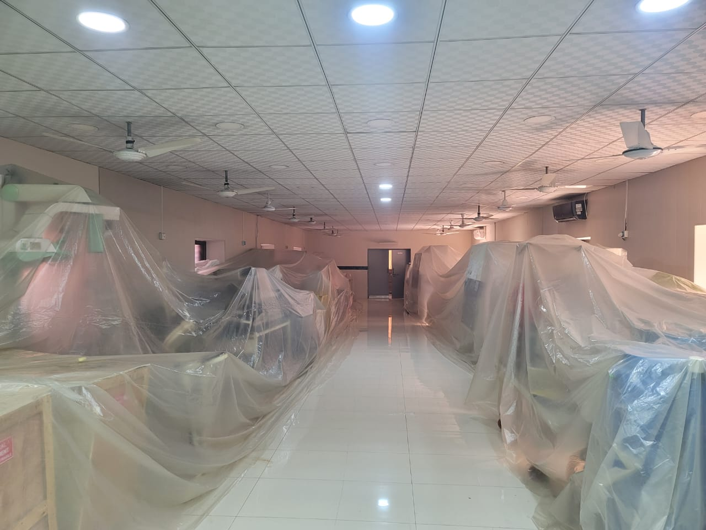
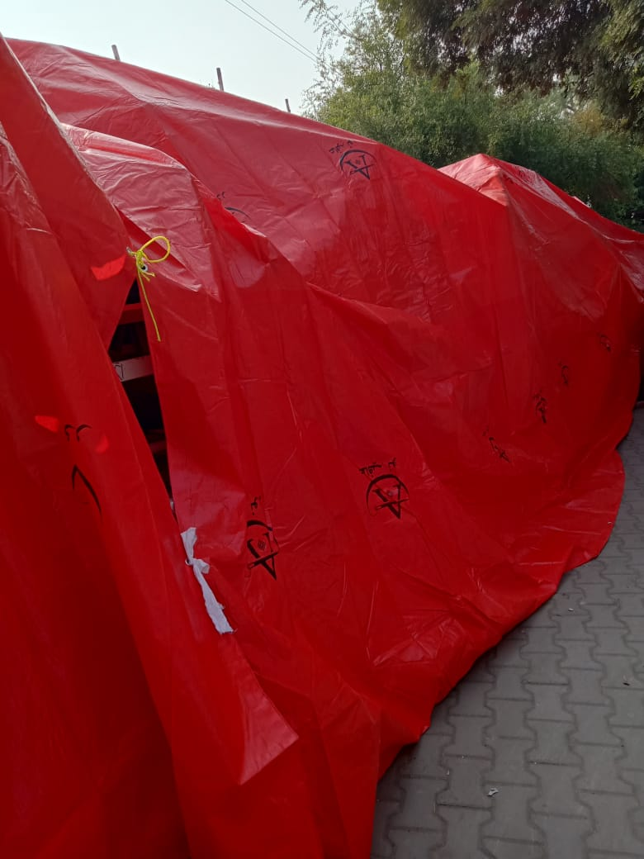
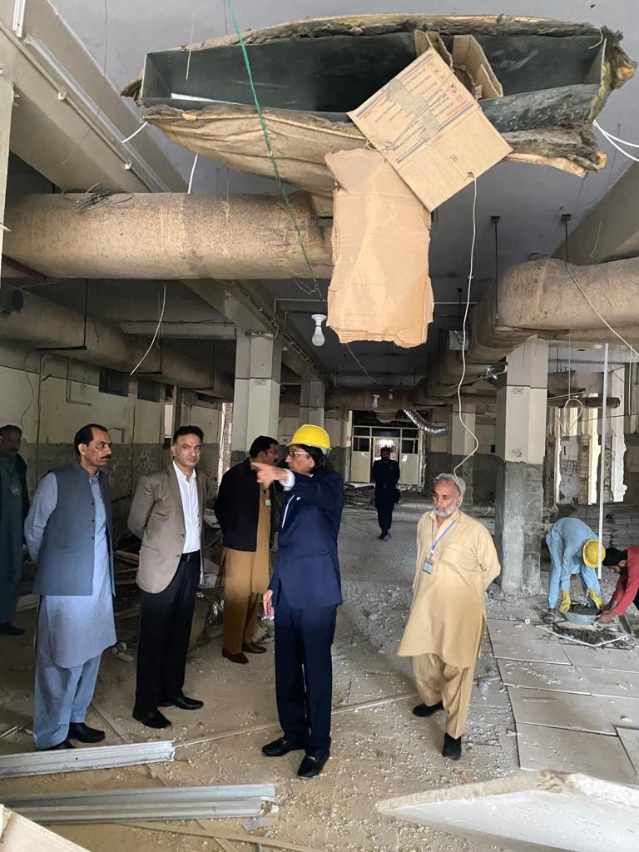

Slide 12
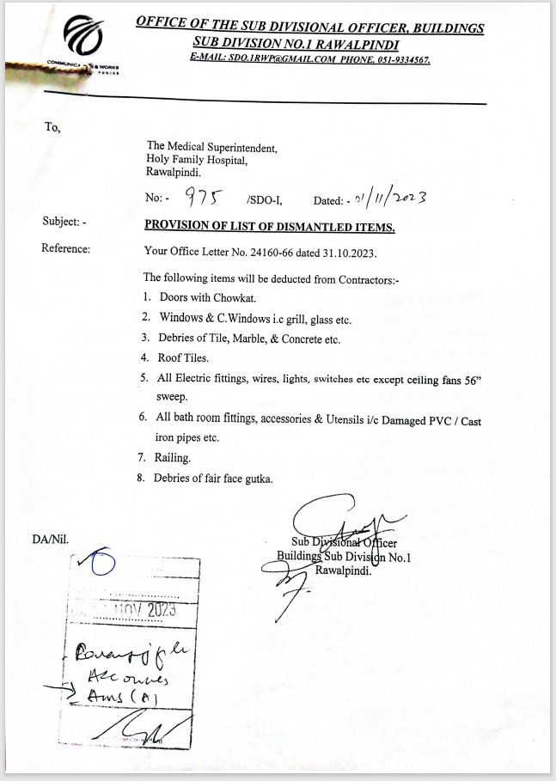
PROVISION OF LIST OF DISMANTLED ITEMS BY C & W
The following items will be deducted from Contractors:-
Doors with Chowkat.
Windows & C.Windows i.e grill, glass etc.
Debries of Tile, Marble, & Concrete etc.
Roof Tiles.
All Electric fittings, wires, lights, switches etc except ceiling fans 56” sweep.
All bath room fittings, accessories & Utensils i.e Damaged PVC / Cast Iron pipes etc.
Railing.
Debries of fair face gutka.

Slide 13
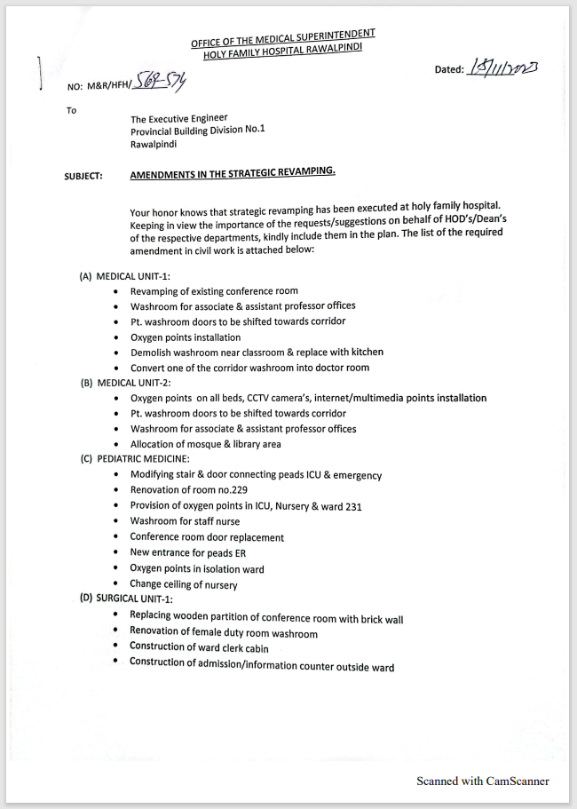
AMENDMENTS IN THE STRATEGIC REVAMPING
Construction of Brick Wall in Medical & Surgical ER to extend Beds Capacity , Construction of wall to extends Surgical ER OTs
Oxygen Points installation , Pts Washroom doors to be shifted Outside , Washroom for AP & Professors Offices MU I & II
Oxygen Points in Isolation wards, ICU, Nursery & Wards 231, New Entrance in PAEDS ER
Replacing of Wooden wall with Brick wall, Renovation of Female Duty room washroom, Construction of Cabin, Construction of Admission info Counter outside ward in SU I
Oxygen Point installation, Isolation/Immunosuppressant room in Nephrology
Oxygen Points, HVAC Ducting, Fully Equipped HDU in Neurosurgery
Connecting Bridge b/w Old & New Building, Racks all over the Admin Block in offices
Installation of Active & Passive Networking along with ELV system

Slide 14
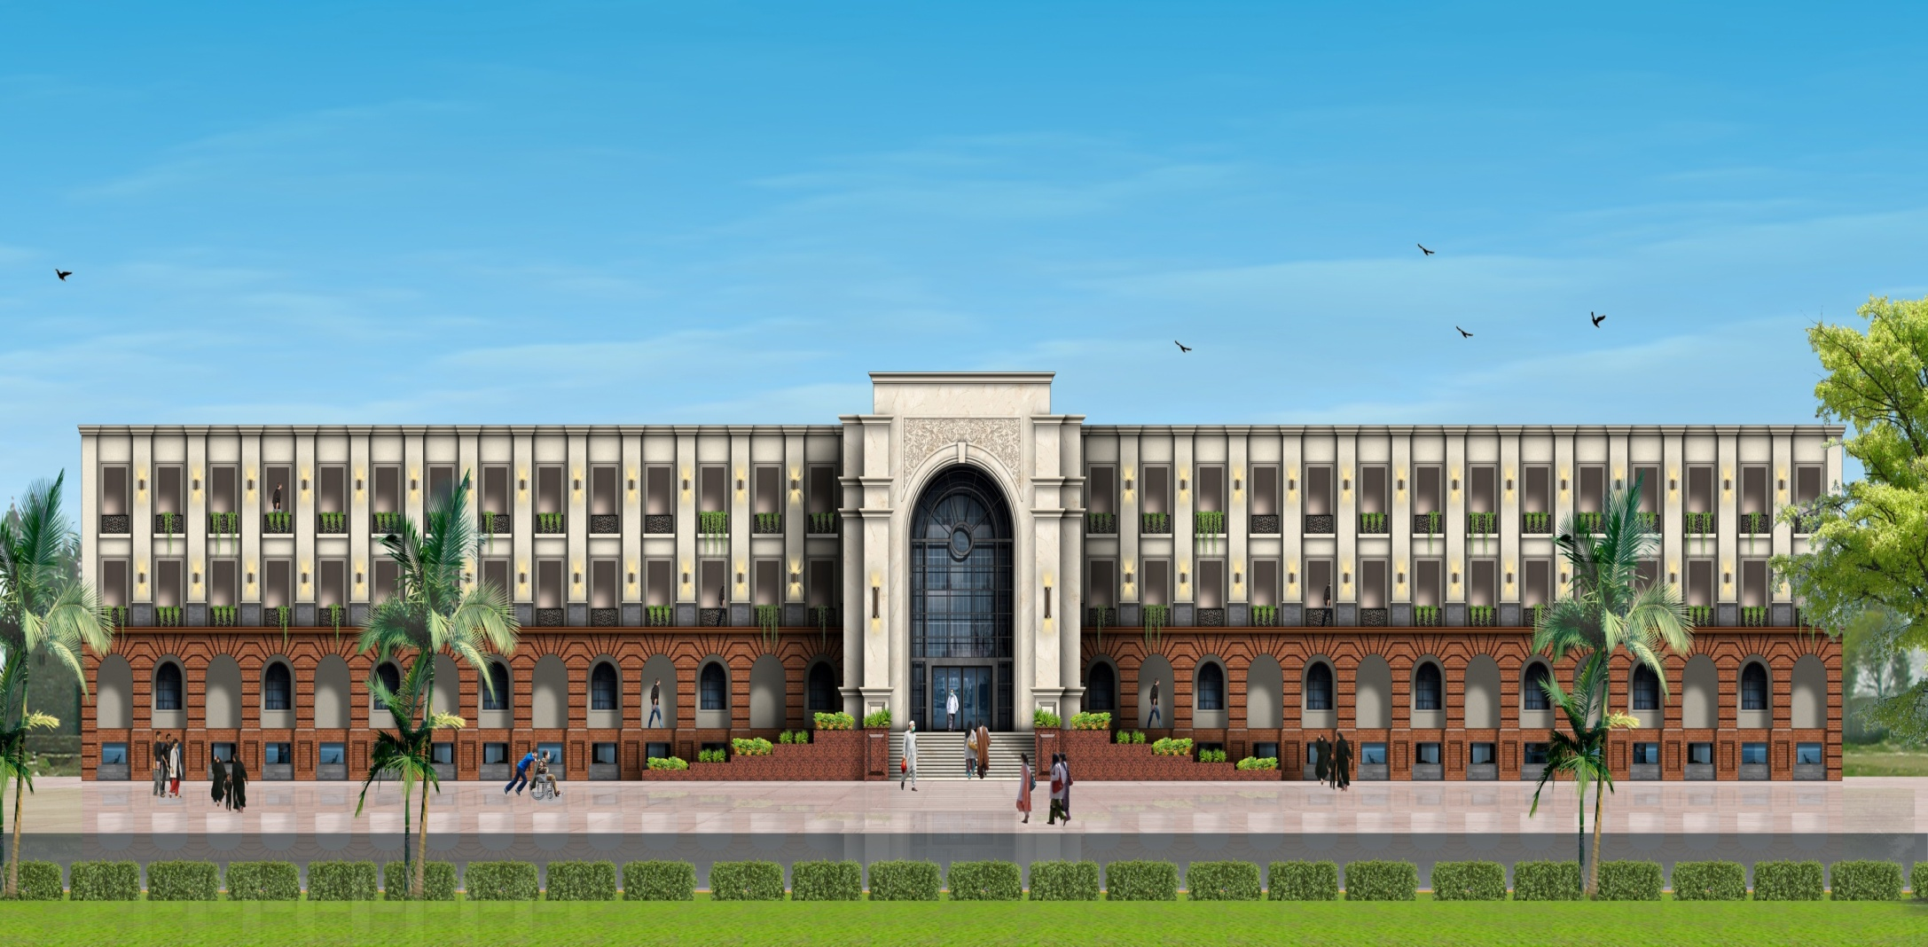
31st Jan 2023 InshaAllah
Thank You

