Slide 1
Benazir Bhutto Hospital, Rawalpindi
Specialized Healthcare and Medical Education Department
February 2024

Slide 2
Benazir Bhutto Hospital, Rawalpindi
Emergency
PKR 100 Million invested, functionalized already

Slide 3
The current government initiated the revamping of Benazir Bhutto Hospital, Rawalpindi in 2023

Slide 4
Benazir Bhutto Hospital, Rawalpindi
Today’s inauguration

Slide 5
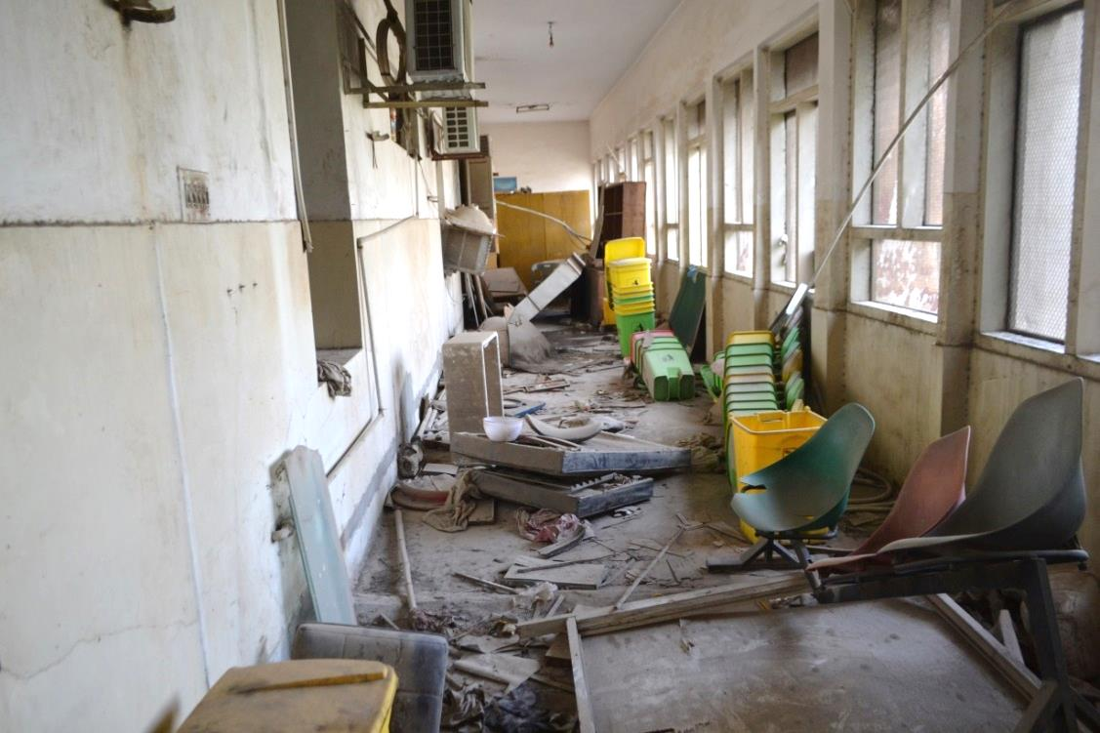
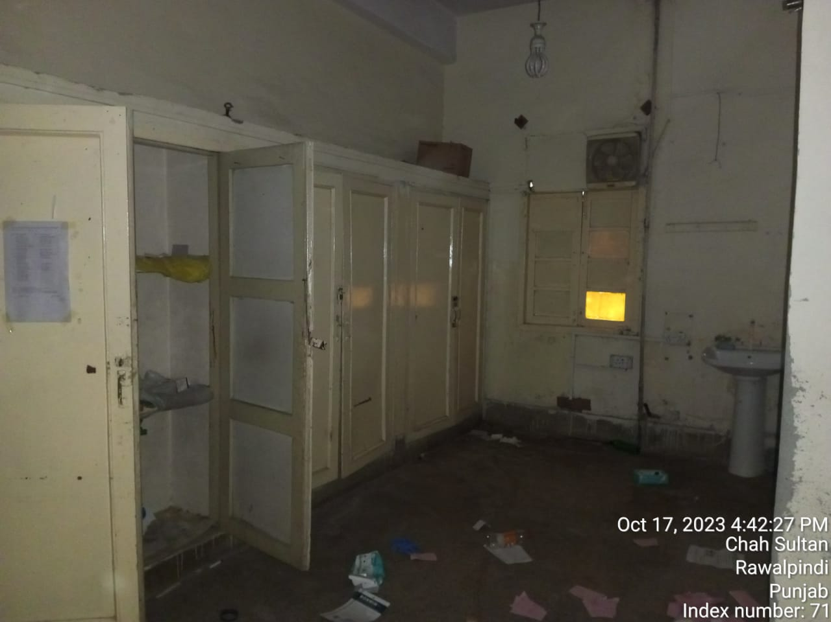
Before Revamping, the facility looked like this…

Slide 6
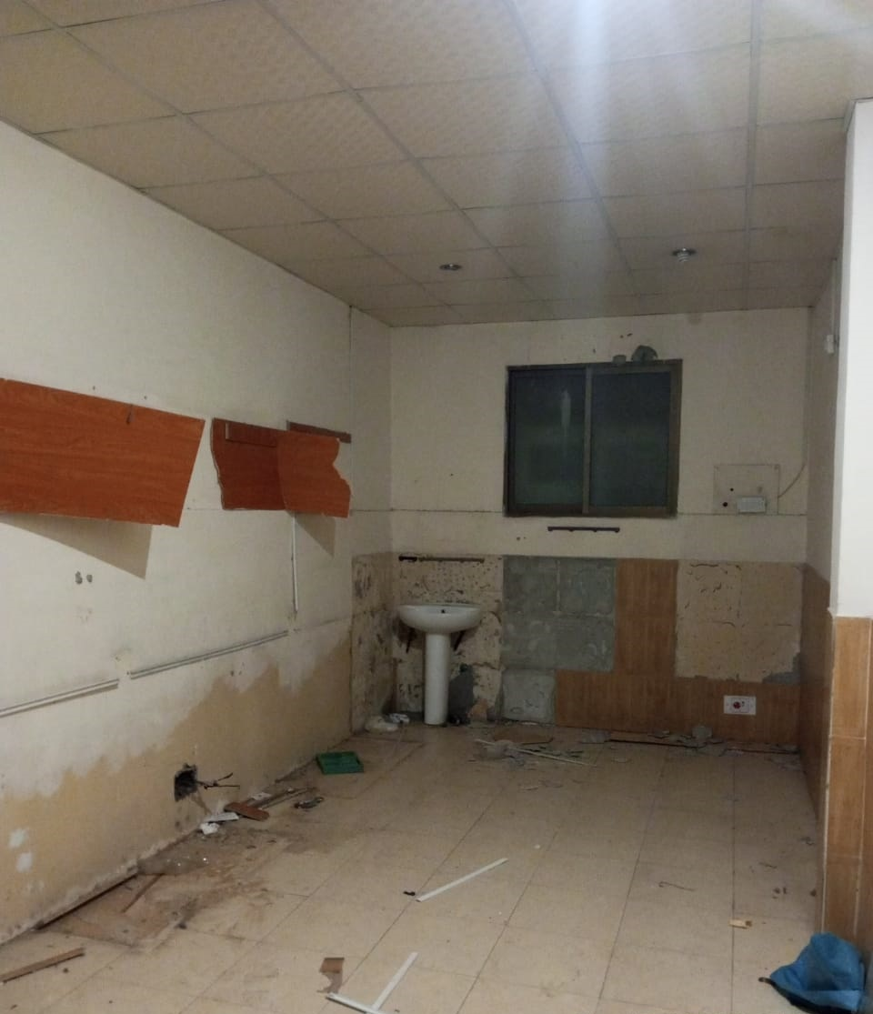
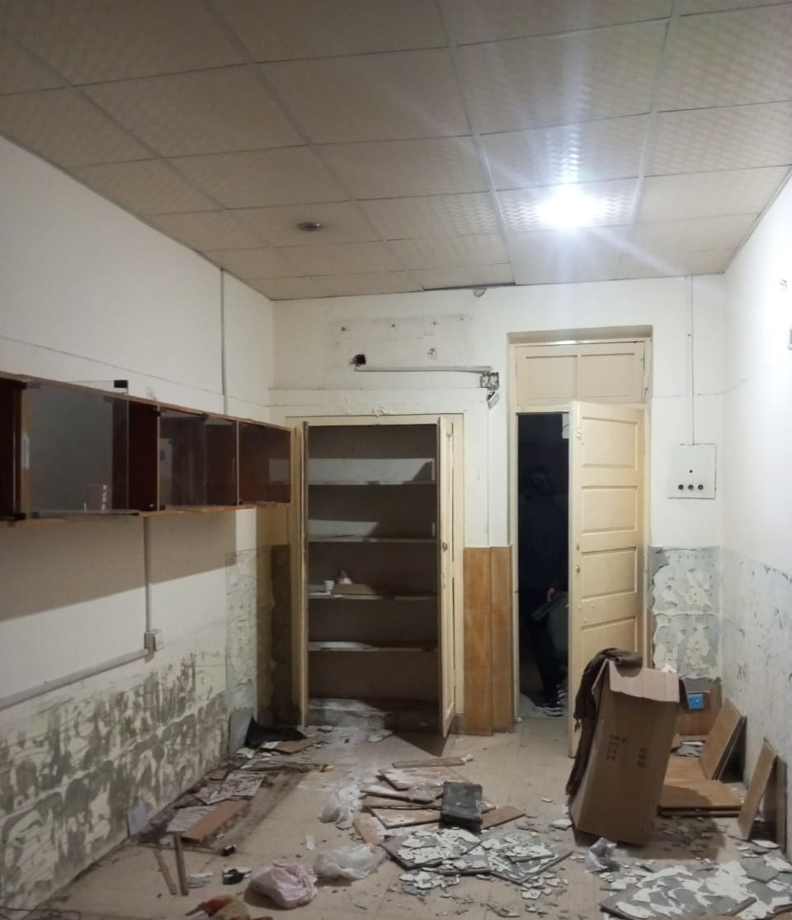
Before Revamping, the facility looked like this…

Slide 7
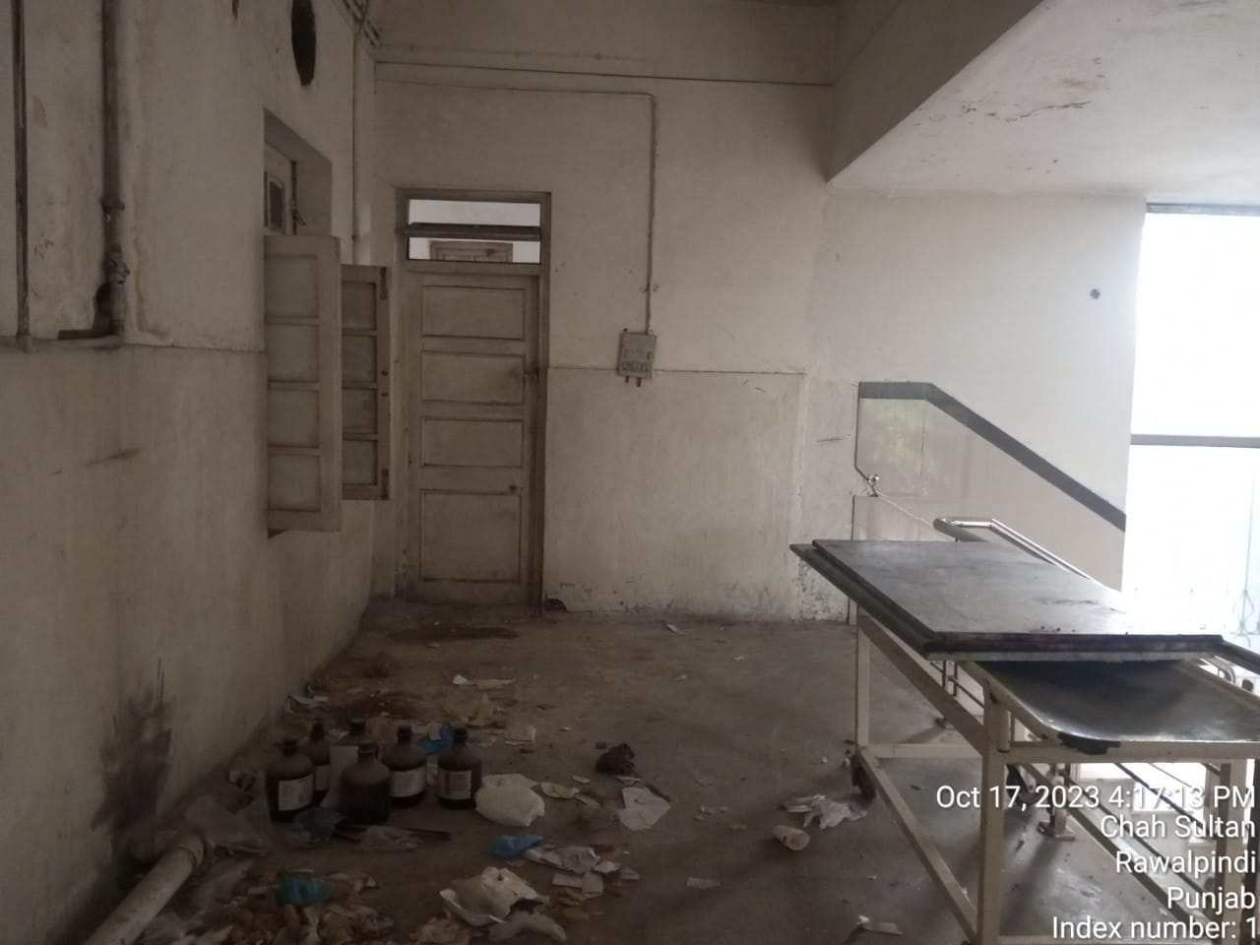
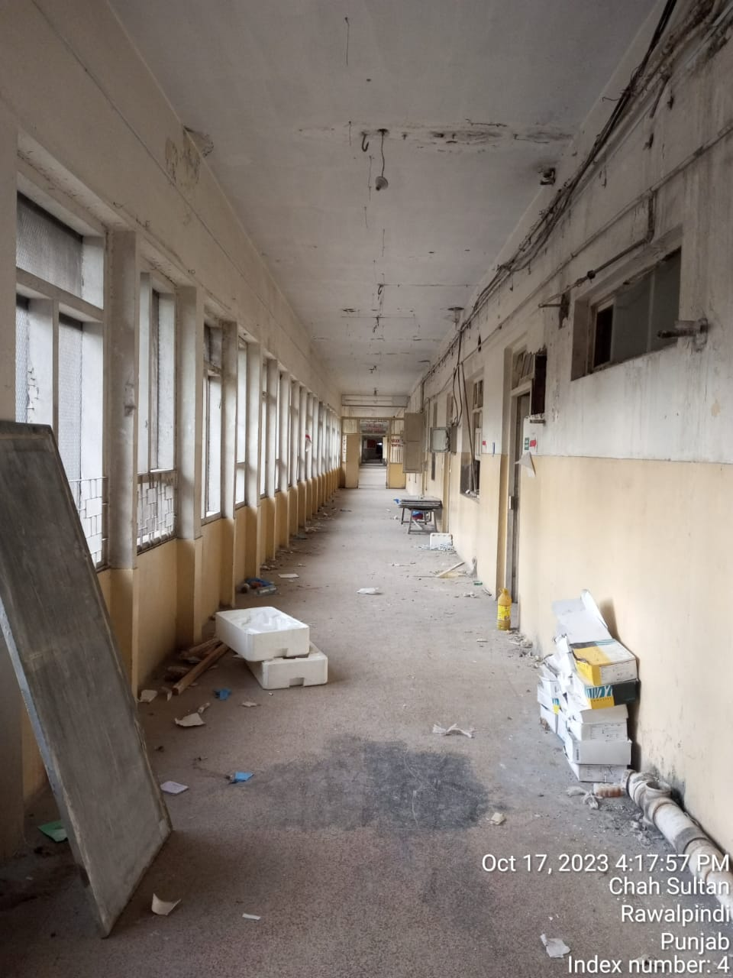
Before Revamping, the facility looked like this…

Slide 8
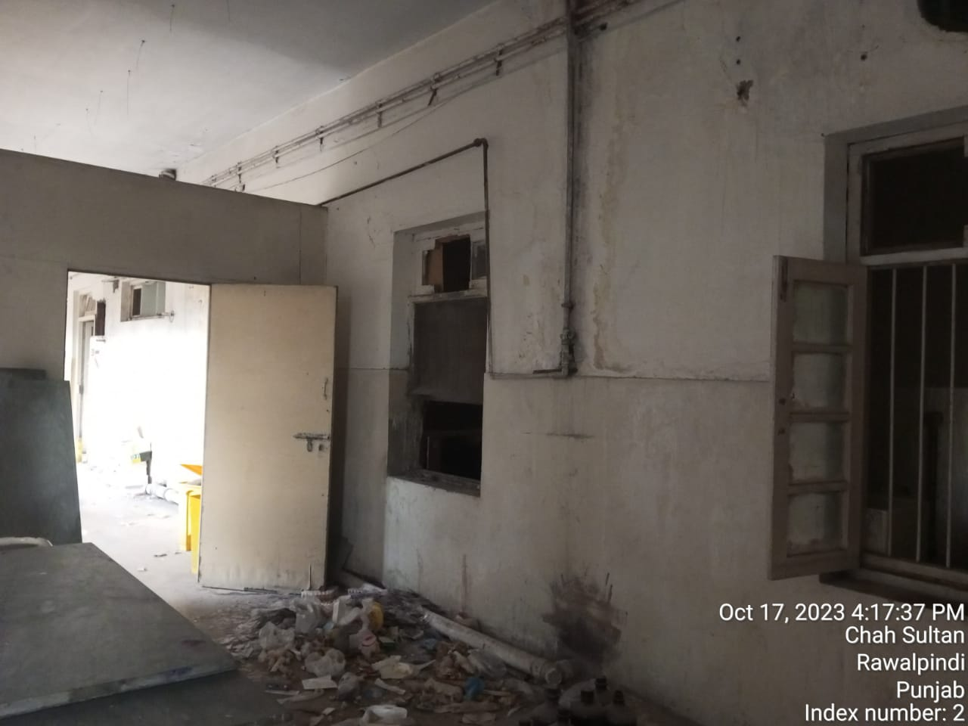
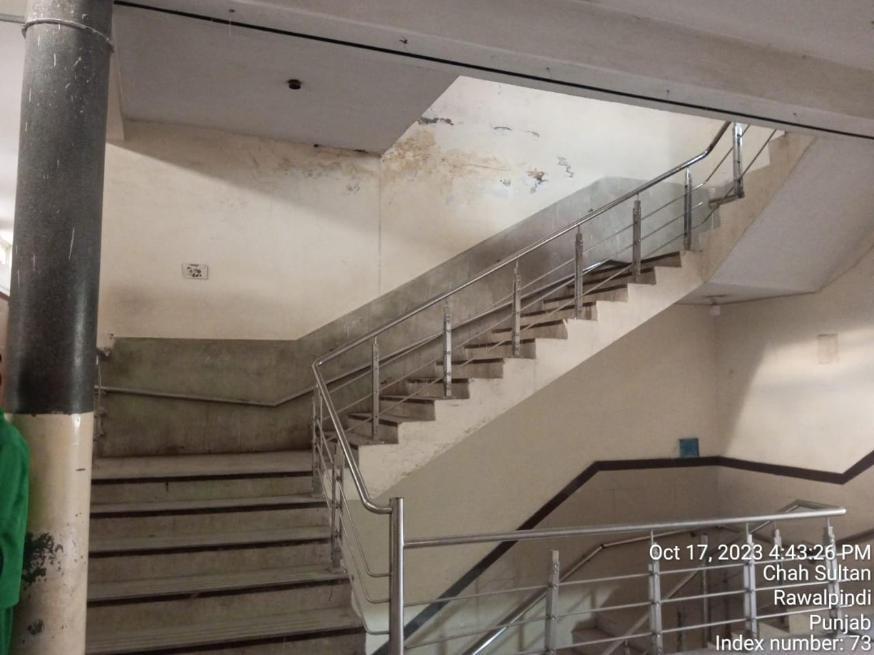
Before Revamping, the facility looked like this…

Slide 9
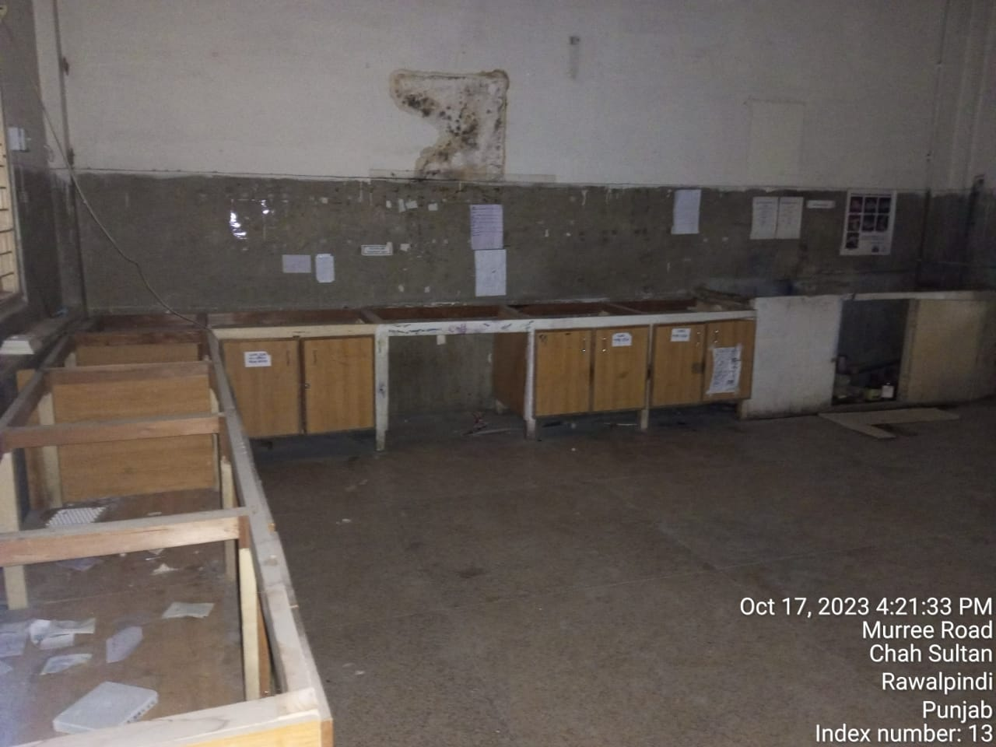
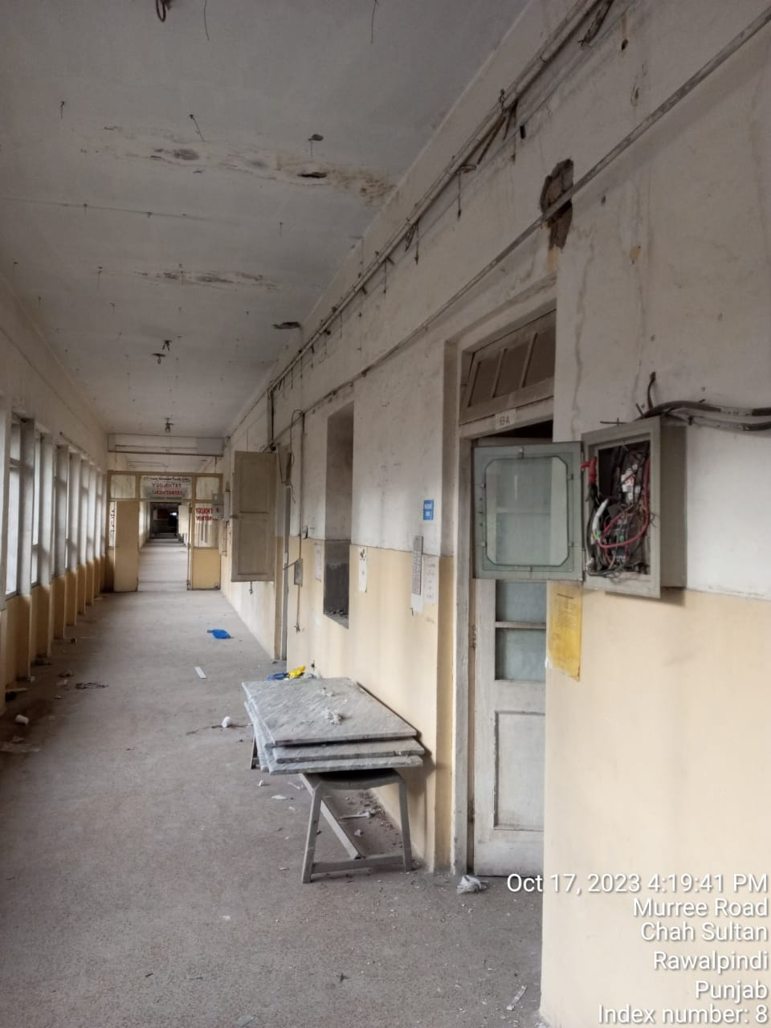
Before Revamping, the facility looked like this…

Slide 10
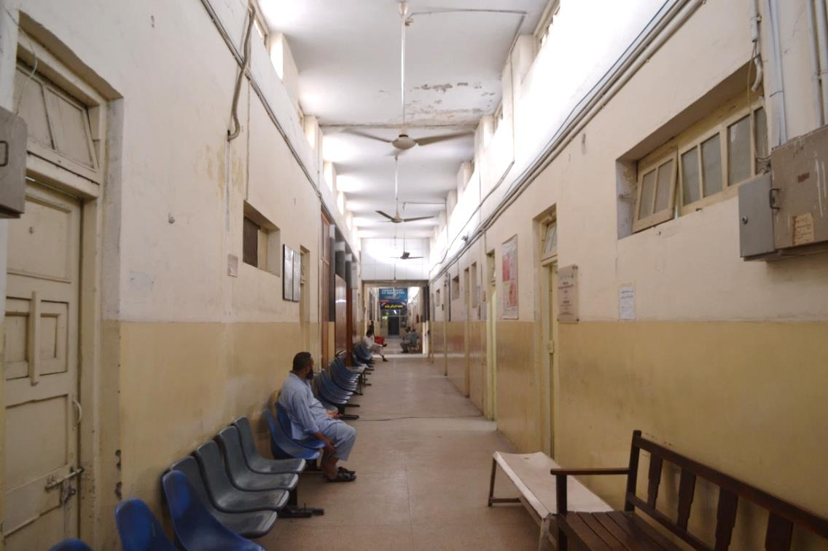
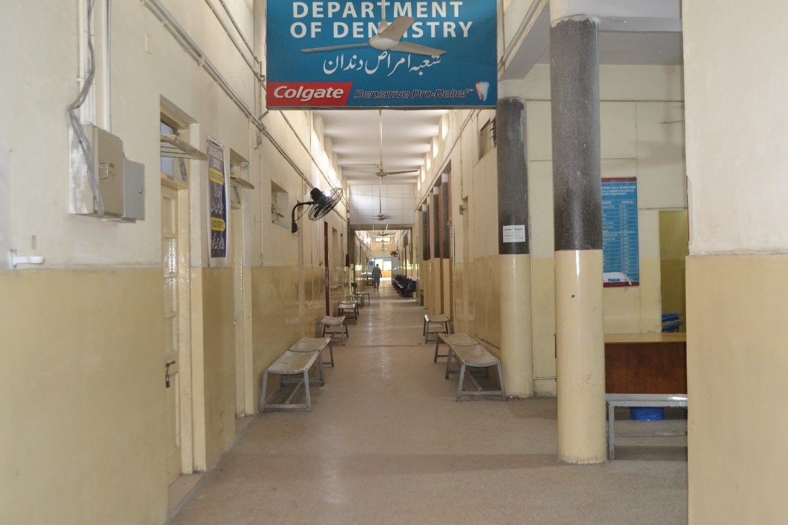
Before Revamping, the facility looked like this…

Slide 11
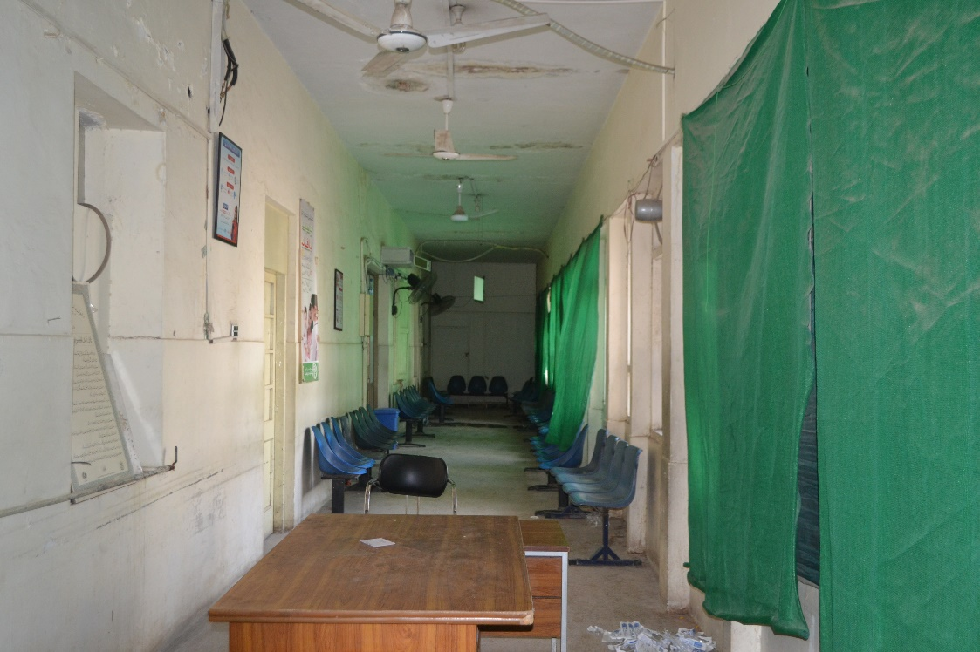
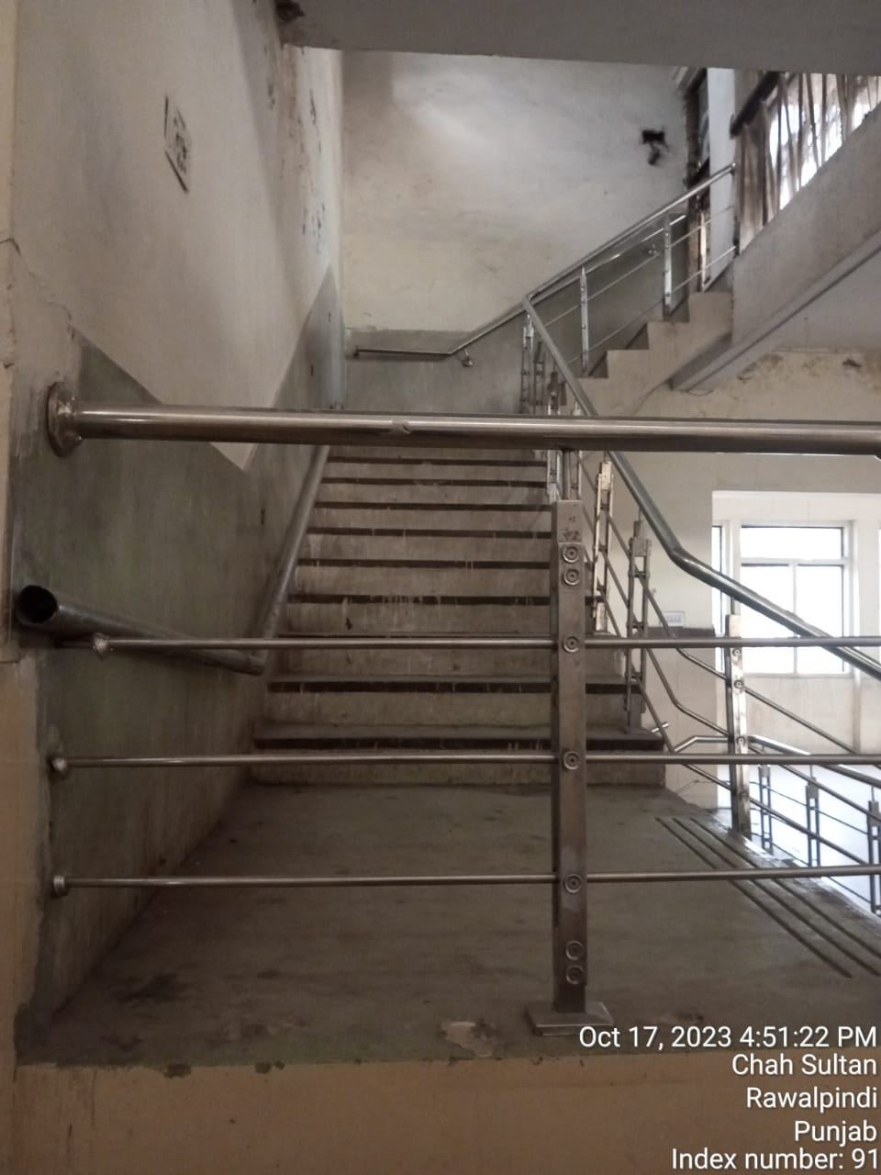
Before Revamping, the facility looked like this…

Slide 12
476 Million PKR has been invested in Revamping of the Hospital
379 Million
Capital Investment
97 Million
Revenue Investment

Slide 13
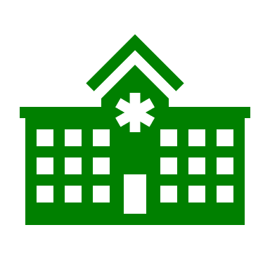
Scope of Revamping of Benazir Bhutto Hospital
Revamping of OPD
Revamping of Psychiatry &
Physiotherapy Department
Provision of critical biomedical & non biomedical equipment
External Area
Development

Slide 14
Current State of Benazir Bhutto Hospital – After Revamping

Slide 15
Current State of Benazir Bhutto Hospital – After Revamping

Slide 16
Current State of Benazir Bhutto Hospital – After Revamping

Slide 17
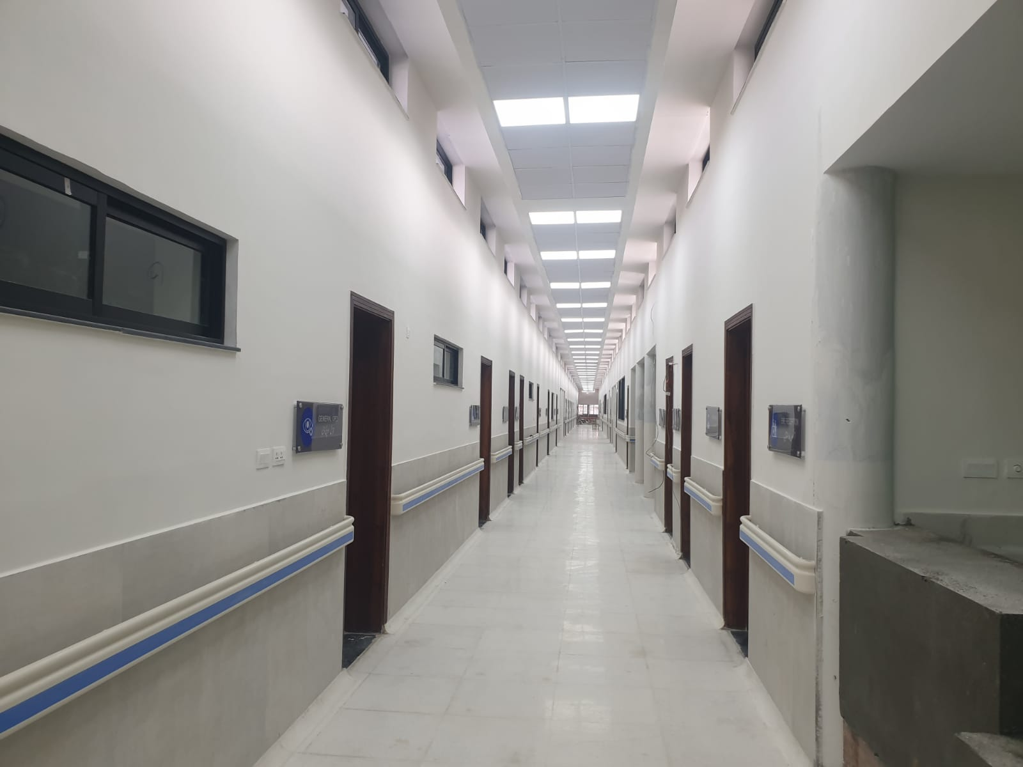
Current State of Benazir Bhutto Hospital – After Revamping

Slide 18
Current State of Benazir Bhutto Hospital – After Revamping

Slide 19
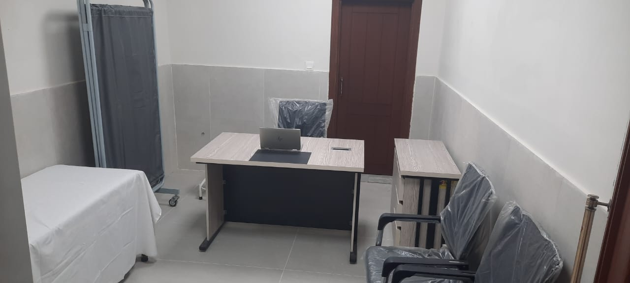
Current State of Benazir Bhutto Hospital – After Revamping

Slide 20
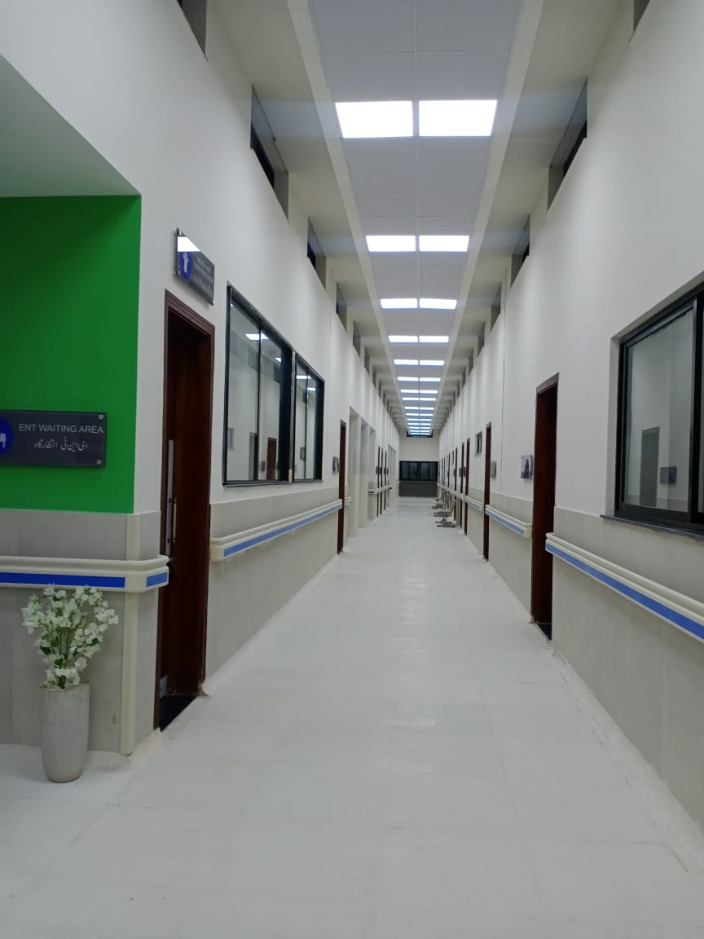
Current State of Benazir Bhutto Hospital – After Revamping

Slide 21
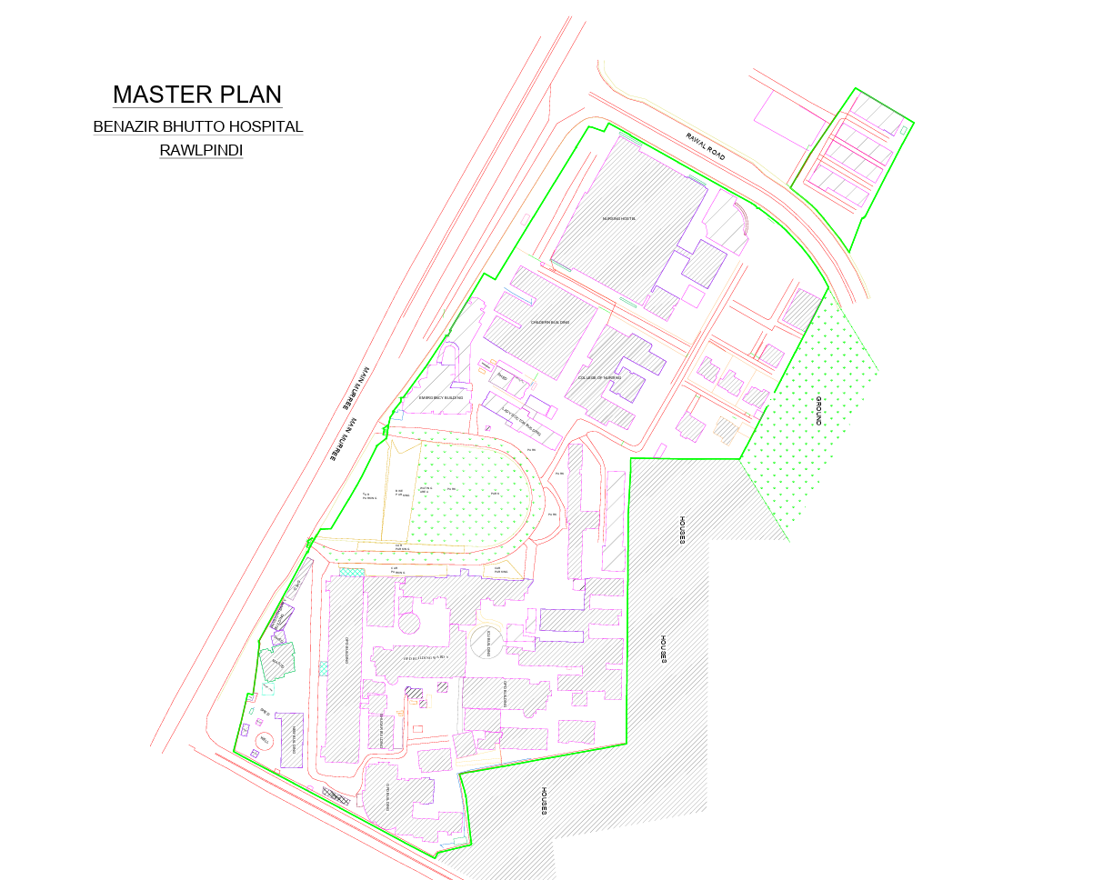
Overview of Benazir Bhutto Hospital, Rawalpindi
 | Total
Beds (Sanctioned) | 1,025
Clinical HR | 1,025
Departments | 16
Specialties | 16
Blocks | 10
OTs | 07
Labs | 01

Slide 22
Overview of Benazir Bhutto Hospital, Rawalpindi
Service Delivery Overview
Diagnostic Overview
 | Daily Average
OPD Patients | 2974
IPD Patients | ~ 196
Emergency Patients | ~ 1,985
Total Surgeries / Procedures | ~ 42
 | Total | Daily Average Utilization
X-Ray Machines | 18 | ~ 387
CT Scan Machines | 01 | ~ 72
ECGs | 41 | ~ 116
Ultrasounds | 19 | ~ 259
Pathology Labs | 01 | ~ 4,095

