Slide 1
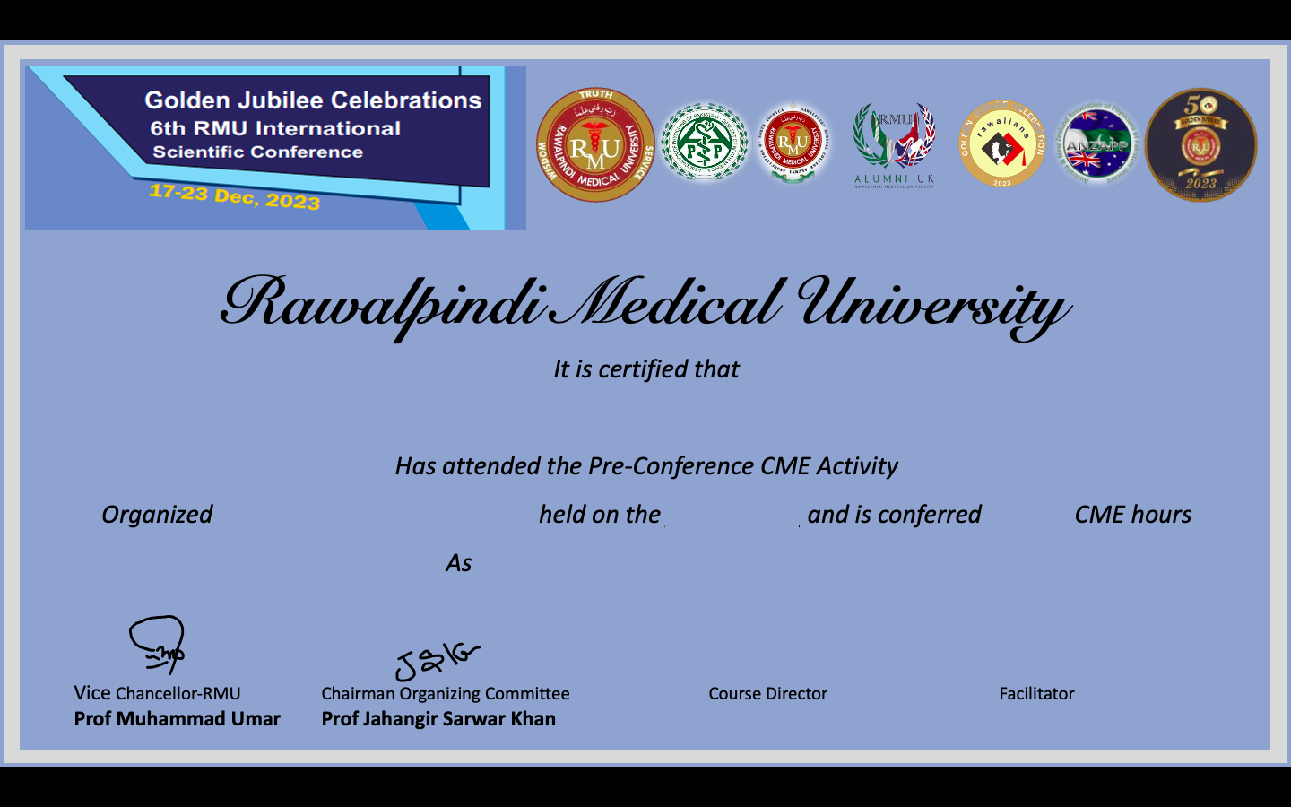
____________________________________
_____________________
_________
______
Facilitator/ Organizer/ Participant
Dr
Dr

