Slide 1
Department Name
Picture of HOD / LOGO of Department
Introduction of Department
-------------------------------------------------------------------------------------------------------------------------------------------------------------------------- .
------------------------------------------------------------------------------------------------------------------------------------------------ .
Name of HOD
HOD (designation)

Slide 2
Vision
----------------------------------------------------------------------------------------------------------------------------------------------------------------------------------------------------------------------------------------------------------------------------------------------------------------------------------------------------
Mission
-------------------------------------------------------------------------------------------------------------------------------------------------------------------------------------------------------------------------------------------------------------------------------------------------

Slide 3
Objectives
-----------------------------------------------
--------------------------------------------------------
-----------------------------------------
------------------------------------------------------------------------
-----------------------------------------------------------
---------------------------------------------
-----------------------------------------
------------------------------------------------------------------------
-----------------------------------------------------------
---------------------------------------------

Slide 4
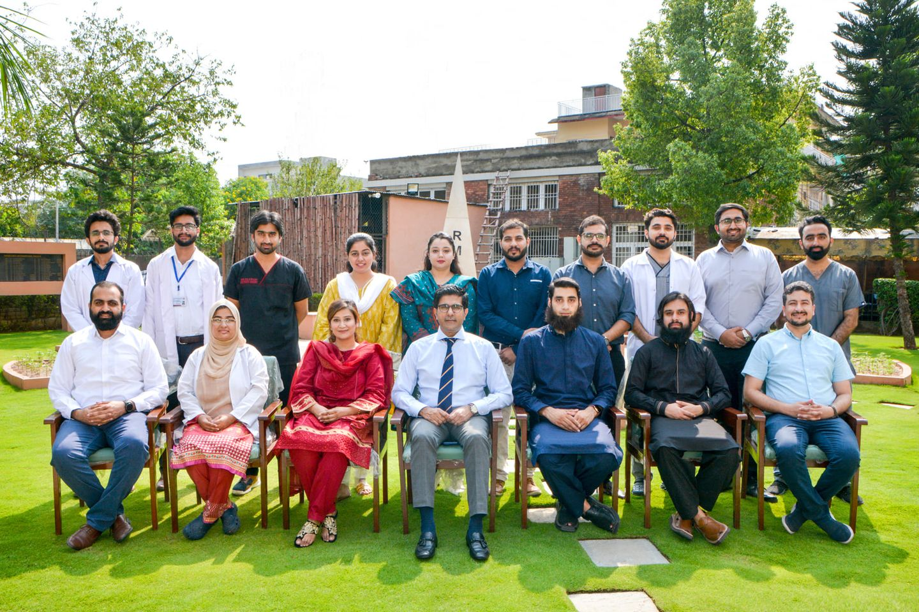
DEPARTMENT OF PEDIATRIC SURGERY, HOLY FAMILY HOSPITAL

Slide 5
FACULTY OF PEDIATRIC SURGERY
DR ALI CHAUDHARY
M.B.B.S, MS(Pediatric Surgery)
Senior Registrar
Department of Pediatric Surgery
DR. MUDASSAR FIAZ GONDAL MBBS, MS Associate Professor of Pediatric surgery Head of the Department Pediatric surgery
DR. UMER FRAZ MBBS, FCPS Assistant Professor of Pediatric surgery Department Of Pediatric Surgery

Slide 6
Our Team / Faculty
Name
Designation
Name
Designation
Name
Designation
Name
Designation
Name
Designation
Name
Designation

Slide 7
RESEARCH MODEL OF THE DEPARTMENT
Disease Research projects
The idea of disease Project is based on patient care approach and its the holistic review ,which will encompass its prevalence, mode of presentation along with other demographic details, epidemiological review, interpretation of data , devise local guidelines based on audit, community awareness, innovation and grants for research .
Fellowship/University Research Thesis
These are the projects which are required for completion of residency program/CPSP residents will write articles for completion of their college requirement
Research literature-based Academics
It consists of approaching the academic topics and comparing the standard practices with recent advancements
Clinical Audit/Quality Improvement Projects
Quality improvement projects focusing on improved patient care according to our own setup.

Slide 8
DISEASE RESEARCH PROJECTS UPDATED 15th -Sep 2022 Following Post graduate trainees have been allotted the below topics since 2019:
Sr | Trainee Name | Project Title
1 | Dr Osama Iftikhar | Blunt Trauma Abdomen
2 | Dr Laraib Rasul | Defecation Problem In Children
3 | Dr Ameena Shahwar | Anorectal Malformation
4 | Dr Jawad Jahangir | Testicular Care
5 | Dr Faizaan Shahid | Electrical Burn In Children
6 | Dr Salman | Germs Cell Tumor In Children
7 | Dr Noor Ul Sabah Butt | Surgical Clinical Audit
8 | Dr Mehak Fatima/Dr Hasnain Aslam | A Neonate as surgical patient Care
9 | Dr Awais Chaudhary | Penile Health Care
10 | Dr Waqas Sahi | Kidney care in children

Slide 9
COLORECTAL GROUP
This group focuses on all the surgical colorectal problems either congenital or acquired in pediatric age group.
Defecation Problems In Children (worth mentioning is the Bowel Management Program)
Anorectal Malformation Congenital Birth Defect

Slide 10
Accident & Emergency Group
Blunt Trauma Abdomen In Children
Electric Burn Catastrophe

Slide 11
Testicular Health Children Penile Health Kidney Care In Children
UROGENITAL GROUP

Slide 12
CLINICAL AUDIT AND QUALITY IMPROVEMENT PROJECTS
.
Systematic and critical analysis of the quality of clinical care
This includes the procedures used for diagnosis and treatment, the associated use of resources and the effect of care on the outcome and quality of life for the patient.
Temporal trend in emergency operation theatre on pediatric surgical emergency floor
Epidemiological comparison of anorectal malformation with other GI abnormalities

Slide 13
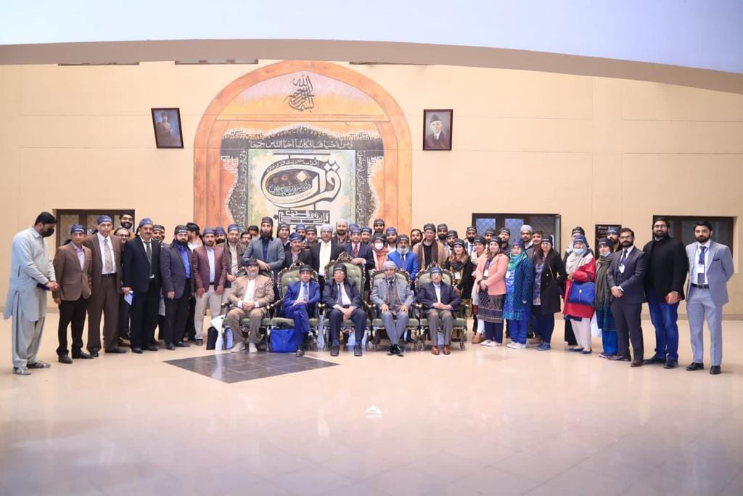
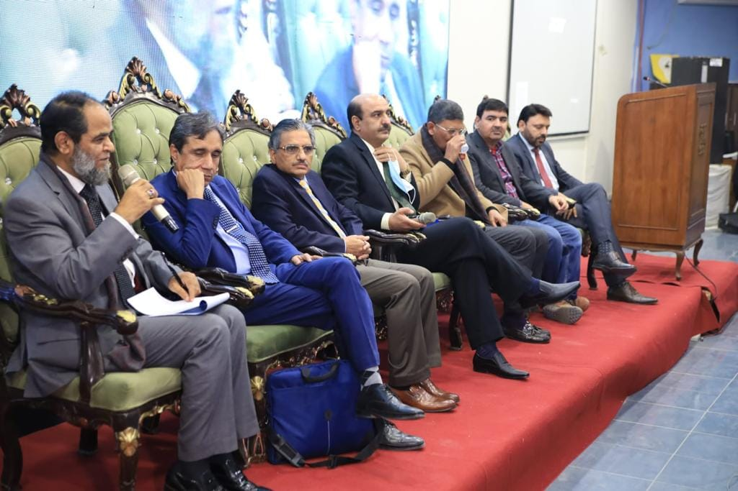
Flagship Health Care Project SYMPOSIA 21st December (little day for little ones) “NEONATAL AS A SURGICAL PATIENT”

Slide 14
RESEARCH ACTIVITIES
ANNUAL WOFAPS CONFERENCE OCTOBER 2022
Workshop on GLOBAL PEDIATRIC SURGICAL CARE 17 may 2022-23 may 2022
7th Annual Pediatric Orthopedic society of Pakistan, Feb 2022
6th International Conference, Shalimar Medical and Dental College, Feb 2022
Pre-Conference CME activity on SPSS, 17 Dec 2021
Masterclass on covid 19, Department of medicine, RMU, 8 Dec 2021
Masterclass on research: A world of opportunities, Department of pediatric surgery, RMU, 7 Dec 2021
Masterclass on Clinical Audit, Department of pediatric surgery, RMU, 6 Dec 2021
30th Annual APSP conference, June 2022

Slide 15
5th International RMU Conference 21-23 Dec 2021
4th Annual Resident Research conference, 23 Dec 2021
Neonate as a Surgical Patient symposium, Dec 21,2021
6th Annual conference of research section of IAPS, Dec 2021
24th Annual Psychiatric Conference, Nov 2021
7 days extensive webinar on Research and its components, July 2021
29th Annual APSP conference, March 2021
3rd Annual Resident Research conference, Rawalpindi Medical University, 16 dec 2020
Research Grant visit to WOFAPS 2019 at DOHA, QATAR

Slide 16
PRESENTATIONS
Poster Presentations:
3rd Annual Resident Research conference, Rawalpindi Medical University, 16 dec 2020
24th Annual Psychiatric Conference, Nov 2021
4th Annual Resident Research conference, 23 Dec 2021
Annual WOFAPS conference, October 2022
Oral Presentations:
7th Annual Pediatric Orthopedic society of Pakistan, Feb 2022
6th International Conference, Shalamar Medical and Dental College, Feb 2022
30th Annual APSP conference, June 2022
Annual WOFAPS conference, October 2022
29th APSP Annual conference
30th APSP Annual conference

Slide 17
PUBLICATIONS
Sr | Title | Journal | Year
1 | Case Report: Multiple intussusceptions with congenital anomalous band | RJRMU , Supplement of JRMU | 2020
2 | Case Report: Intrauterine torsion of finger | RJRMU , Supplement of JRMU | 2021
3 | Original article: Assessment of communication skills of post graduate residents using HPSS scale | RJRMU , Supplement of JRMU | 2021
4 | Editorial: Importance of step down units built with public private partnership | RJRMU , Supplement of JRMU | 2021
5 | Epidemiology of ARM amongst other GIT related problems | Cureus Journal of medical sciences | 2022
6 | Case report: Type 4 ileal atresia with anorectal malformation | Cureus Journal of medical sciences | 2022
7 | Original article: Conservative management of blunt trauma abdomen; know when not operate | JCPSP | In process
8 | Original article: To evaluate the psychosocial impact of electric burn on children. | Cureus Journal of medical sciences | In process
9 | Monster extracted out of a 7 year old child : a case report- | APSP | Published

Slide 18
Sr | Title | Journal | Year
10 | Ruptured duplication cyst of transverse colon | African Journal of Surgery | 2020
11 | Surgical field fire in a neonate | JCPSP | 2020
12 | Isolated sigmoid stricture in an infant following NEC | RJRMU | 2020
13 | Extrarenal Wilms tumor : a case report- | Iranian journal of surgery | 2023
14 | A tale of conjoint twins; Successful separation of pyo pagus twins | Journal of pediatric surgery | In process

Slide 19
Activities
Announcements/News
----------------------------
--------------------------
----------------------------
----------------------------
----------------------------
-------------------------
----------------------------
--------------------------
--------------------------

Slide 20
Quick Links
(Links/topics related to department)
Link 1
Link 2
Link 3
Link 4
Link 5
Link 6
Link 7
Link 8
Link 9

